Slide 1

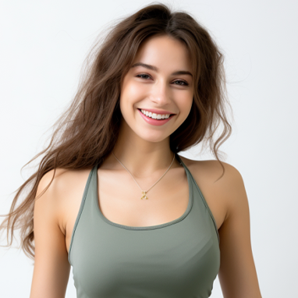
(123) 456-7890
sophiamiller@email.com
Sophia Miller
Dedicated and compassionate Yoga Instructor with a passion for promoting physical and mental well-being. Seeking to leverage 8 years of experience in leading yoga classes to create a positive and empowering environment for students to explore their practice and achieve their health goals.
Skills:
Proficient in various yoga styles
Strong interpersonal skills
Clear and concise instruction
Knowledge of anatomy
Experience:
Yoga Instructor
Blissful Yoga Studio, City, State
(Years: 20XX - Present)
Lead weekly group yoga classes in various styles, including Vinyasa, Hatha,
and Restorative.
Provide personalized guidance and adjustments to students to ensure
proper alignment and safety.
Develop and implement specialized workshops and events to deepen
students' understanding and practice of yoga.
Cultivate a supportive and inclusive atmosphere where students of all levels
feel welcome and empowered.
Private Yoga Instructor
Freelance, City, State
(Years: 20XX - Present)
Offer personalized one-on-one yoga sessions tailored to clients' specific
needs and goals.
Provide hands-on adjustments and modifications to accommodate
individual abilities and limitations.
Create customized sequences and practices to address clients' unique
concerns, such as stress reduction, flexibility, or injury recovery.
Yoga Instructor
Vikasa Yoga Studio, City, State
(Years: 20XX - Present)
Lead weekly group yoga classes in various styles, including Vinyasa,.
Provide personalized guidance and adjustments to students.
Track progress and provide ongoing support and encouragement to help
clients achieve their wellness objectives.
Education:
Certified Yoga Teacher Training Program, Yoga School Name, 2020
Bachelor of Arts in Psychology, University Name, City, State
Graduated: Month, Year

