Slide 1
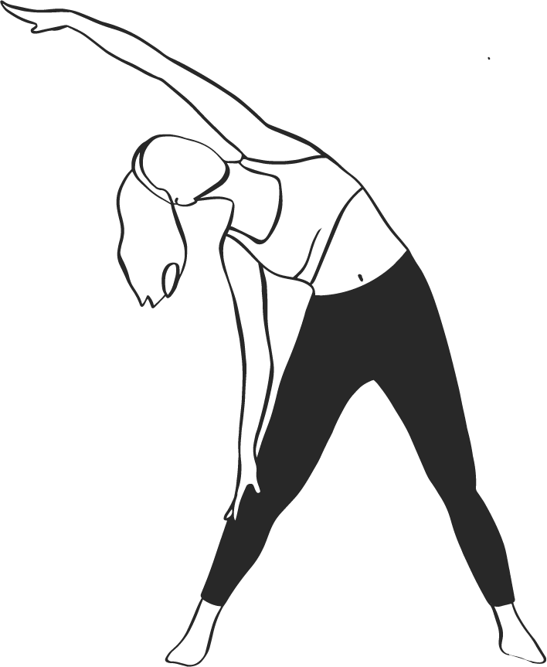
WEEKLY WORKOUT
M O N D A Y
T H U R S D A Y
S U N D A Y
ACTIVITY: 30 MINUTES OF CARDIO
HIGH-INTENSITY INTERVAL TRAINING
REST AND REFLECT
RUNNING
BURPEES
DAY OF REST FOR RECOVER
BRISK WALKING
SPRINTS
CYCLING
JUMPING ROPE
T U E S D A Y
F R I D A Y
3 SETS OF 10-15 REPETITIONS
30 MINUTES OF CARDIO
SQUATS
RUNNING
WEIGHTLIFTING
BRISK WALKING
PUSH-UPS
CYCLING
W E D N E S D A Y
S A T U R D A Y
CORE CONDITIONING
OUTDOOR FUN
PLANKS
HIKING
CRUNCHES
PLAYING A SPORT
LEG RAISES
BIKING

