Slide 1
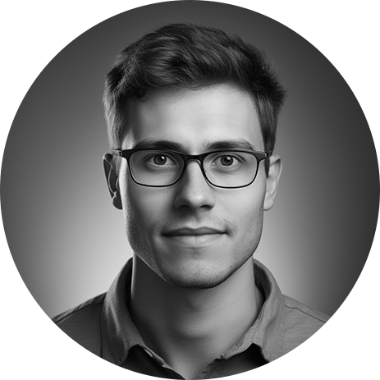
Resume
Senior Software Engineer
JOHN SMITH
(123) 456-7890
john.smith@email.com
www.linkedin.com/in/johnsmith
Professional Objective:
Experienced IT Professional with a passion for solving complex technical challenges and a proven track record of delivering high-quality solutions. Seeking opportunities to leverage my skills and expertise to contribute to innovative IT projects and drive organizational success.
Work Experience:
Senior Software Engineer, ABC Tech Solutions, City, State
January 2020 - Present
Led a team of developers in designing and implementing a critical
software upgrade, resulting in a 20% improvement in system performance.
Collaborated with cross-functional teams to troubleshoot and resolve complex technical issues, ensuring the stability and reliability
of the software.
Conducted code reviews and provided mentorship to junior developers, fostering a culture of continuous learning and improvement.
System Administrator, XYZ Corporation, City, State
June 2017 - December 2019
Managed and maintained a network of 200+ servers, ensuring optimal uptime and security.
Implemented automated backup and recovery procedures, reducing data loss incidents by 30%.
Administered user accounts, access controls, and security policies, enhancing overall system security.
Education:
Bachelor of Science in Computer Science
University of XYZ
City, State
Graduated: May 2017
Page 1 of 2

Slide 2
Resume
Senior Software Engineer
JOHN SMITH
(123) 456-7890
john.smith@email.com
www.linkedin.com/in/johnsmith
Interests and Hobbies:
In my free time, I enjoy participating in hackathons, exploring new programming languages, and contributing to open-source projects. I am also an avid hiker and enjoy outdoor activities such as camping and trail running.
Soft Skills:
Communication: Excellent verbal and written communication skills, facilitating effective collaboration with cross-functional teams.
Problem-Solving: Proven ability to analyze complex issues, identify solutions, and implement them efficiently.
Leadership: Experienced in leading teams, mentoring junior colleagues, and fostering a culture of continuous improvement.
Adaptability: Comfortable in fast-paced environments and quick to adapt to new technologies and challenges.
Time Management: Strong organizational skills and the ability to prioritize tasks effectively.
Teamwork: Collaborative and able to work effectively within diverse teams.
Skills:
Programming Languages: Java, Python, C++
Web Development: HTML, CSS, JavaScript
Operating Systems: Windows, Linux
Database Management: MySQL, MongoDB
Network Administration
Problem Solving and Troubleshooting
Team Leadership and Collaboration
Certifications:
Certified Information Systems Security Professional (CISSP)
Cisco Certified Network Associate (CCNA)
Microsoft Certified Azure Administrator Associate
Page 2 of 2

