Slide 1
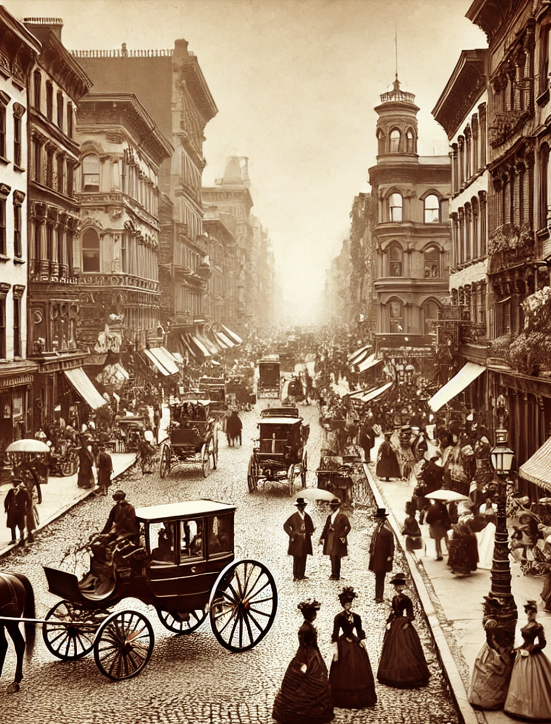
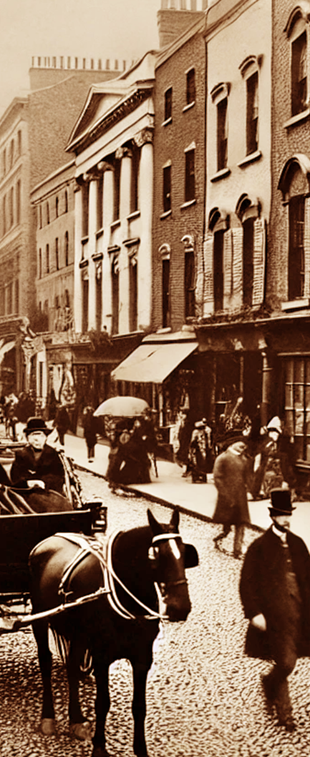
MAY 10, 1885
VOL. 189
THE METROPOLITAN GAZETTE
VOL. 189 - NO. 34 DODGE CITY, TUESDAY, MAY 10, 1885 - 12 PAGES IN 3 SECTIONS PRICE: 5 CENTS
A BUSTLING 1880S
CITY STREET
«Horse-Drawn Carriages, Cobblestones, and the March of Progress»
I
n the 1880s, city streets were
the lifeblood of urban areas, filled with the clatter of horse-drawn carriages and the hum of conversation among pedestrians. The roads were crowded with vendors selling their goods, shopkeepers calling out to customers, and a diverse array of people navigating the growing metropolis. Life on these streets was both chaotic and exciting, as cities rapidly expanded and industrialization transformed the urban landscape. For the middle and upper classes, the streets were
a place to display wealth and status. Gentlemen in top hats and ladies in elegant gowns strolled leisurely along the bustling sidewalks, enjoying the growing amenities of city life, from charming cafés to high-end fashion boutiques. Meanwhile, working-class citizens rushed to and from factories and and from factories and markets, contributing to the growing economy. In the background, tall buildings and smokestacks loomed, symbols of industrial progress.
THE HEART OF THE CITY
«Life on the Streets of 1880»
C
ity streets were lifeblood
of urban filled with the clatter of horse-drawn carriages and the hum of conversation among pedestrians. The roads were crowded with vendors selling their goods, shopkeepers calling out to customers, and a diverse array of people navigating the rapidly expanded and industrialized urban landscape, filled with noise and activity.
For the middle and upper classes, the streets were a place to display wealth and status. Gentlemen in top hats and ladies in elegant gowns strolled along
the sidewalks, enjoying the growing amenities of city life, from cafés to fashion boutiques. Meanwhile, working-class citizens rushed to and from factories and markets, contributing to the growing economy. In the background, tall buildings.
Gentlemen in top hats and ladies in elegant gowns strolled along the sidewalks, Meanwhile, working-class citizens rushed to and from factories and markets, contributing to the growing economy. In the background, tall buildings and smokestacks loomed, symbols of industrial progress. The transition from horse-drawn carriages to more mechanized forms of transport was still decades away, but already, the hustle of 19th-century urban life was palpable. Newspapers were being sold on street corners, and new inventions were changing the world.
HORSE-DRAWN
CARRIAGES,
COBBLESTONES, AND THE MARCH OF PROGRESS
It was still decades away, but already, the hustle had begun.

Slide 2
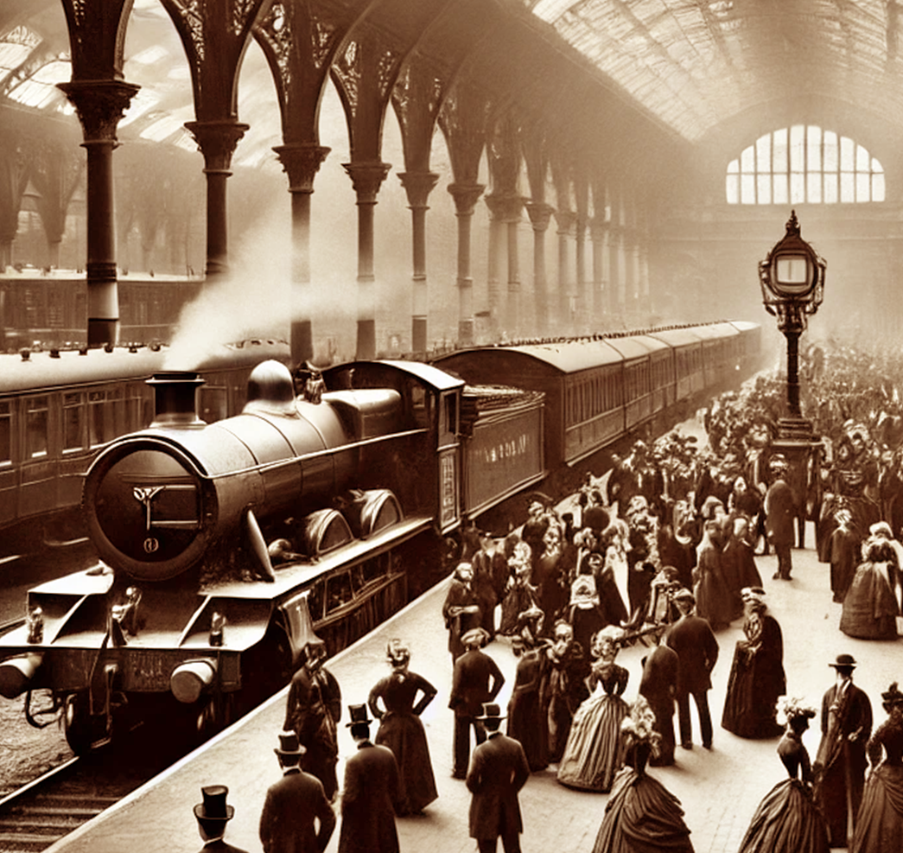
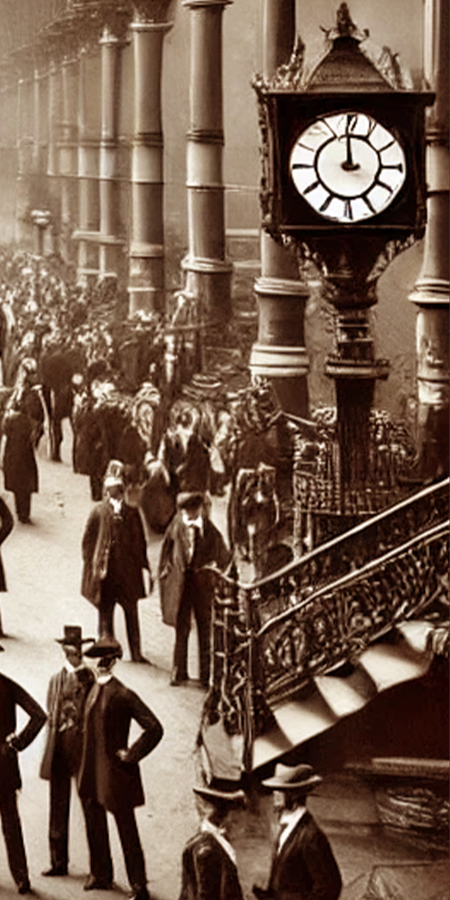
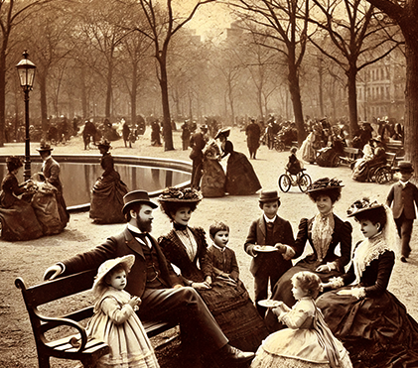
MAY 10, 1885
VOL. 189
A GRAND TRAIN
STATION
A GLIMPSE INTO THE LIVES OF 19TH-CENTURY FACTORY WORKERS
HOW TRAINS TRANSFORMED URBAN LIFE IN THE LATE 19TH
CENTURY
«How Trains Transformed Urban
Life in the Late 19th Century»
No longer limited by horse-drawn carriages or slow riverboats, people could now travel across the country in a matter of days. This newfound mobility led to a rapid expansion of urban areas, as people moved to cities for work or leisure. The train station, as depicted in this photograph, was more than just a transportation hub—it was a social center. People from all walks of life could be found waiting for their trains, from wealthy travelers dressed in fine suits and dresses to working-class families moving in search of better opportunities. The station was a place where the rhythms of the city converged, where the sounds of steam engines and the hustle of passengers blended into the pulse of urban life.
B
y the 1880s, railways had
become a dominant force in shaping cities. The expansion of train networks allowed for faster travel, connecting people, goods, and ideas across long distances. Cities grew around railway hubs, and the grand train stations of the era became architectural marvels, symbolizing progress and modernity. The trains, powered by steam, were known as "iron horses," and they revolutionized transportation. No longer limited by horse-drawn
No longer limited by horse-drawn carriages or slow riverboats, people could now travel across the country in a matter of days. This newfound mobility led to a rapid expansion of urban areas, as people moved to cities for work or leisure. The train station, as depicted in this photograph, was more than just a transportation hub—it was a social center. People from all walks of life could be found waiting for their trains, from wealthy travelers dressed in fine suits and dresses to
TRAIN
HOW TRAINS TRANSFORMED URBAN
LIFE IN THE LATE 19TH CENTURY
B
y the 1880s, railways
had become a dominant force in shaping cities. The expansion of train networks allowed for faster travel, connecting people, goods, and ideas across long distances. Cities grew around railway hubs, and the grand train stations of the era became architectural marvels, symbolizing progress and modernity. The trains, powered by steam, were known as "iron horses," and they revolutionized transportation.
No longer limited by horse-drawn carriages or slow riverboats, people could now travel across the country in a matter of days. This newfound mobility led to a rapid expansion of urban areas, as people moved to cities for work or leisure. The train station, as depicted in this photograph, was more than just a transportation hub—it was a social center. People from all walks of life could be found waiting for their trains, from wealthy travelers dressed in fine suits and dresses to working-class families moving in search of better opportunities. The station was a place where the rhythms of the city converged, where the sounds of steam engines.
THE EXPANSION OF TRAIN NETWORKS ALLOWED FOR FASTER TRAVEL, CONNECTING PEOPLE, GOODS, AND IDEAS ACROSS LONG DISTANCES.
In the 1880s, city streets were the lifeblood of urban areas, filled with the clatter of horse-drawn carriages and the hum of conversation among pedestrians. The roads were crowded with vendors selling
In the 1880s, city streets were the lifeblood of urban areas, filled with the clatter of horse-drawn carriages and the hum of conversation among pedestrians. The roads were crowded with vendors selling

Slide 3
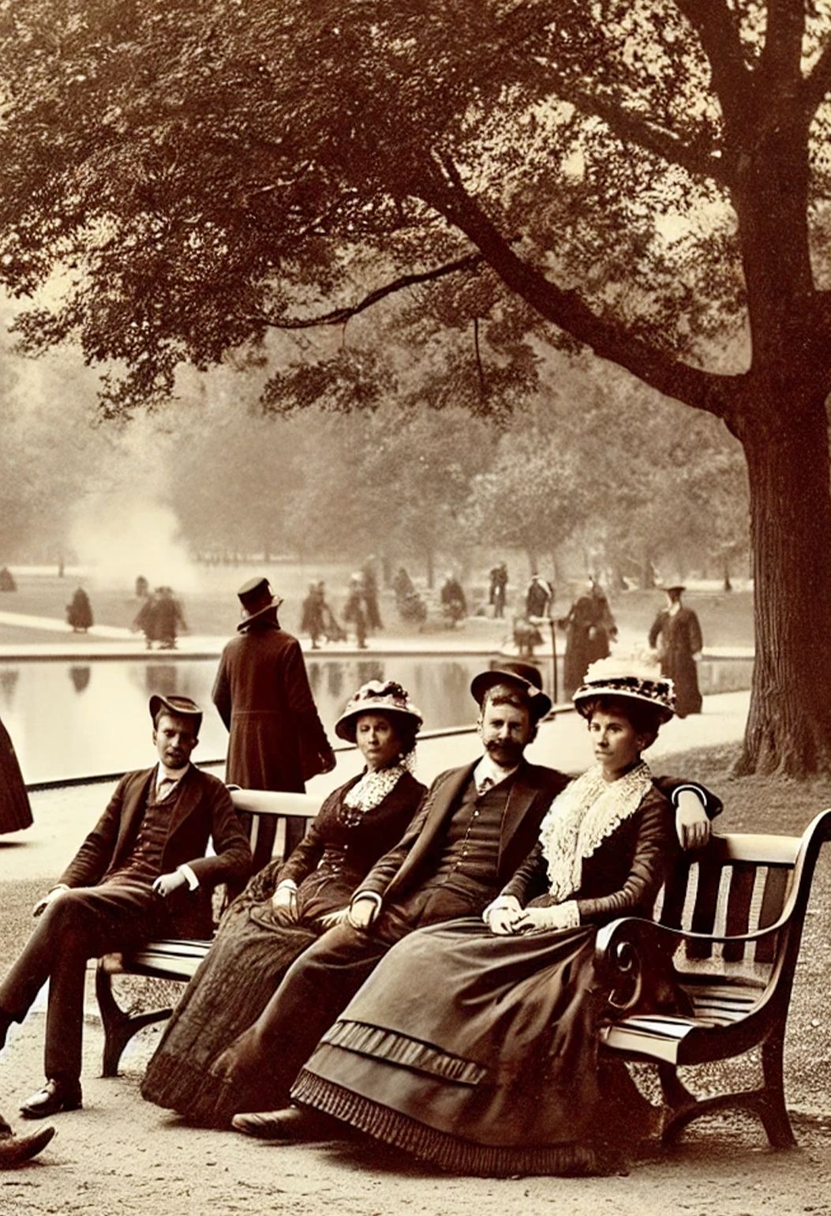
MAY 10, 1885
VOL. 189
MAIN STREET,
DESERT TOWN
«The Place Where Deals Were Made and Legends Were Born»
I
n the 1880s, city streets
were the lifeblood of urban areas, filled with the clatter of horse-drawn carriages and the hum of conversation among pedestrians. The roads were crowded with vendors selling their goods, shopkeepers calling out to customers, and a diverse array of people navigating the rapidly expanded and industrialization transformed the urban landscape.
For the middle and upper classes, the streets were a place to display wealth and status. Gentlemen in top hats and ladies in elegant gowns strolled along the sidewalks, enjoying the growing amenities of city
and the hum of conversation among pedestrians. The roads were crowded with vendors selling their goods, shopkeepers calling out to customers, and a diverse array of people navigating the rapidly expanded and industrialization transformed the urban landscape.
For the middle and upper classes, the streets were a place to display wealth and status. Gentlemen in top hats and ladies in elegant gowns strolled along the sidewalks, enjoying the growing amenities of city life, from cafés to fashion boutiques. Meanwhile, working-class citizens rushed to and from.
SALOONS AND SOCIAL LIFE TODAY
The Place Where Deals Were Made and Legends Were Born
I
n the 1880s, city streets were
the lifeblood of urban areas, filled with the clatter of horse-drawn carriages and the hum of conversation among pedestrians. The roads were crowded with vendors selling their goods, shopkeepers calling out to customers, and a diverse array of people navigating the rapidly expanded and industrialization transformed the urban landscape.
For the middle and upper classes, the streets were a place to display wealth and status. Gentlemen in top hats and ladies in elegant gowns strolled along the sidewalks, enjoying the growing amenities of city life, from cafés to fashion boutiques. Meanwhile, working-class citizens rushed to and from factories and
In the 1880s, city streets were the lifeblood of urban areas, filled with the clatter of horse-drawn carriages and the hum of conversation among pedestrians. The roads were crowded with vendors selling their goods, shopkeepers calling out to customers, and a diverse array of people navigating the rapidly expanded and industrialization transformed the urban landscape.
For the middle and upper classes, the streets were a place to display wealth and status. Gentlemen in top hats and ladies in elegant gowns strolled along the sidewalks, enjoying the growing amenities of city life, from cafés to fashion boutiques. Meanwhile, working-class citizens rushed to and from factories and
and ladies in elegant gowns strolled along the sidewalks, enjoying the growing amenities of city life, from cafés to fashion boutiques. Meanwhile, working-class citizens rushed to and from factories and markets, contributing to the growing economy.
status. Gentlemen in top hats and ladies in elegant gowns strolled along the sidewalks, Meanwhile, working-class citizens rushed to and from factories and markets, contributing to the growing economy. In the background, tall buildings and smokestacks loomed, symbols of industrial progress.
The transition from horse-drawn carriages to more mechanized forms of transport was still decades away, but already, the hustle of the hustle of the hustle of the hustle of the hustle of 19th-century urban life was palpable. Newspapers were being sold on street corners, and new inventions like the telephone were beginning to make their mark on society.
HORSE-DRAWN
CARRIAGES, COBBLESTONES, AND THE MARCH OF PROGRESS
It was still decades away, but already, the hustle of 19th-century urban life was palpable. Newspapers were being sold on street corners, and new inventions like the telephone were beginning to make their mark on society.

Slide 4
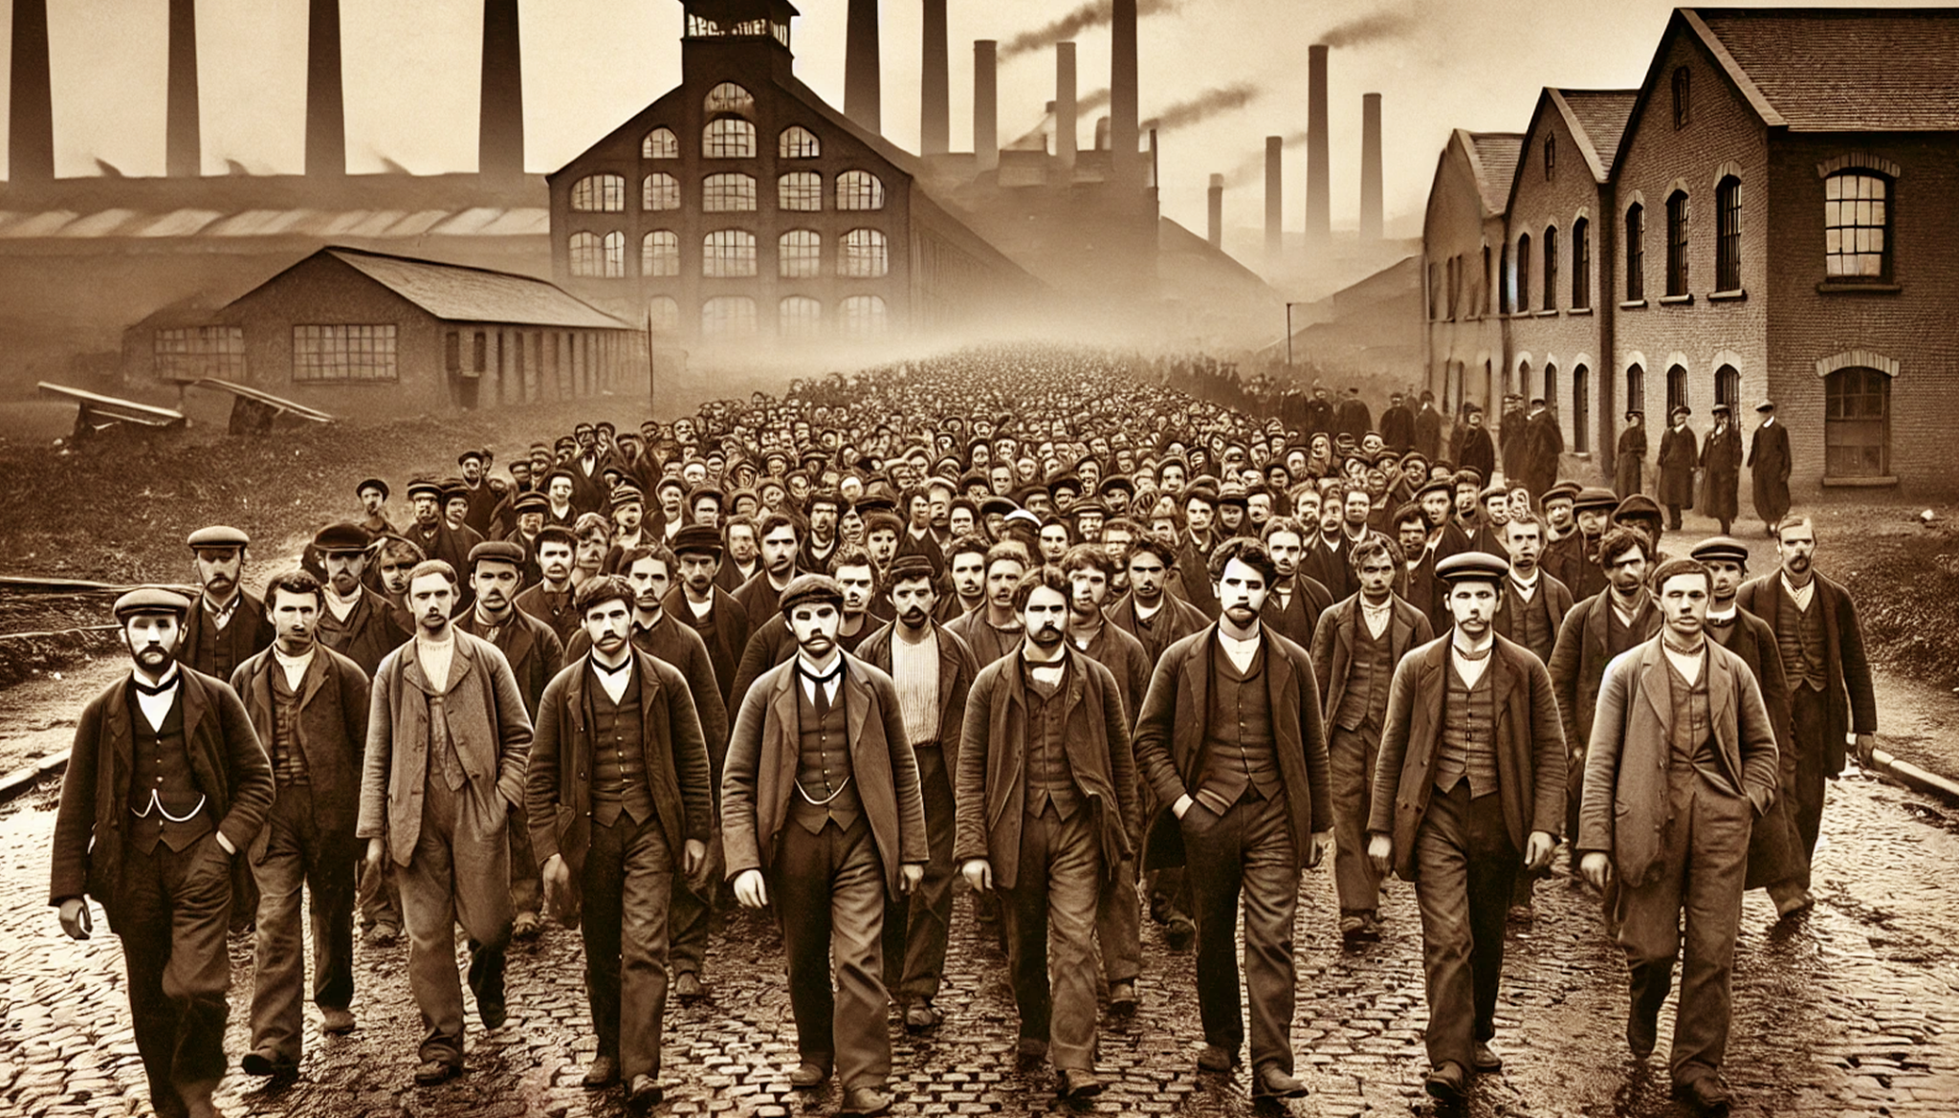
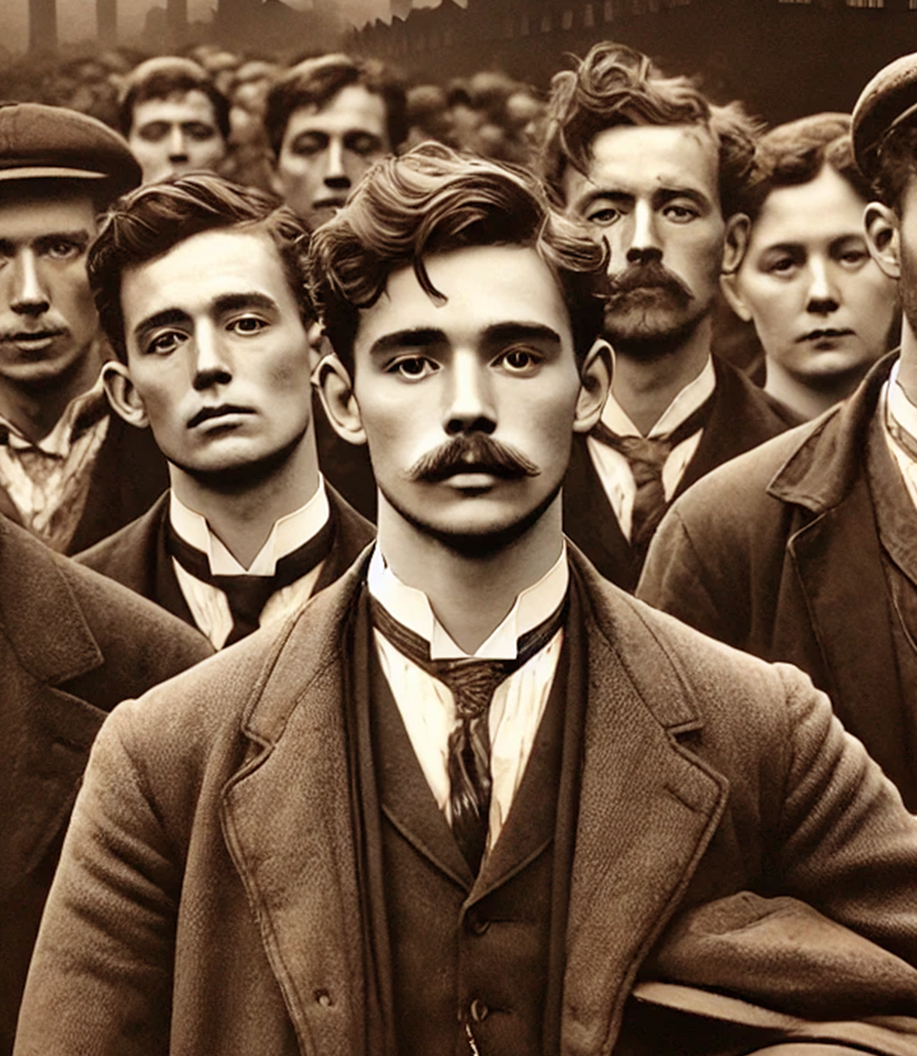
MAY 10, 1885
VOL. 189
THE WORKERS BEHIND THE MACHINES
«A Glimpse into the Lives of 19th-Century Factory Workers»
T
For the middle and upper classes, the streets were a place to display wealth and status. Gentlemen in top hats and ladies in elegant gowns strolled along the sidewalks, enjoying the growing amenities of city life, from cafés to fashion boutiques. Meanwhile, working-class citizens rushed to and from factories and and from factories and markets, contributing to the growing economy. In the background, tall buildings and smokestacks loomed, symbols of industrial progress.
For the middle and upper classes, the streets were a place to display wealth and status. Gentlemen in top hats and ladies in elegant gowns strolled along the sidewalks, enjoying the growing amenities of city life, from cafés to fashion boutiques. Meanwhile, working-class citizens rushed to and from factories and and from factories and markets, contributing to the growing economy. In the background, tall buildings and smokestacks loomed, symbols of
For the middle and upper classes, the streets were a place to display wealth and status. Gentlemen in top hats and ladies in elegant gowns strolled along the sidewalks, enjoying the growing amenities of
growing economy. In the background, tall buildings and smokestacks loomed, symbols of industrial progress. Growing economy. In the background, tall buildings and smokestacks loomed, symbols of progress.
he 1880s, city streets were
the lifeblood of urban are filled with the clatter of horse-drawn carriages and the hum of conversation among pedestrians. The roads were crowded with vendors selling their goods, shopkeepers calling out to customers, and a diverse array of people navigating the growing metropolis. Life on these streets was both chaotic and exciting, as cities rapidly expanded and industrialization transformed.
A GLIMPSE INTO THE
LIVES OF 19TH-CENTURY FACTORY WORKERS
In the 1880s, city streets were the lifeblood of urban areas, filled with the clatter of horse-drawn carriages and the hum of conversation among pedestrians. The roads were crowded with vendors selling their goods, shopkeepers

