Slide 1
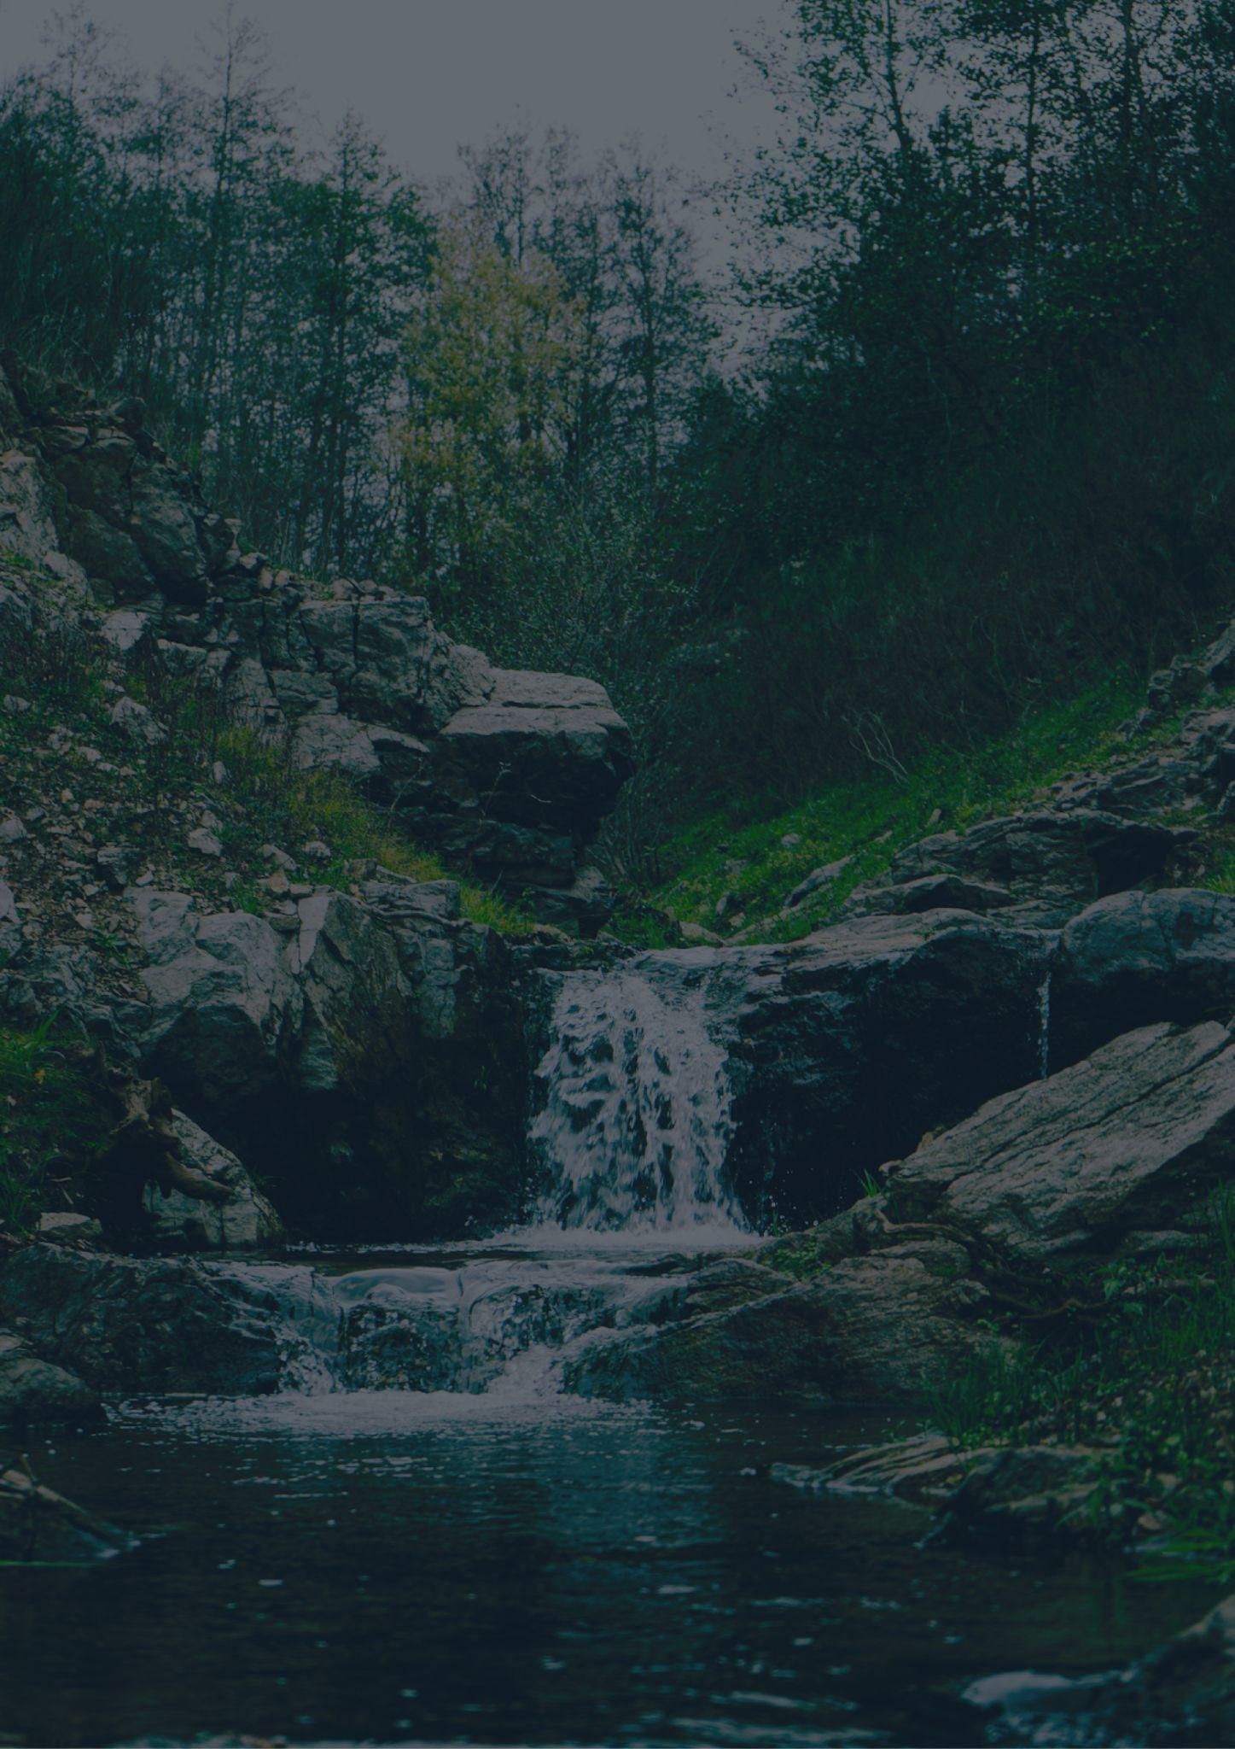
WEST VIRGINIA
Travel bucket list
Blackwater Falls
Explore Seneca Caverns
Monongahela Forest
Huntington Museum
Seneca Rocks
Beckley Coal Mine
The Greenbrier
Grave Creek Burial Mounds
Ski & Play at Snowshoe
Cathedral Falls
Berkeley Springs
West Virginia State Capitol
New River Gorge
Mothman Festival
White Water Rafting
Victorian Wheeling
Harpers Ferry
Mothman Research Center
West Virginia Penitentiary
New River Gorge Bridge
Mothman Museum
Lost World Caverns
Cass Scenic Railroad Park
Prickett’s Fort
Mothman Festival
Spruce Knob
West Virginia Museum
Harper’s Ferry

