Slide 1
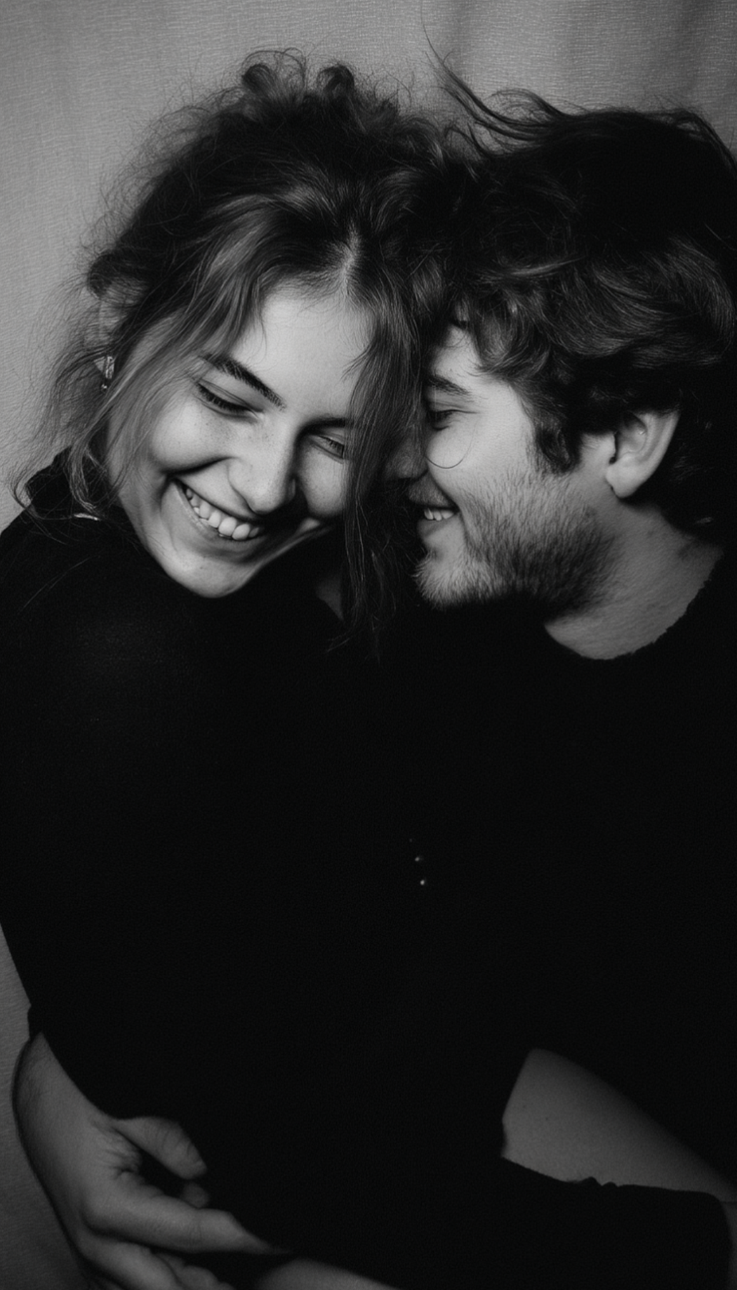
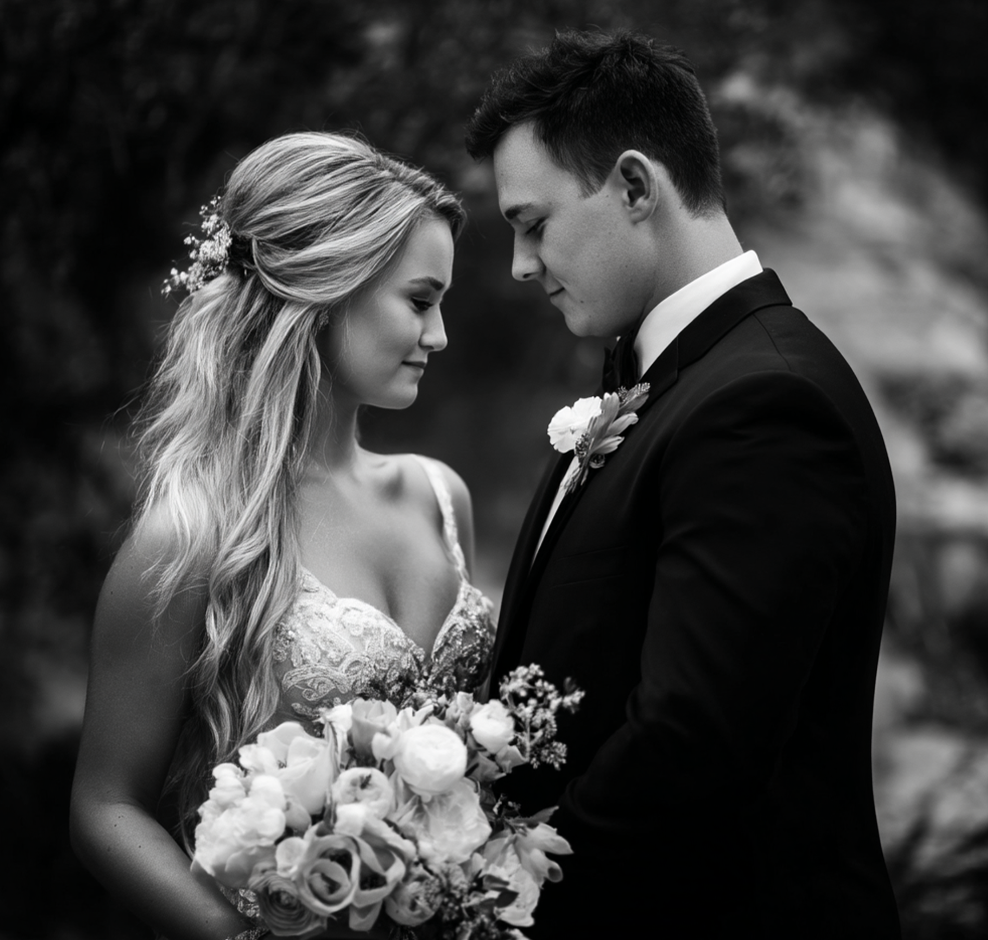
Special Wedding Edition
September 20, 2027
Special Wedding Edition
September 20, 2027
LOVE STORY FEATURE ARTICLE
The Love Times
Would you like some coffee?
EMILY & MICHAEL
It all started on a quiet Tuesday evening in the university library. Emily was buried in art history books, while Michael was struggling to fix a stubborn coding problem. Their eyes met over the hum of computers and the rustle of papers. A simple offer — “Would you like some coffee?” — turned into hours of conversation that night.
From that moment, their story unfolded across city streets, airports, and countless shared adventures. They traveled to Italy, where Emily fell in love with Renaissance art and Michael learned to order gelato in perfect Italian. They hiked mountains in Colorado, watched sunsets on quiet beaches, and laughed through rainy days when nothing went as planned. They knew their journey was just beginning.
ARE GETTING MARRIED!
EMILY JOHNSON
MICHAEL CARTER
Emily is an art historian with a passion for paintings, museums, and preserving stories from the past. She has always been known for her kind heart, endless curiosity, and creative spirit. Her friends describe her as the one who will always notice the beauty in small things — whether it’s a delicate flower or a hidden detail in a painting.
Michael is a dedicated software engineer who thrives on solving problems and building things from scratch. He loves hiking and discovering new places. He is steady and brings balance to Emily’s creative whirlwind. His sense of humor spirit are what made Emily fall in love with him from the very beginning.
The long-awaited day has finally arrived — Emily Johnson and Michael Carter are saying “I do.” Surrounded by family, friends, and all the people who have been part of their journey, the couple is ready to celebrate their love story in grand style.

Slide 2
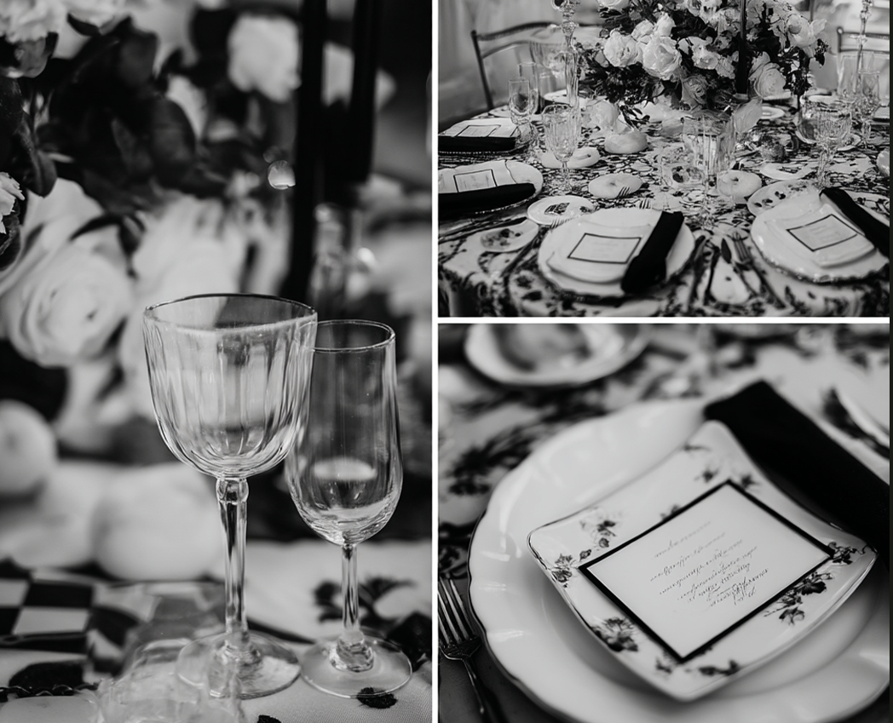
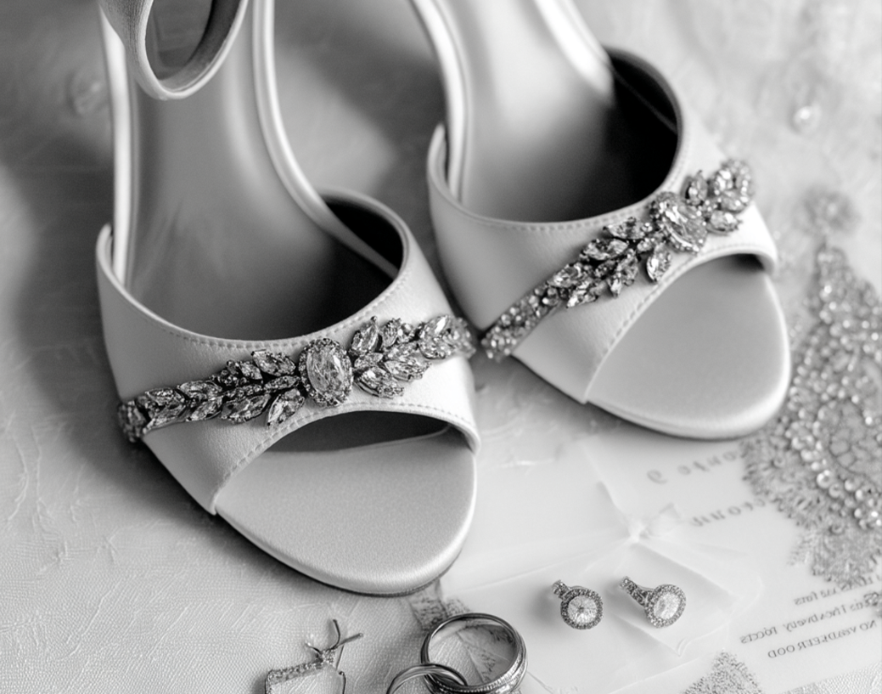
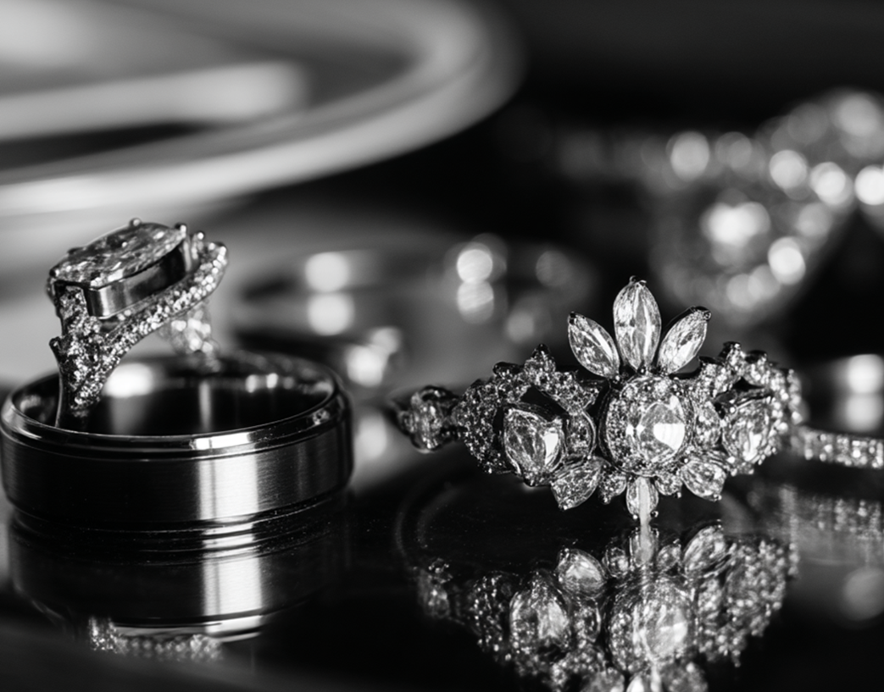
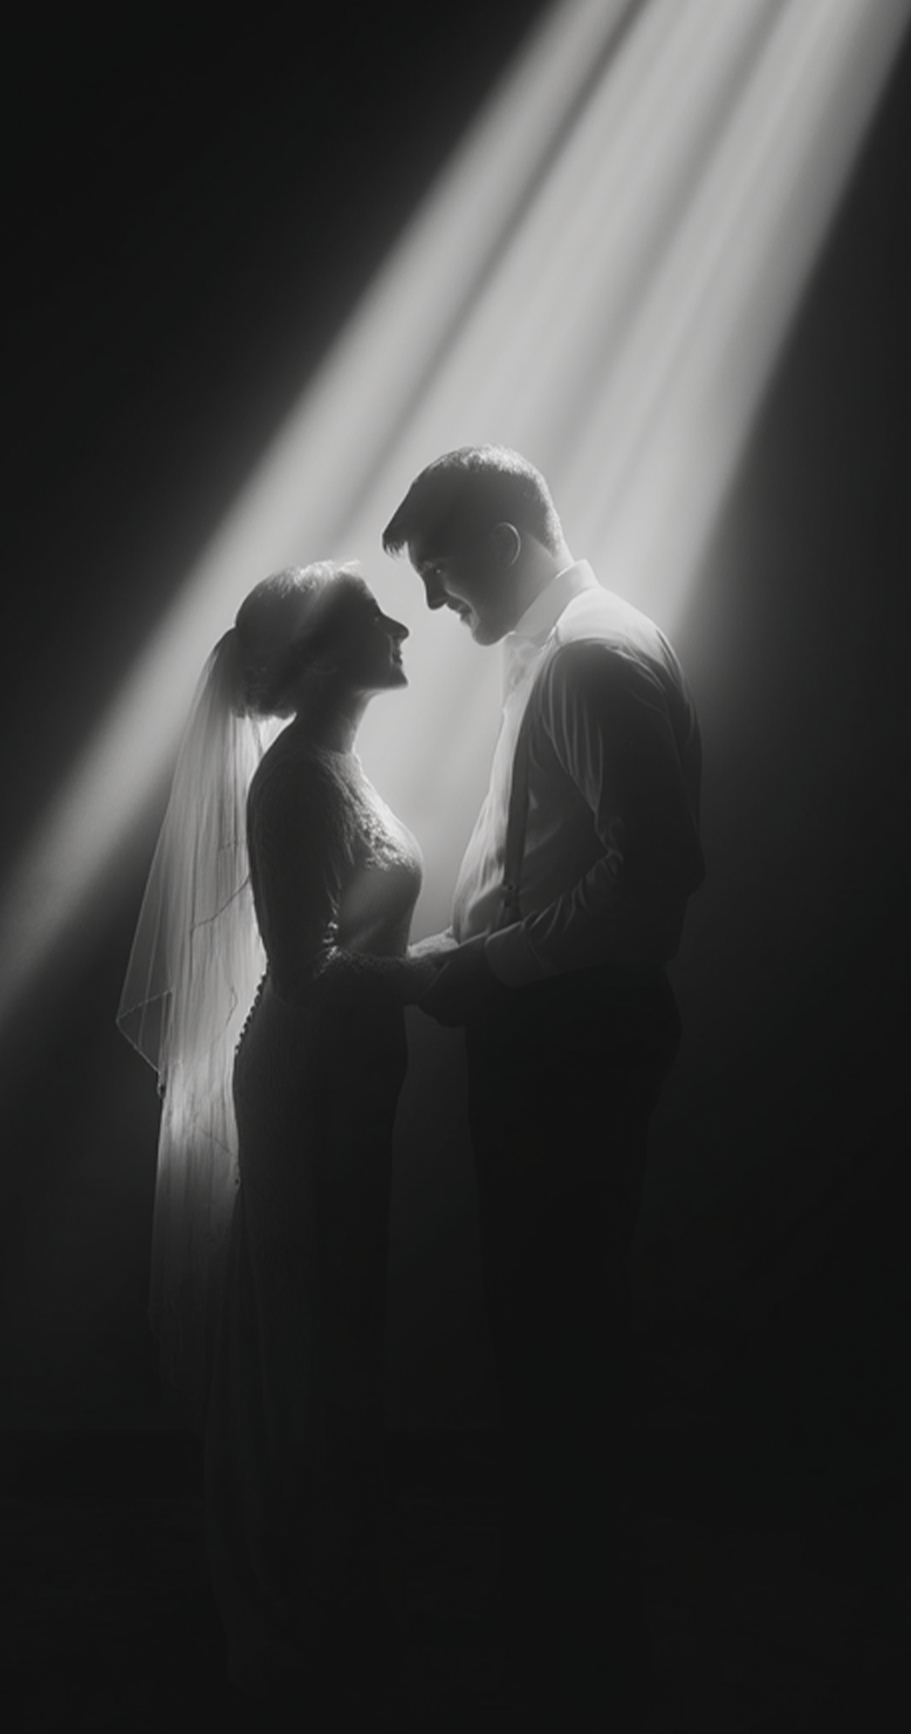
Special Wedding Edition
September 20, 2027
Special Wedding Edition
September 20, 2027
•
FROM THE COUPLE
We feel incredibly blessed to celebrate this day with the people we love most. Your presence is the most meaningful gift we could ever ask for. If you wish to honor us with a gift, we kindly ask for contributions to our honeymoon adventure fund. We plan to explore the wonders of Japan next spring, and your generosity will help us create memories that last a lifetime.
WEDDING DAY
PROGRAM
•
2:30 PM
Guests arrive at Rosewood Chapel, welcomed with soft music and refreshments.
3:00 PM
The ceremony begins, with vows exchanged under the chapel’s stained-glass windows.
4:00 PM
Group photos in the rose garden.
5:30 PM
Reception dinner at The Grand Magnolia Hall, featuring a three-course meal, wine, and heartfelt toasts.
8:00 PM
First dance of the newlyweds, followed by cake cutting and champagne.
9:00 PM
Live band & open dance floor — join us for an evening of music and laughter.
12:00 AM
Sparkler send-off for the bride and groom.
DRESS CODE & ETIQUETTE
Please join us in elegant attire — pastel shades and soft tones are encouraged to match the romantic setting. For the ceremony, guests are kindly asked to silence their phones and enjoy the moment with us fully. During the reception, don’t forget to bring your best dance moves!
ENTERTAINMENT & FUN
WEDDING TRADITIONS
A live jazz band will set the mood during dinner.
Guests are invited to share messages in the couple’s Memory Guest Book.
A photo booth will be available with props and instant prints — don’t forget to grab your keepsake!
Did you know? The tradition of the wedding cake dates back to ancient Rome, where guests would break bread over the bride’s head as a blessing for love, joy, fertility, and prosperity, ensuring the couple’s future happiness together. Today, Emily and Michael will cut their cake together — a cherished symbol of unity, love, and lifelong shared happiness.
Follow along and share your photos on
social media with our hashtag:
#ForeverCarter

