Slide 1
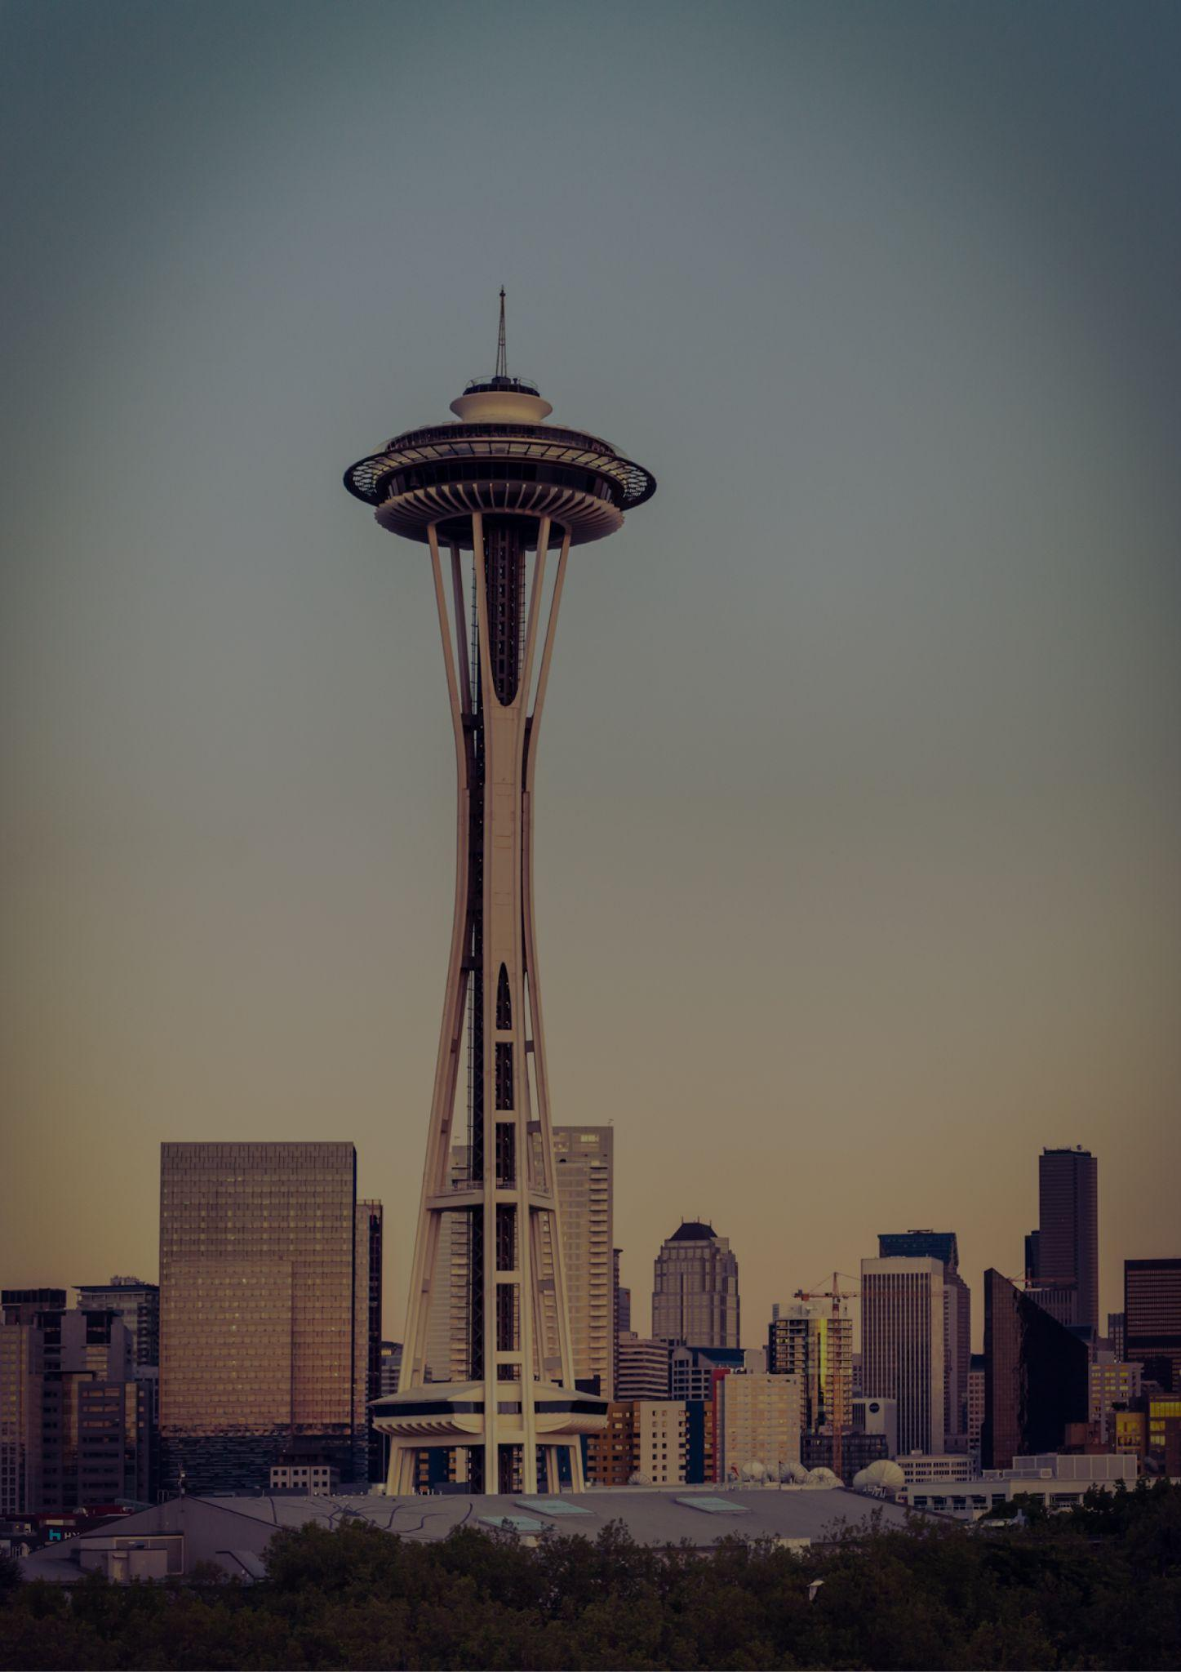
Washington
Travel bucket list
Snoqualmie Falls
Olympic National Park
San Juan Islands
Mount Rainier Park
Seattle Downtown
Leavenworth
North Cascades Park
Puget Sound
Bellingham
Columbia River Gorge
Port Angeles
Vashon Island
Bellingham
Leavenworth
Sol Duc Hot Springs
Pacific Crest Trail
Tacoma
Snoqualmie Falls
Fort Worden
Bainbridge Island
Winthrop, Methow Valley
Palouse Falls
Washington State Capitol
Vancouver
Future of Flight, Everett
Lake Chelan
North Cascades Park
Washington State Ferries

