Slide 1
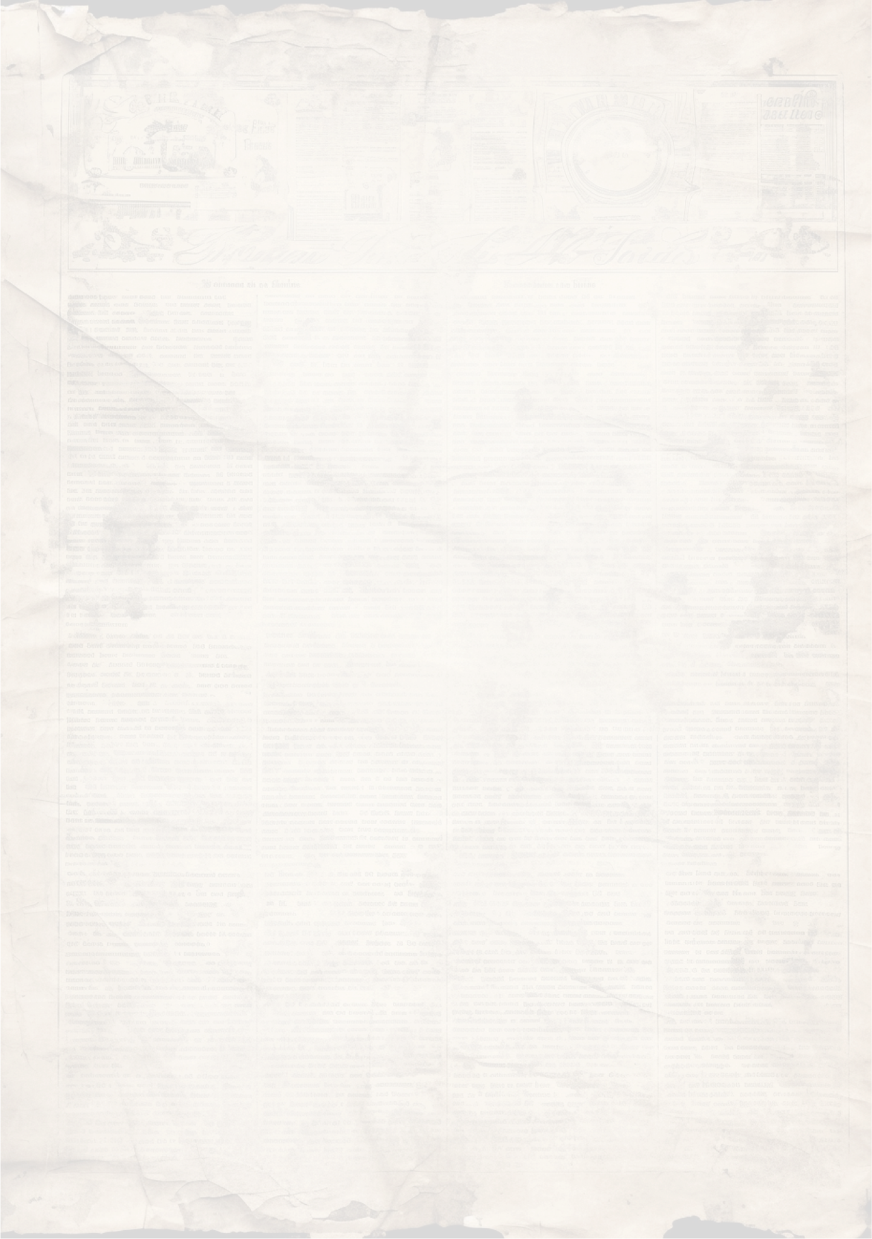


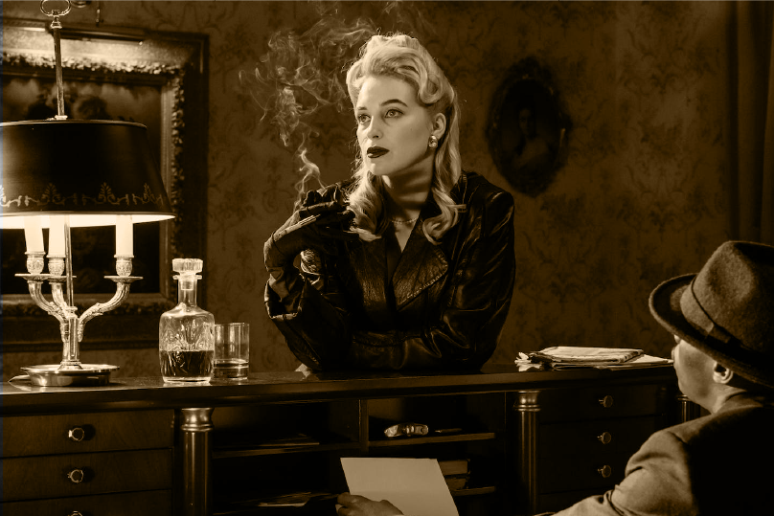
Vintage Newspaper
Issue - #1
Sunday, November 15, 1970
$0.25
Moon Landing Celebrations
C
elebrations erupted worldwide as humanity achieved the remarkable feat of landing on
the moon for the first time. The historic event marks a giant leap for mankind.
As celebrations unfold across the world, people gather in joyous awe, recognizing the significance of this historic milestone. From technological breakthroughs to the unification of nations in a shared vision of exploration, the legacy of this achievement will endure through the ages.
Today, as we celebrate the anniversary of this extraordinary event, let us reflect on the daring spirit that propelled humanity beyond Earth's confines and into the vastness of space, forever changing the course of history.
"Prohibition Era: The Roaring Twenties"
E
xplore the tumultuous era of Prohibition, speakeasies, and the Jazz Age. Learn about the
societal changes and the impact of this transformative period in American history.
Classic Movie Spotlight:
“Casablanca”
S
D
elve into the timeless allure of the iconic film "Casablanca." Discover why this cinematic
tep Back in Time with Our Retro Collection! Discover classic fashion, home decor, and
accessories inspired by the glamour of bygone eras. Visit our store today
masterpiece continues to captivate audiences decades after its release.

Slide 2
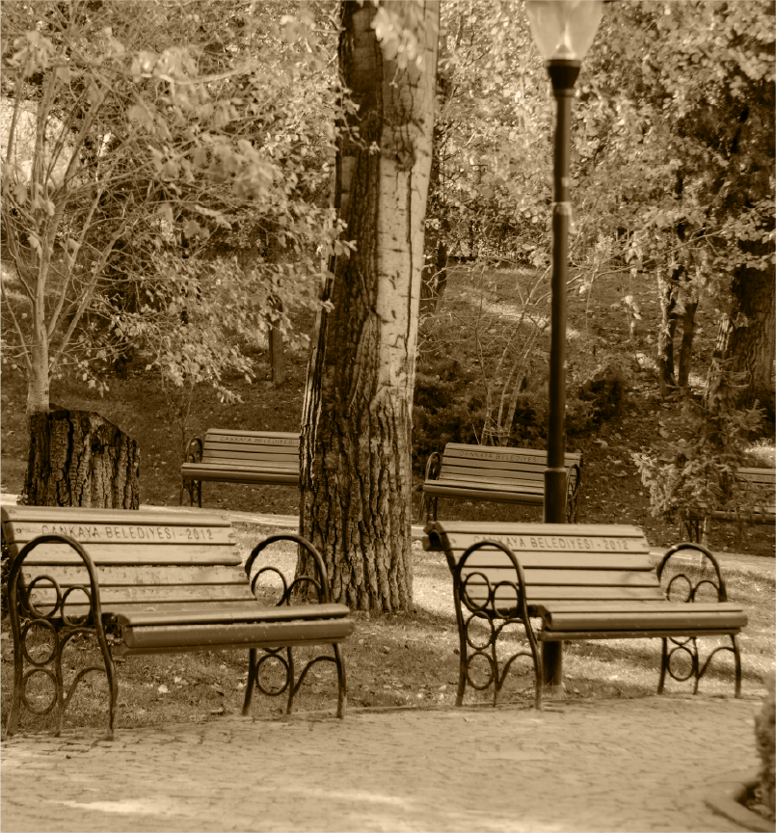
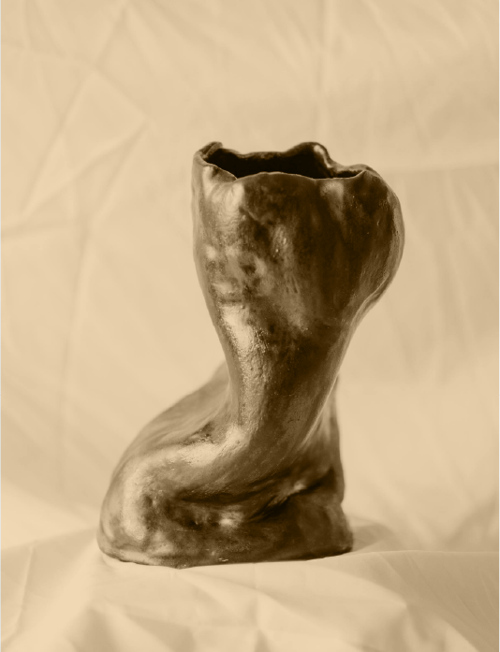
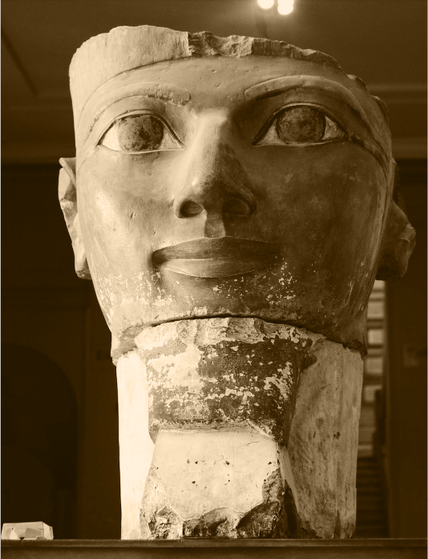
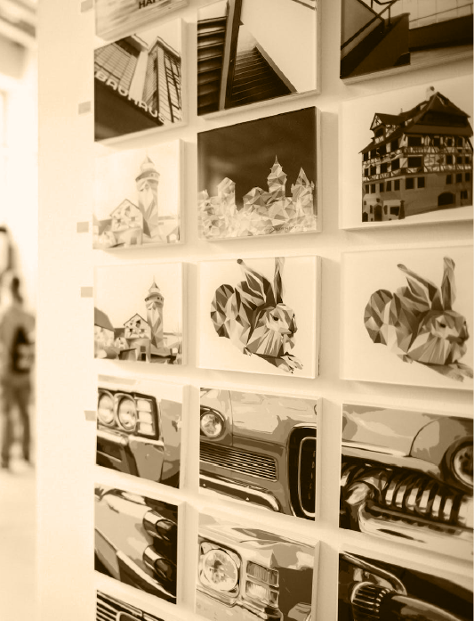
Local Events:
Vintage Newspaper
Sunday, November 15, 1970
Page - 2
Community Picnic
Delights Locals at
Central Park
L
ast Saturday, families and friends gathered at Central Park for a delightful community picnic.
Organized by the Neighborhood Association, the event featured live music, games, and a variety of delicious homemade dishes.
The sunny weather added to the festive atmosphere, with attendees praising the event as a perfect way to connect with neighbors and enjoy the outdoors.
Art Exhibition Showcases Local Talent at the Town Hall Gallery
T
he Town Hall Gallery hosted a captivating art exhibition featuring works from talented local artists. Paintings, sculptures, and mixed-media pieces adorned the gallery walls, showcasing the diverse creativity
within our community. Visitors praised the exhibition's quality and expressed admiration for the artists' unique perspectives.

Slide 3
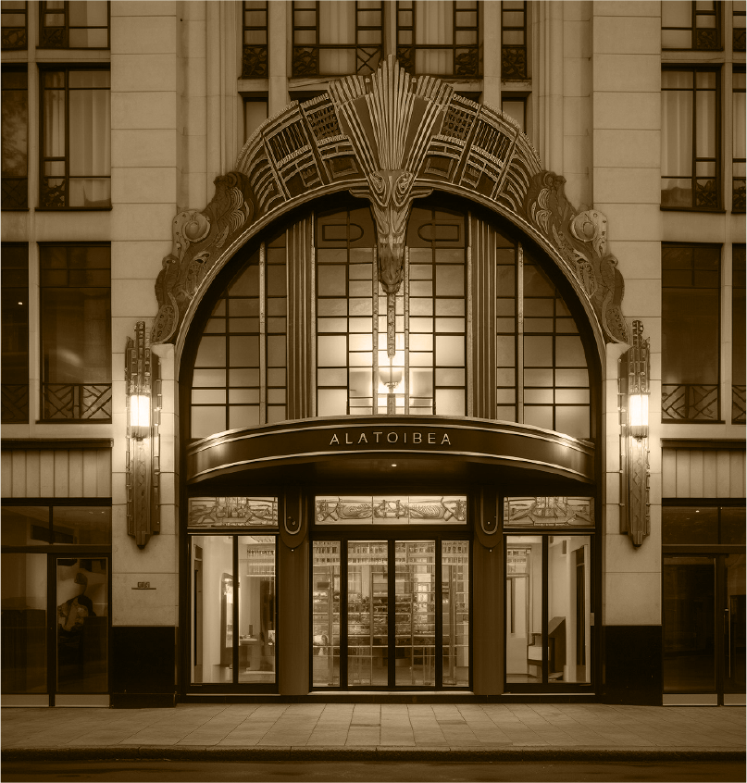
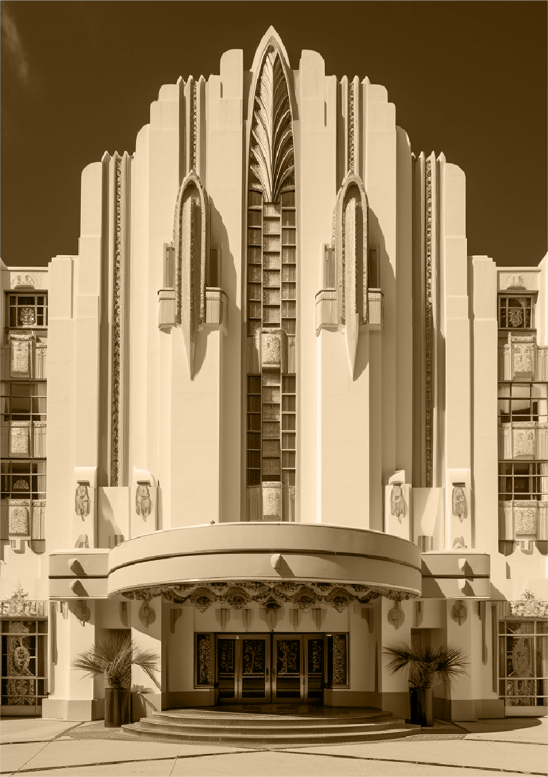
Featured Story:
Vintage Newspaper
Sunday, November 15, 1970
Page - 3
The Rise of Art Deco Architecture
I
n the roaring twenties, an artistic movement emerged, revolutionizing skylines and transforming
cityscapes. Art Deco, the architectural embodiment of modernity and elegance, has taken the globe by storm. This innovative design style, with its geometric shapes, sleek lines, and lavish embellishments, has become the hallmark of sophistication.
One iconic example of this architectural prowess is the Chrysler Building in New York City. Rising triumphantly, its metallic sheen and intricate ornamentation symbolize the zenith of Art Deco grandeur. From the opulent lobbies to its crowning spire, this skyscraper stands as a testament to the movement's ingenuity.
A
cross the Atlantic, the Palais de Chaillot in Paris commands attention with its geometric
precision and stunning visual appeal. Its symmetrical facades and decorative elements exemplify the elegance and glamour synonymous with Art Deco.
Not confined by borders, Art Deco's influence extends worldwide, gracing theaters, hotels, and even everyday objects with its signature style. From Miami's vibrant pastel-hued buildings to Mumbai's majestic cinemas, Art Deco continues to captivate and inspire.
With its marriage of form and function, Art Deco architecture embodies the spirit of an era and remains a timeless testament to human creativity.
Witness the revolution firsthand and marvel at the magnificence of Art Deco - a testament to innovation, elegance, and the human spirit's quest for beauty!

Slide 4
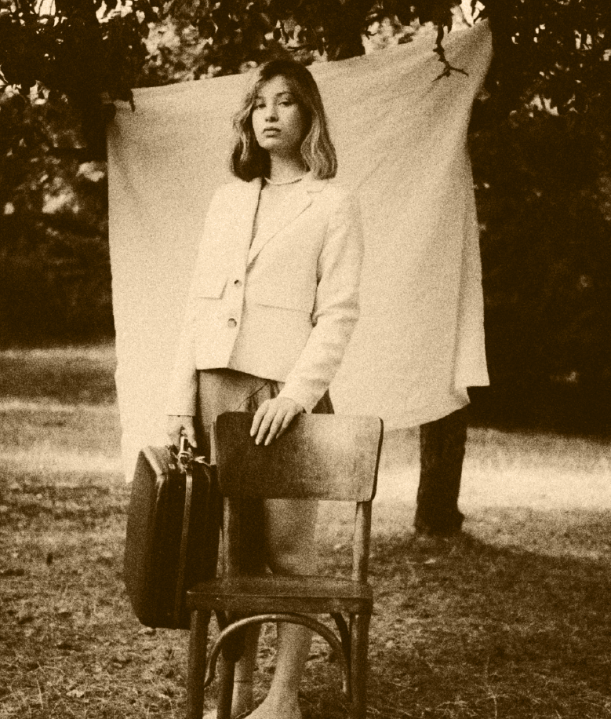
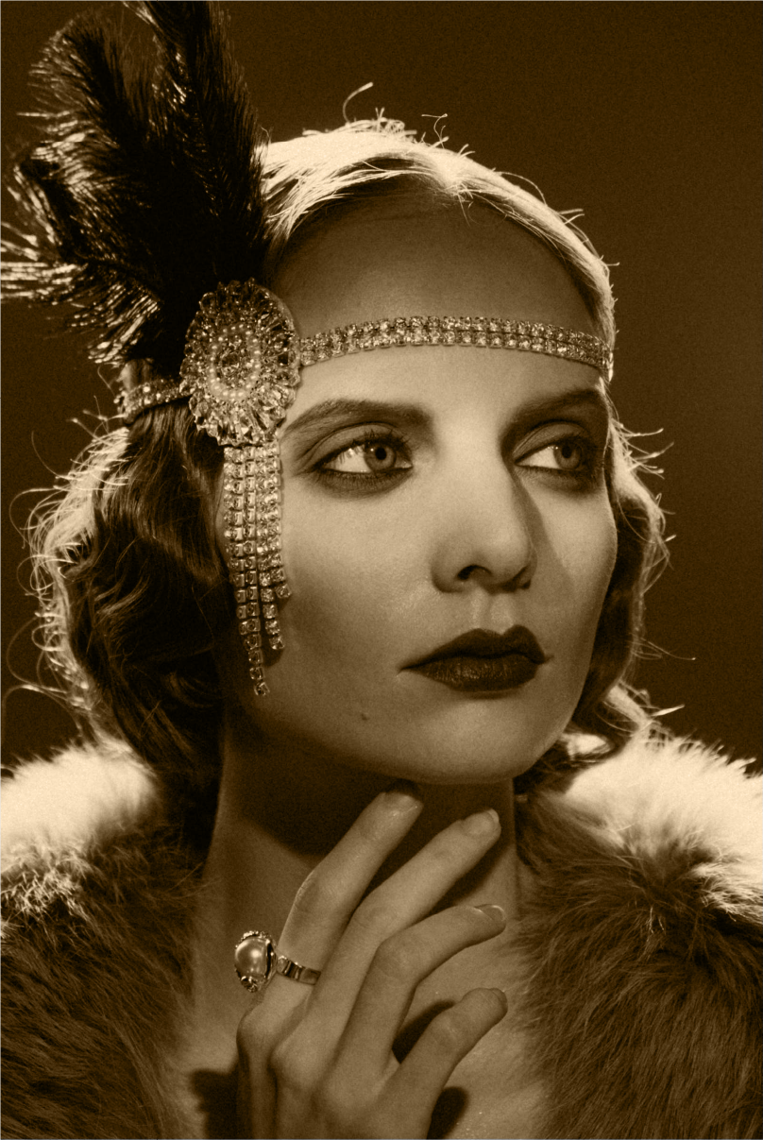
Lifestyle:
Vintage Newspaper
Sunday, November 15, 1970
Page - 4
Fashion Tips for Vintage Glamour
Silhouettes and Cuts:
W
omen's Fashion: Look for images or descriptions of women wearing dresses with
defined waistlines, full skirts, pencil skirts, and tailored suits. The 1920s featured flapper dresses with dropped waists, while the 1950s showcased hourglass silhouettes.
Men's Fashion: Men's suits often had a slim, structured silhouette with wide lapels. Trousers were typically high-waisted and tailored.
Accessories:
H
ats: Women adorned themselves with pillbox hats, cloche hats, or wide-brimmed hats. Men
often wore fedoras or flat caps.
Jewelry: Statement pieces like pearls, long necklaces, brooches, and Art Deco-inspired jewelry were common for women. Men wore cufflinks, tie pins, and pocket squares.
Fabrics and Textures:
W
omen's Fashion: Fabrics like satin, silk, lace, and chiffon were popular. Consider images
showcasing these materials in evening gowns, cocktail dresses, or blouses.
Men's Fashion: Wool suits were prevalent, often with pinstripes or herringbone patterns.

