Slide 1
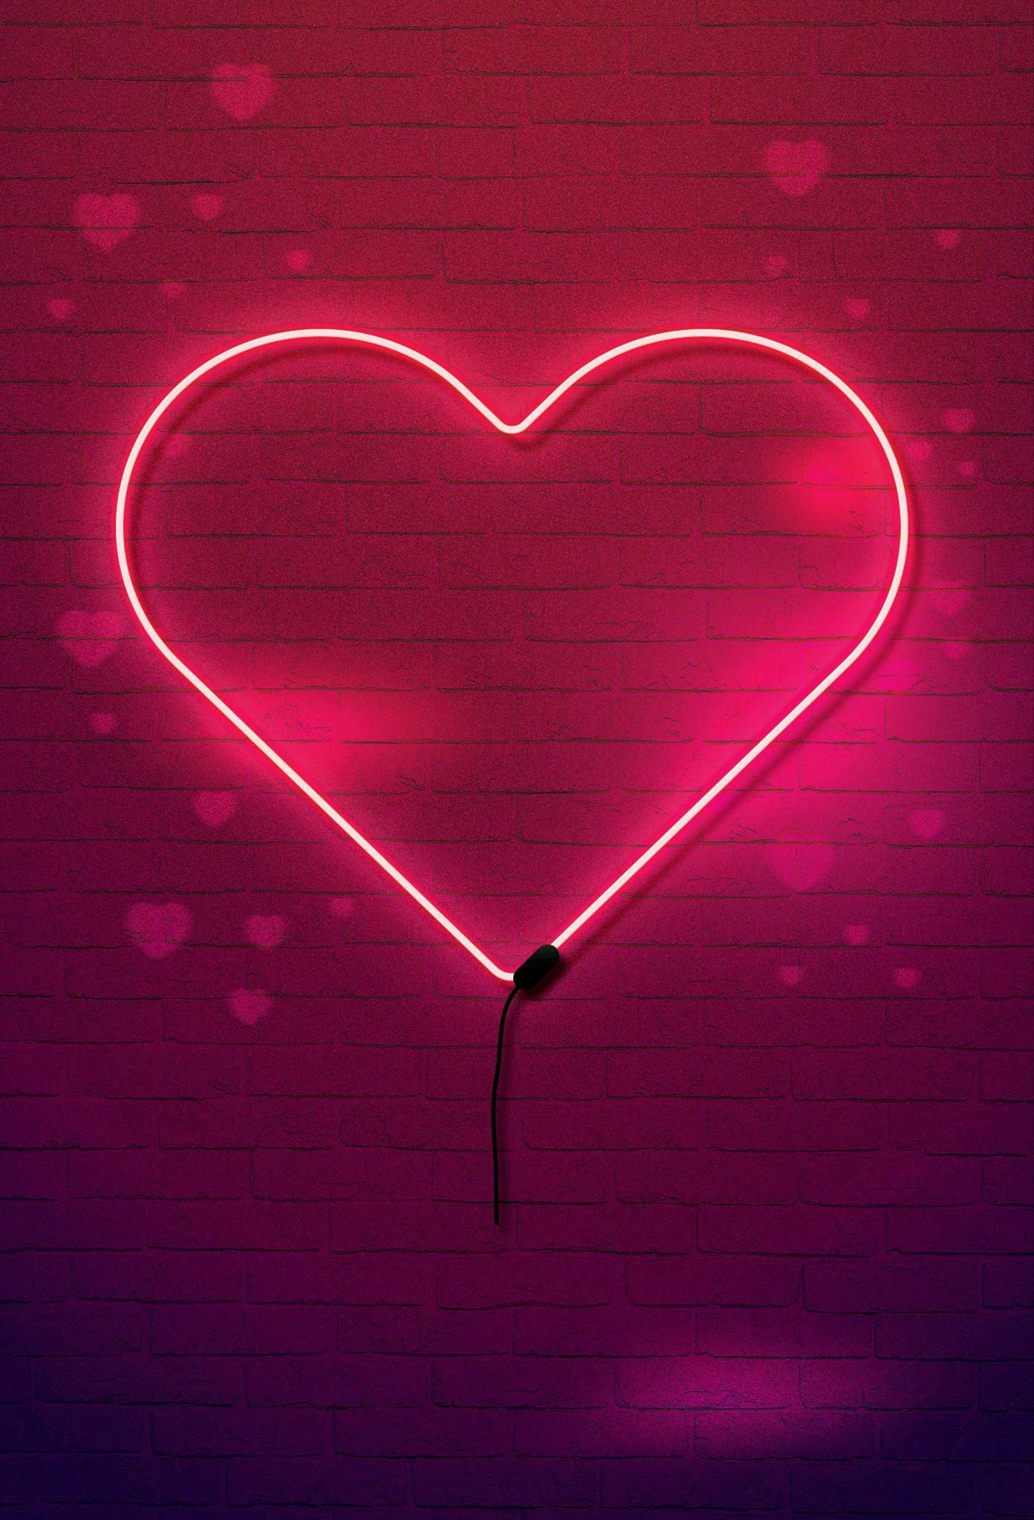











SATURDAY
14 Feb 2026
Valentine s
Valentine’s
Night
FEATURING
Raving Phil
the heartbeats
Doors open 10 pm | Tickets $15 | Min. Age 18
www.your-club-name.LTD | contact: (123) 456 7890 | 10 Hill Street, Seattle
YOUR CLUB

