Slide 1
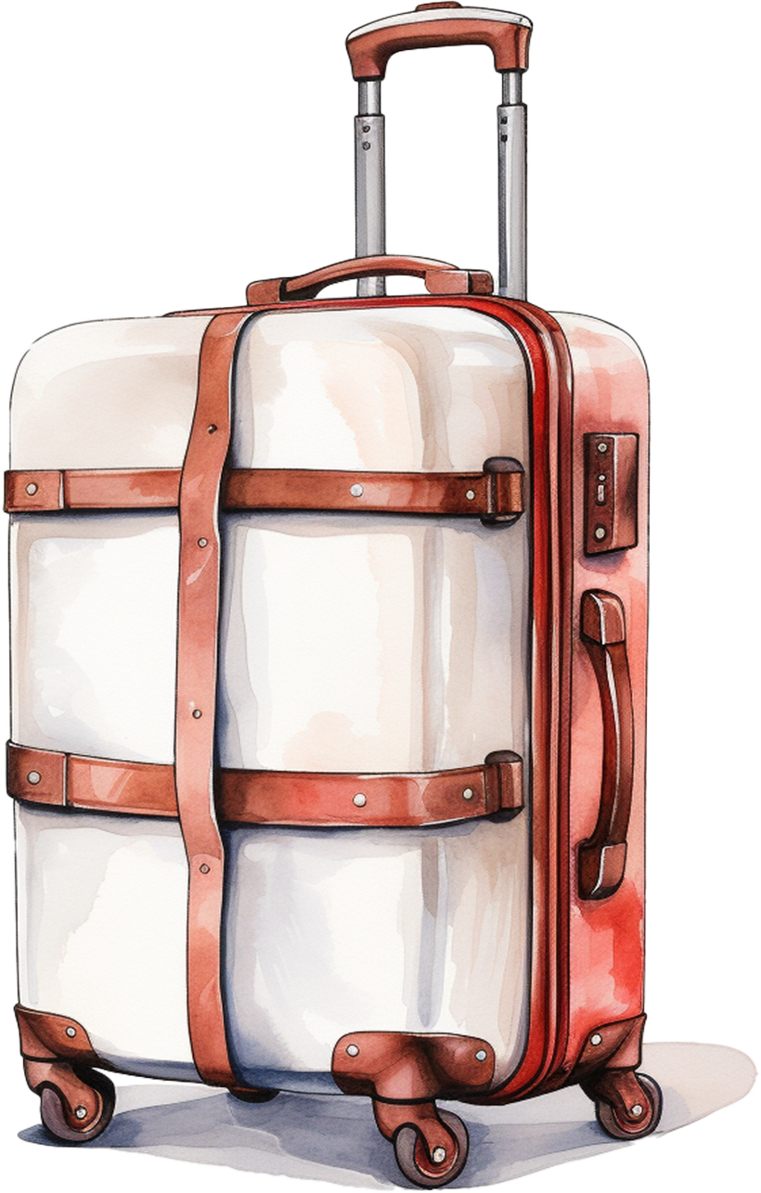
ULTIMATE PACKING LIST
CLOTHING:
TOILETRIES:
TRAVEL GEAR:
TOPS
DENTAL CARE
SUITCASE
T-SHIRTS
TOOTHBRUSH
TRAVEL PILLOW
SHIRTS
TOOTHPASTE
TSA-APPROVED LOCKS
BLOUSES
DENTAL FLOSS
LUGGAGE TAGS
BOTTOMS
HAIR CARE
TRAVEL WALLET
PANTS
SHAMPOO
PORTABLE LUGGAGE
SHORTS
CONDITIONER
SCALE
SKIRTS
HAIRBRUSH
OUTERWEAR
SKINCARE
DOCUMENTS AND MONEY:
UNDERGARMENTS
FACE WASH
PASSPORT
SLEEPWEAR
MOISTURIZER
DRIVER'S LICENSE
SWIMWEAR
SUNSCREEN
HEALTH INSURANCE
ACCESSORIES
RAZOR
CREDIT CARDS/CASH
HATS
FEMININE PRODUCTS
VISA
SCARVES
EYE CARE
ID
GLOVES
CONTACT LENSES
BELTS
GLASSES
MEDICATIONS:
ELECTRONICS:
MEDICATIONS
PHONE
PAIN RELIEVER
LAPTOP OR TABLET
ALLERGY
CHARGER
FIRST AID
CAMERA
BANDAGES
POWER BANK
ANTISEPTIC
HEADPHONES
TWEEZERS
ADAPTER

