Slide 1
GREECE
JUNE 5
-
JUNE 18
TRAVEL ITINERARY

Slide 2
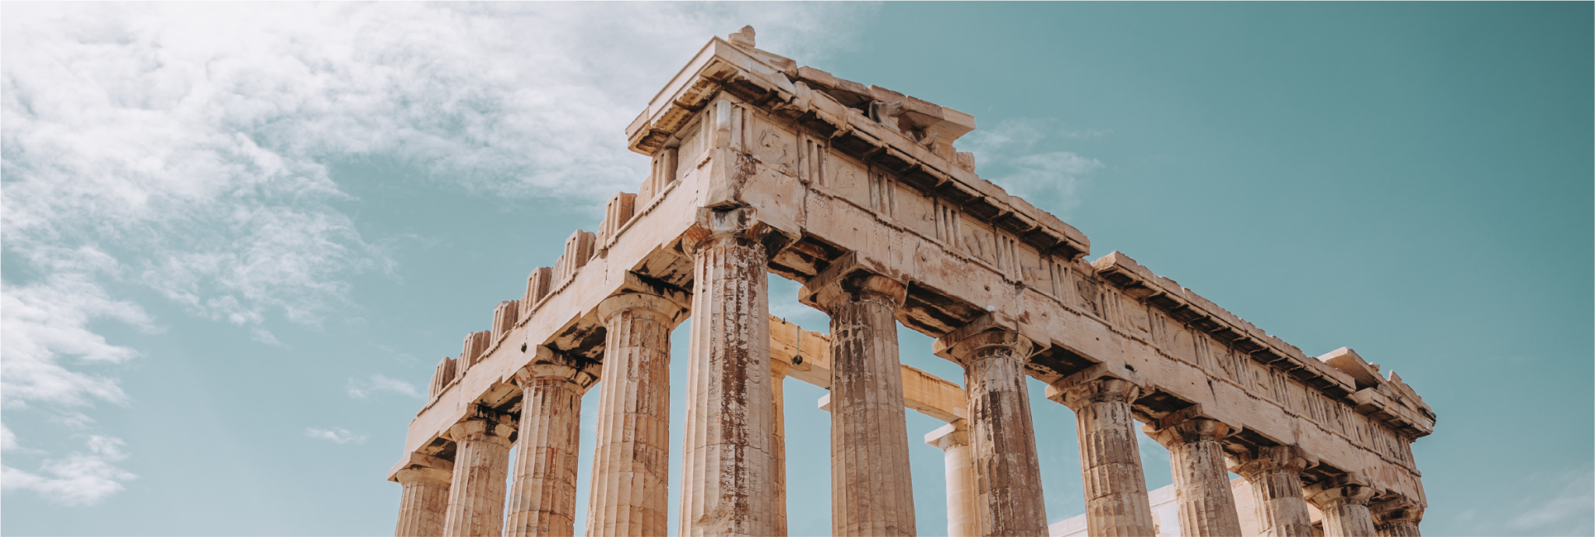
TOURS
ACROPOLIS
Walking Tour / 1.5 hours
Dionysiou Areopagitou 5-3, Athina 117 42, Greece
+ Price: $48/person
SANTORINI
ATV Tour / 3.5 hours
Agios Georgios, Santorini 847 03
+ Price: $98/person
KNOSSOS PALACE
Walking Tour / 1.5 hours
Palace Archaeological site, 44, Iraklio 713 06
+ Price: $53/person

Slide 3
DETAILS
TRANSPORTATION
JFK > ATH ARRIVE 11AM
UBER > TO HOTEL (30 min)
ITINERARY
MORNING
ARRIVE AT HOTEL
GRAB BREAKFAST AT HOTEL
HEAD TO ACROPOLIS
AFTERNOON
EXPLORE ACROPOLIS
GRAB LUNCH IN THE PLAKA
SHOPPING IN MONASTIRAKI
EVENING
DINNER DOWNTOWN
LIVE MUSIC IN THE WANDER PSIRRI

