Slide 1
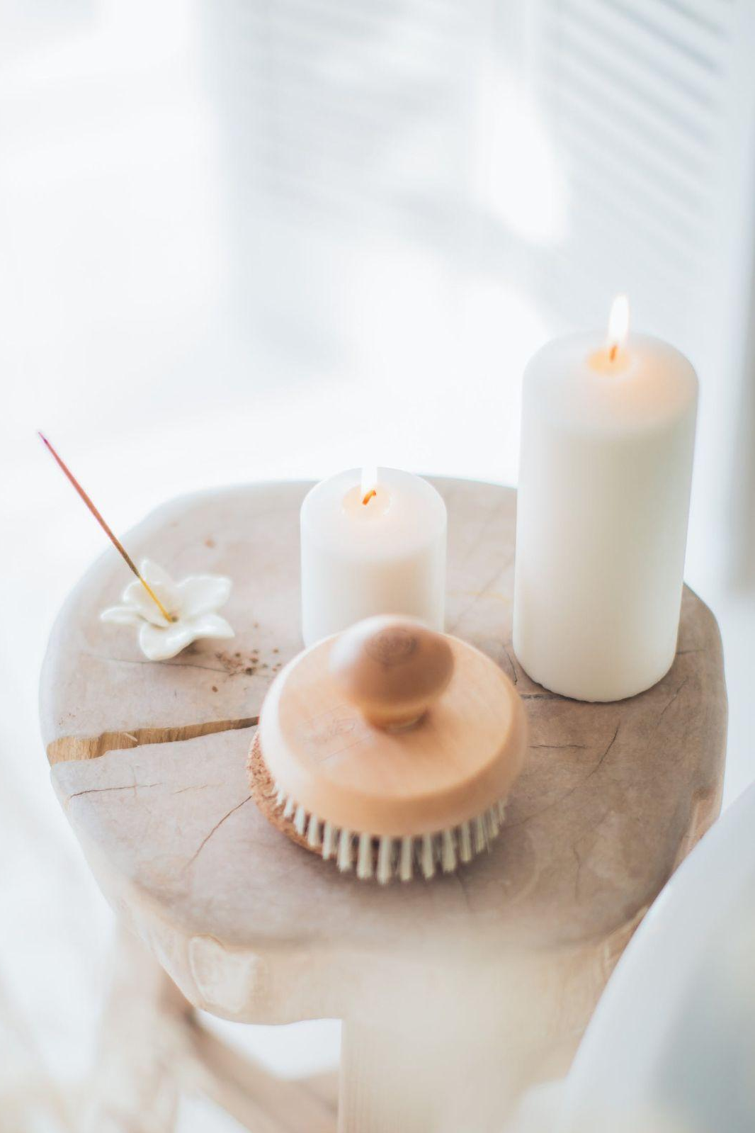
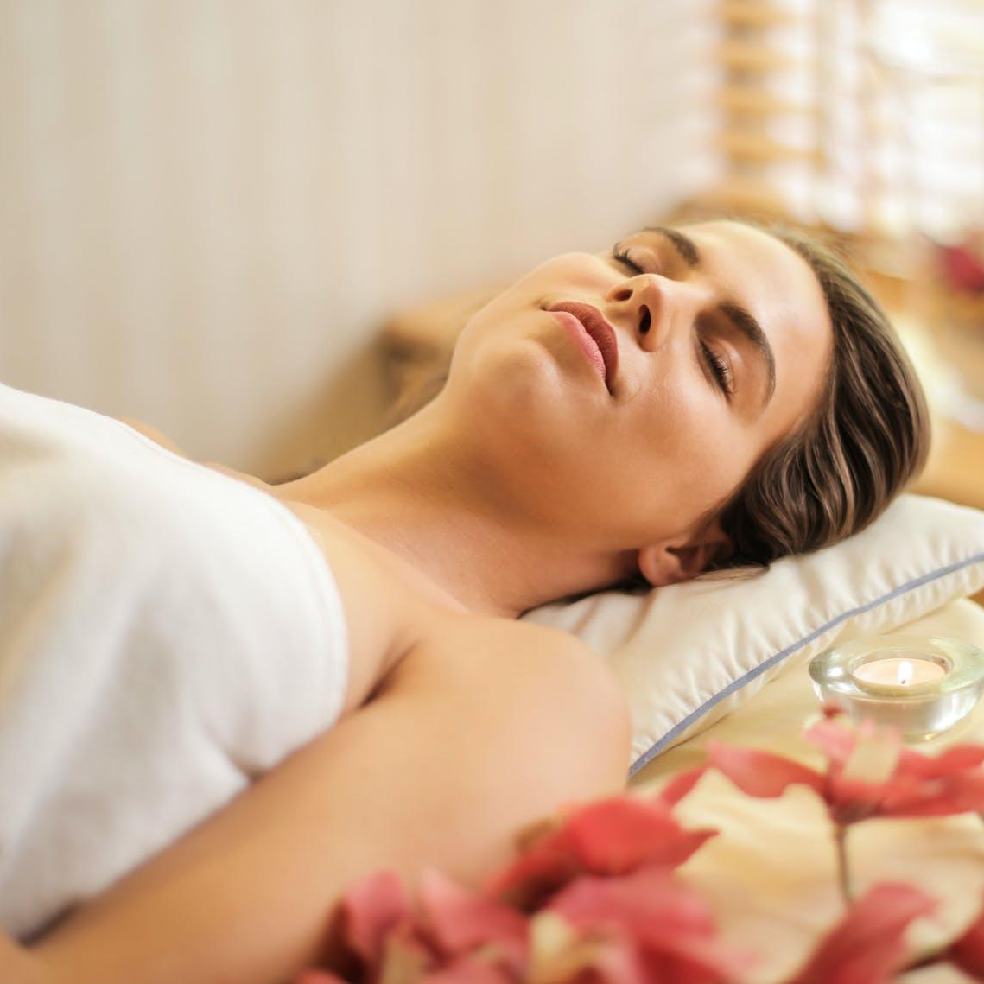
Introduction
Indulge in Tranquility
Welcome to Spa & Massage Salon, where relaxation meets revitalization. Step into our oasis of tranquility and embark on a journey to inner harmony and wellness.
Contact Us
Beauty Salon
Example@mail.com
Example.com
5703 Rippin Crescent Apt.
185, New Tremaine
+1 012-345-6789
SPA & MASSAGE
Our mission is to provide an escape from the stresses of everyday life by offering luxurious spa experiences that rejuvenate the body, mind, and spirit.
@yournamespasalon
Relax, Rejuvenate, Renew

Slide 2
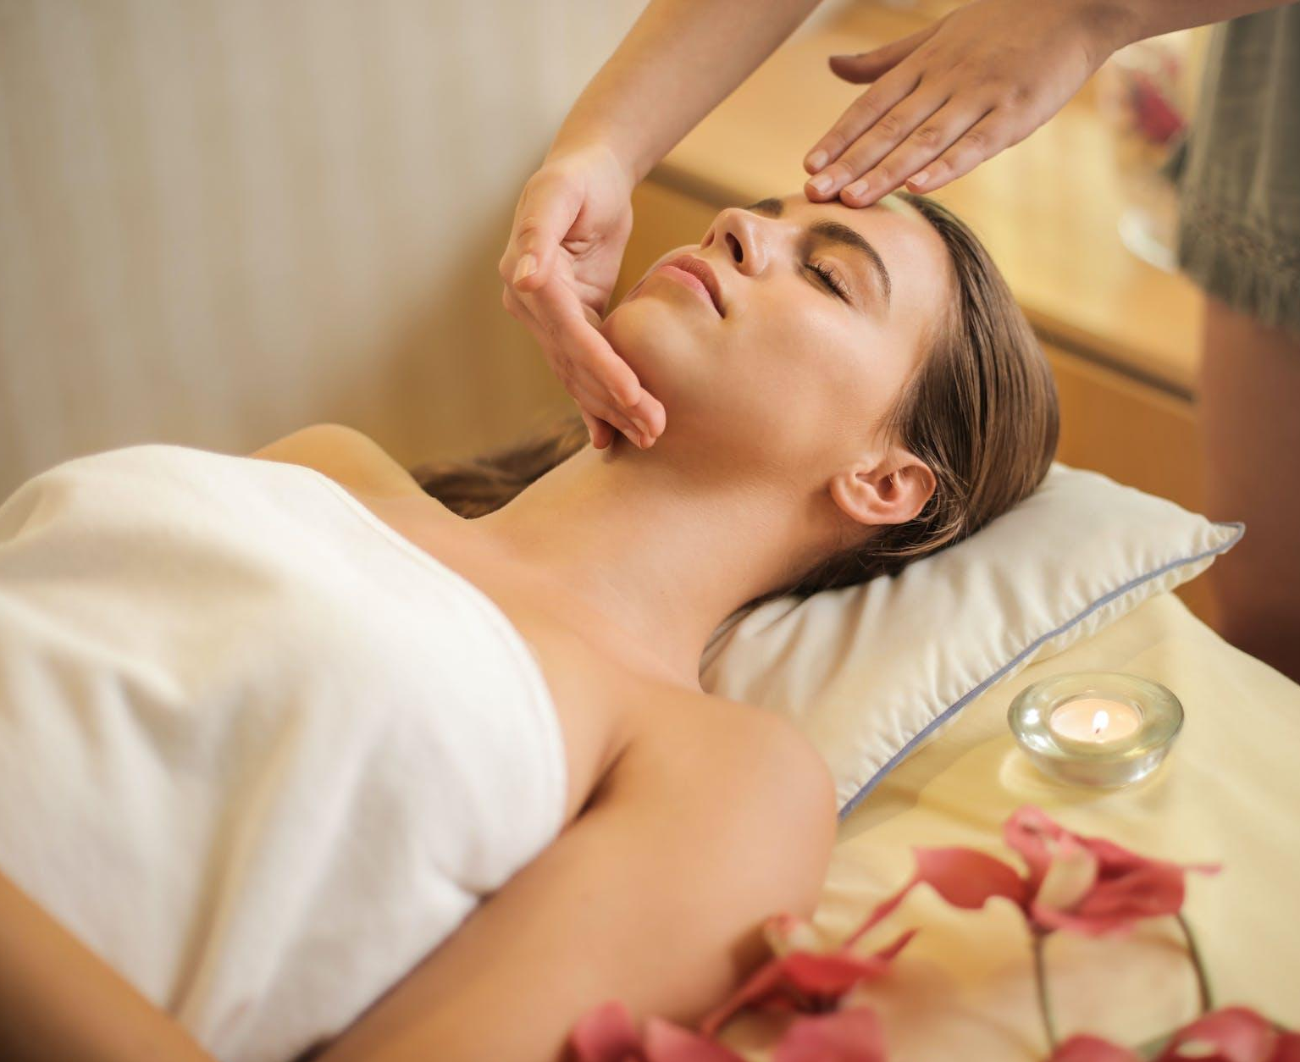
Why Choose Us
Our certified and experienced therapists provide personalized care tailored to your needs, ensuring a blissful experience.
Our Services Offered
Immerse yourself in our serene
environment, designed to promote
relaxation and tranquility.
MASSAGE THERAPIES:
Swedish
$55.00
Deep tissue
$75.00
35% Special Ofer
Hot stone
$60.00
We use premium, natural products to enhance your spa experience, leaving you refreshed and glowing.
Aromatherapy
$45.00
SPA TREATMENTS:
Indulge in the ultimate relaxation with our exclusive Blissful Escape Package designed to rejuvenate your body and mind.
Facials
$60.00
Body scrubs
$70.00
Wraps
$75.00
WELLNESS PACKAGES:
Details about package deals
combining different services
for a comprehensive spa experience.
$90.00

