Slide 1
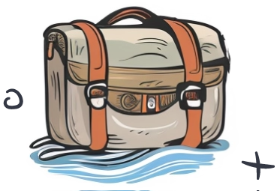
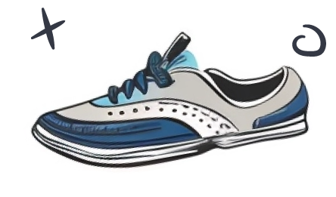
Travel Plan
Traveling To
Berlin
Madrid
Rome
What to Pack
August
Documents and Essentials
M
T
W
T
F
S
S
Toiletries
1
2
3
4
Electronics
5
6
7
8
9
10
11
Clothing
12
13
14
15
16
17
18
Miscellaneous
19
20
21
22
23
24
25
26
27
28
29
30
31
Travel Route
Departure Time: [Insert Departure Time]
Notes
Mode of Transportation: Flight

