Slide 1
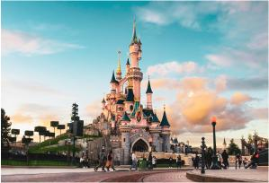
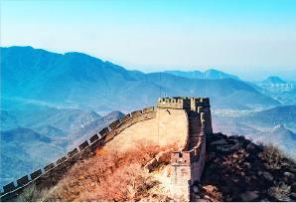
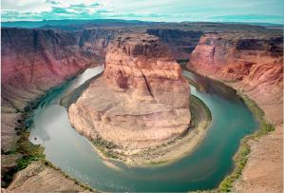
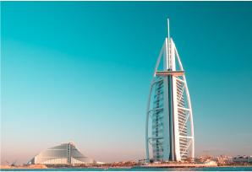
ULTIMATE
Europe
Travel Bucket List
Go to Disneyland
Stonehenge
Drink beer at Oktoberfest
Soak in the blue lagoon
Sistine Chapel
Explore the Amazon
Ride a gondola in Venice
Kilimanjaro
See the Northern lights
Niagara Falls
The Grand Canyon
Berlin Wall
Great Barrier Reef
Niagara Falls
Pyramids of Giza
Statue of Liberty
Galapagos islands
Mount Fuji
Taj Mahal
Cappadocia, Turkey
Terracotta Army
Great wall of China
Leaning Tower of Pisa
Santorini
The Sahara desert
Go on a safari
Sagrada Familian
Sydney Harbour Bridge
Go up the Eiffel Tower
Christ the Redeemer
Float in the Dead Sea
Trek to Machu Picchu
Big Ben
Burj khalifa
Easter island
Kinderdijk windmills
Stand under the Hollywood sign
Throw a coin in the Trevi Fountain
Cruise around the Phi Phi islands
Go on an American or European Road Trip
Sydney Harbour Bridge
Neuschwanstein castle

