Slide 1



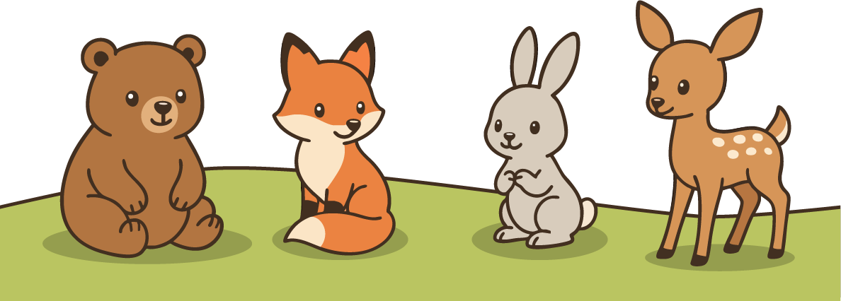
Trace the Alphabet Worksheet
Aa Bb Cc Dd Ee
Ff Gg Hh Ii Jj
Kk Ll Mm Nn
Oo Pp Qq Rr Ss
Tt Uu Vv Ww
Xx Yy Zz

