Slide 1






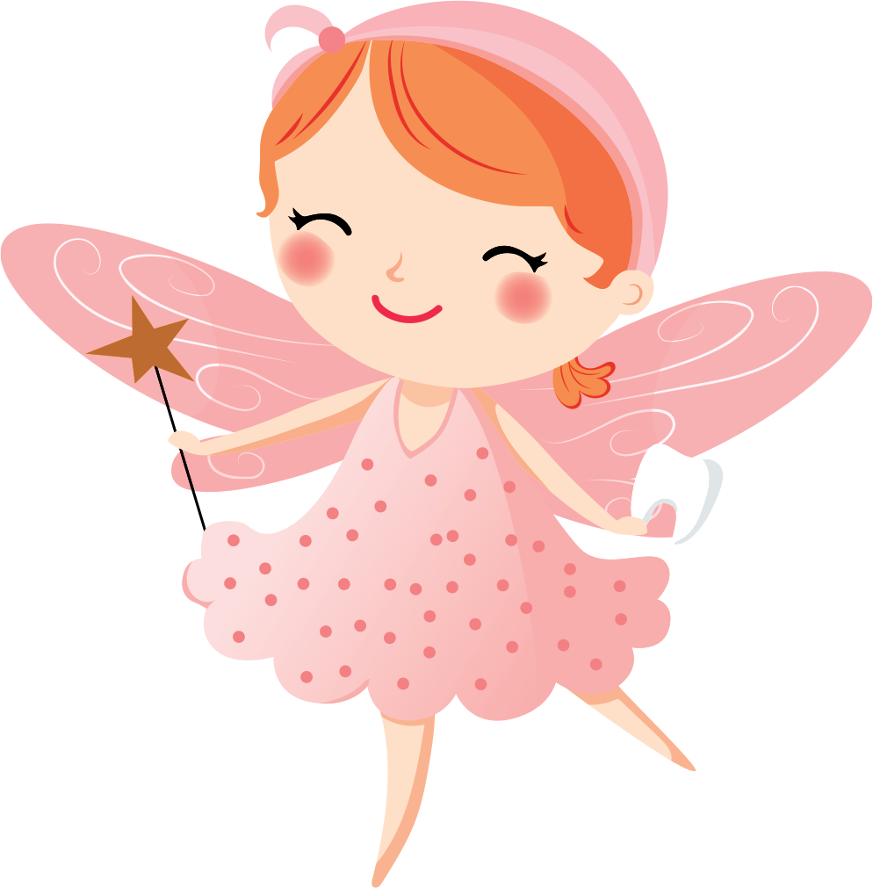

Dear Lili,
Greetings from the Tooth Fairy! I hope this letter finds you in good health and high spirits. I'm writing to express my delight at receiving your precious tooth and to thank you for your thoughtful gift.
First and foremost, let me congratulate you on losing a tooth! It's an important milestone and a sign that you're growing up. Your lost tooth is like a tiny treasure that holds wonderful memories and marks a special moment in your life.
I must say, your tooth is exquisite! It's a sparkling gem that shines with the magic of childhood. I have added it to my collection of teeth, each of which carries a unique story and a touch of enchantment.
As a token of my appreciation, I've left a small surprise under your pillow. Keep an eye out for it! Remember, every time you lose a tooth, it's a chance for you to spread a little bit of magic and make the world a brighter place.
Always remember to take good care of your teeth. Brushing, flossing, and regular visits to the dentist are essential to keeping your smile healthy and beautiful.
Thank you again for your lovely gift and for making my night so magical. Keep being kind, curious, and full of wonder. You're a true treasure!
Sending you glittering dreams and
fairy wishes,
The Tooth Fairy

