Slide 1
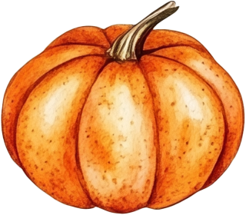
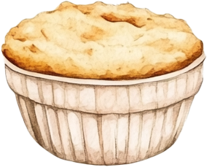
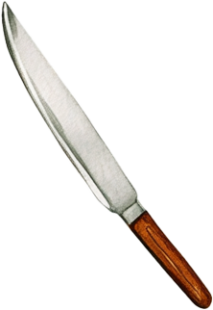
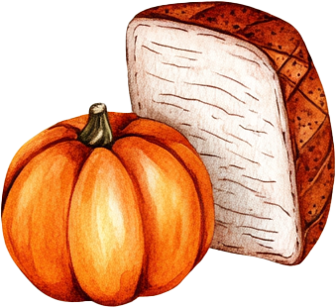
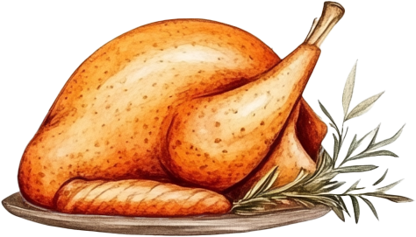
Dear [Guest’s Name],
You’re invited to celebrate
Thanksgiving with the
Johnson family!
Thanksgiving
Feast
Date: Thursday, November 28, 2024
Time: 5:00 PM
Location: 123 Harvest Lane, Maple Town
Warm regards, The Johnson Family

