Slide 1
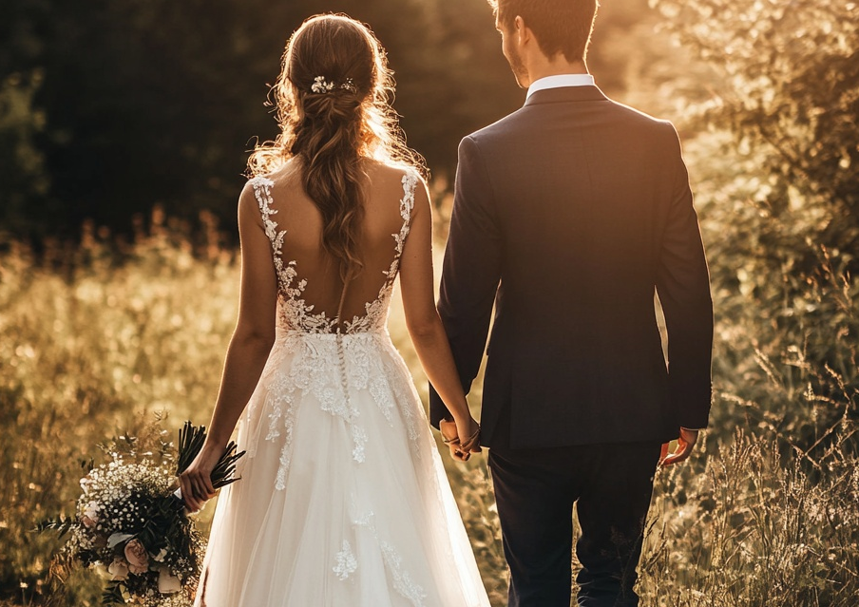
Thank You
Michael & Sarah
1 1 . 1 2 . 2 0 X X

Slide 2
Your Stamp Here
Michael & Sarah
1234 Elm Street, Springfield, Illinois 62704
Dear Family & Friends
Deliver To:
We are incredibly grateful for your presence at our wedding. We look forward to sharing many more happy moments with you.
With Love
Michael & Sarah Brown

