Slide 1
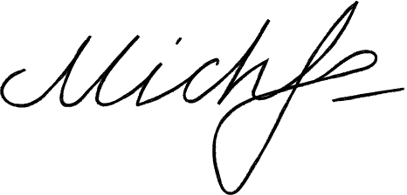
Michelle Lindon
Resignation Letter
December 27, 2026
Ms Allen Strosin
General Manager
Praesent Finibus Industries
65012 Bogisich Ridges Suite 676, CA 5734
+012-345-67890
To Ms. Allen:
Kindly accept this letter as my formal resignation as a staff member of Salem Court Industries. My last day is expected to be on January 19, 2025, two weeks from today.
I am incredibly grateful for the opportunities that I have been given in this post. I value the insights that I have learned, and I expect them to help me in my future endeavors. I would also like to thank you for being supportive of my professional growth. I have enjoyed working with you and the rest of the team.
Let me know how I can help in making the transition of responsibilities as seamless as possible for everyone involved. Thank you.
Best wishes,
Michelle Lindon
+012-345-67890
@gdoc.io
best@gdoc.io

