Slide 1
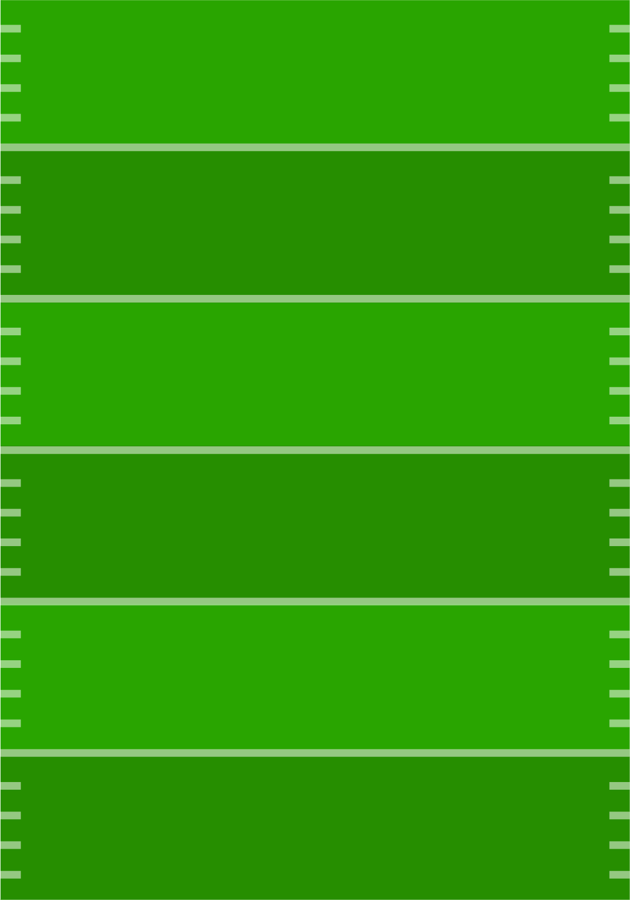
GUESS THE GAME
Write your guesses — the person with the most
correct answers wins!
Which team will win the coin toss?
Will the coin land on heads or tails?
Which team will win the game?
Who will be ahead at the end of the 1st quarter?
Who will be ahead at the end of the 2nd quarter?
Who will be ahead at the end of the 3rd quarter?
Which team’s quarterback will get sacked first?
Which team will be the first to turn the ball over?
Will the first turnover be a fumble or interception?
Will each team have a turnover in the game?
Will every drive be completed, or an incomplete pass occur?
Which team will call the first timeout?
Which team will score first?
Which team will score a touchdown first?
Will a field goal be kicked during the game?
Will there be a missed field goal during the game?
Will there be a safety during the game?
Which team will be the first to punt?
Which team will be the first to convert a 4th down?
Will the game go into overtime?
Will there be a scoreless quarter during the game?
Which team will score last?
Which quarter will be the highest scoring?
What will the first score be (TD, FG, safety)?
What will the last score be (TD, FG, safety)?
Will the first penalty be called on a passing play?
Will the first play be a running or passing play?
Who will be the first to challenge a play?
What will the result of the first challenge be?
What will be the result of the first conversion during the game?
Will there be a 2-point conversion in the 4th quarter?
Will there be a lead change during the game?
Will a team score in the last 3 minutes of the game?
More templates on gdoc.io

