Slide 1
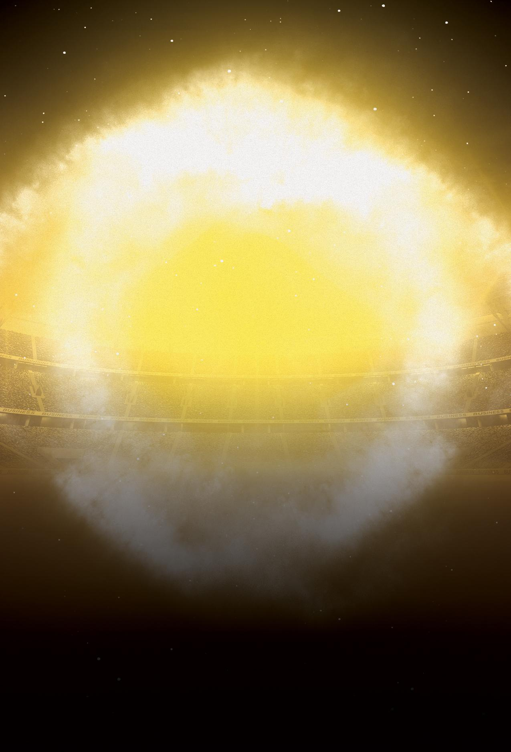
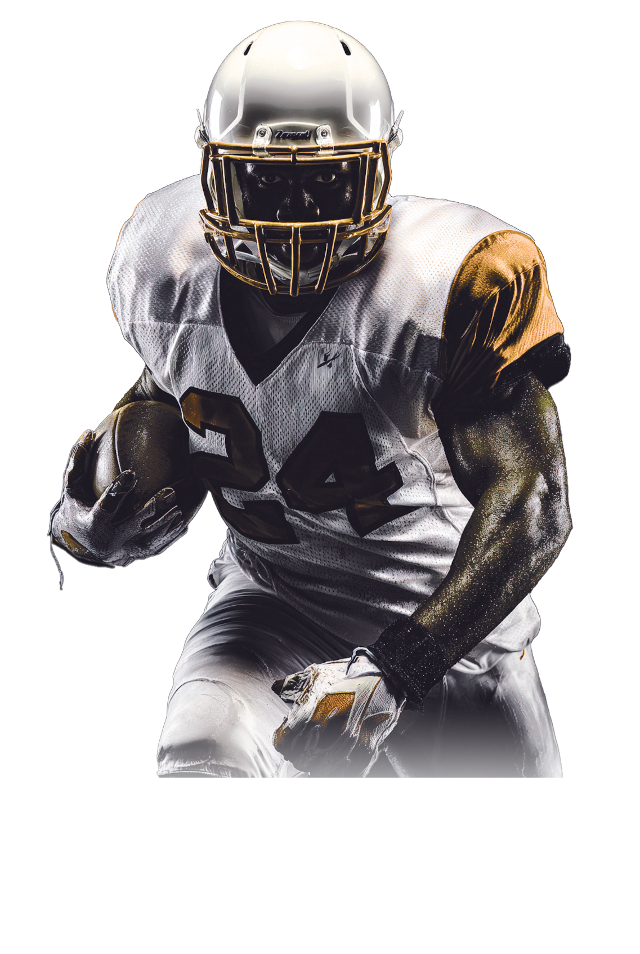


SUNDAY FEBRUARY 8
RAVENS VS PATRIOTS
JACKSON’S PUB
@
123.456.7890 I 123 EAST SIDE I MIAMI, FL 12345
WWW.YOURPUBNAME.LTD

