Slide 1
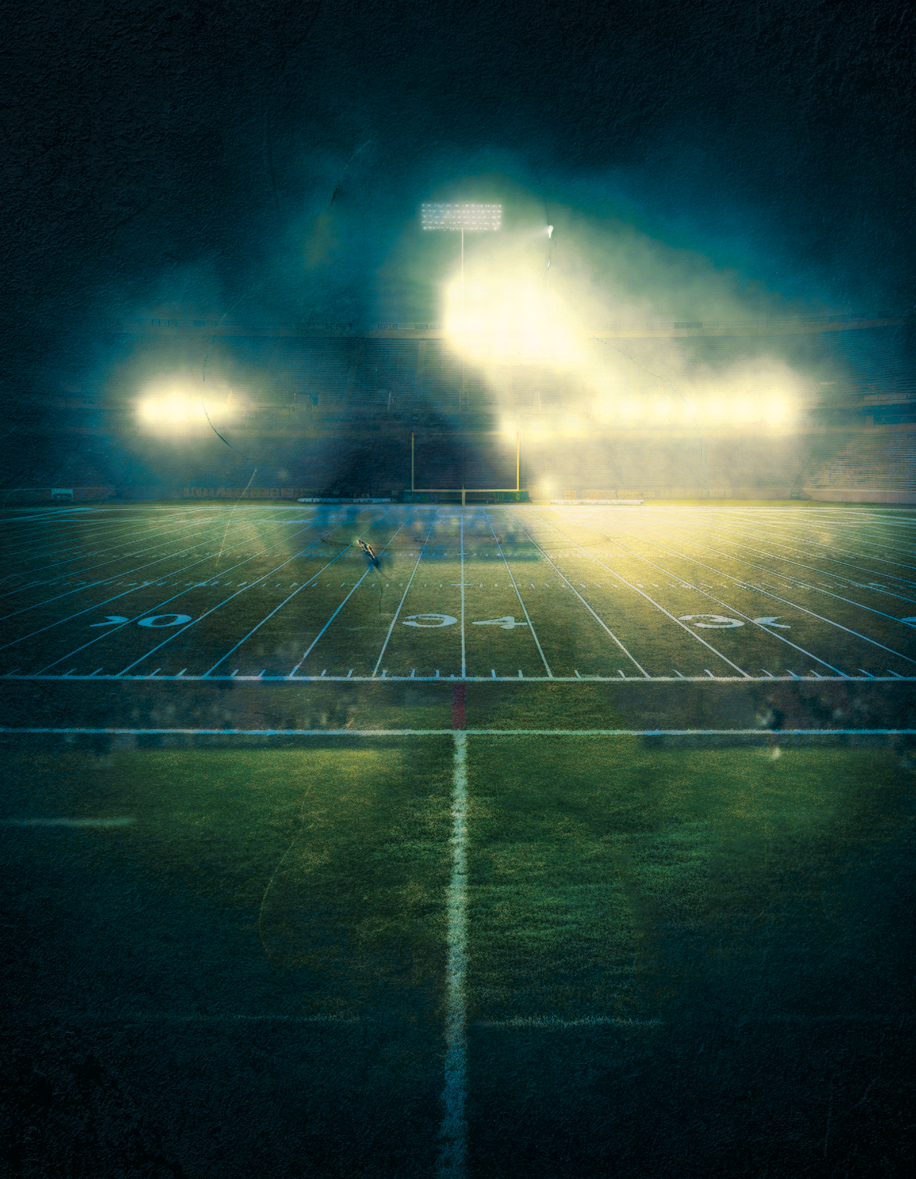
F E B R U A R Y 1 1 , 2 0 2 4
SUPER
BOWL
FINAL GAME
TEAMNAME 1
vs
TEAMNAME 2
YOUR CLUB NAME, 19TH AVENUE, NY
DOOR OPEN AT 5PM, ENTRY 5$
More info: 905-958-95-95 - run@gmail.com - runsite.com

