Slide 1



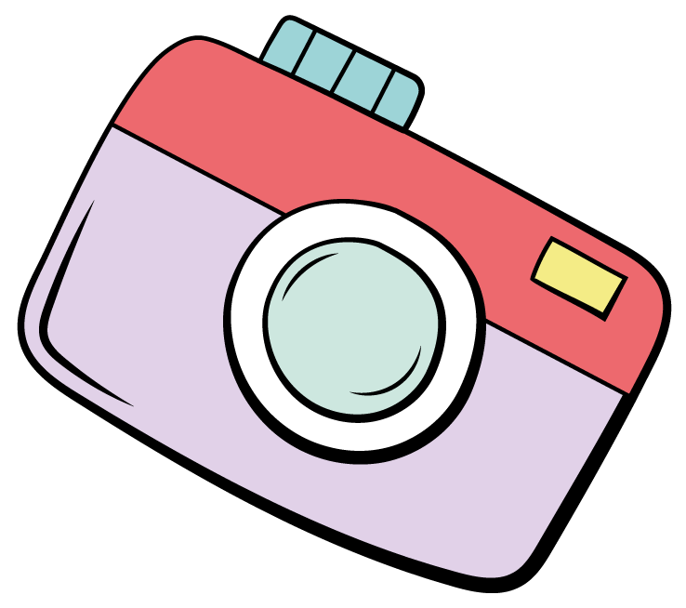
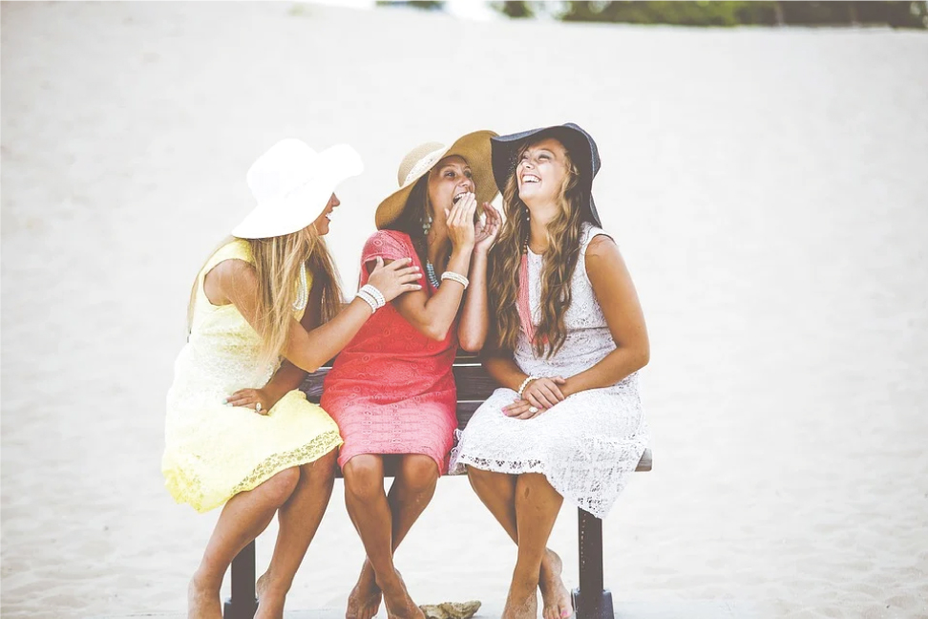


WHAT TO PACK
TO BEACH VACATION
Beach Gear
Umbrella
Beach Cart
Waterproof Blanket
Hooded Towel
Beach Chair
Fun
Beach Toys
Mini Pool
Kites
Bubbles
Sun/Bug Protection
Sunscreen
Water Shoes
Misting Fan
Bug Repellent
Anti-Itch Cream
21 AUGUST, SATURDAY

