Slide 1
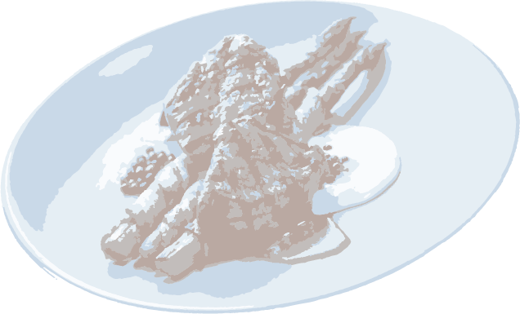
Treutel

Slide 2
Mohamed
Treutel
Treutel
Master Chef
86735 Floyd River, Rempelhaven
Bilzen, 12852
+1 234-567-8901
example@mail.com
www.example.com

