Slide 1
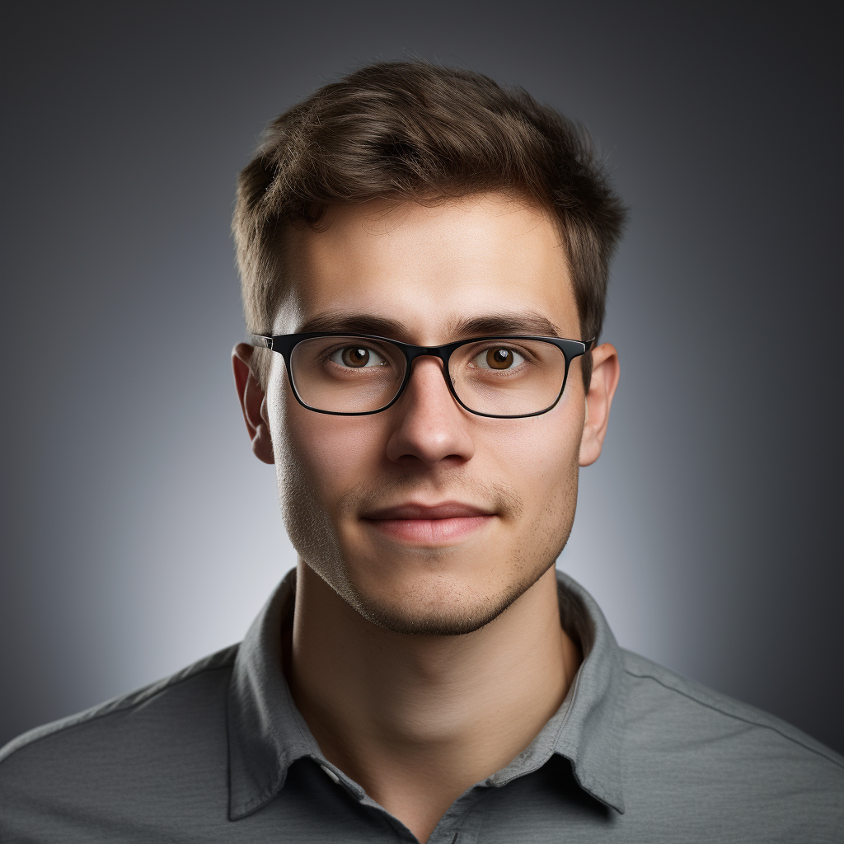


Alex Johnson
alex@techresume.com
321-456-7890
Lead Software Developer
linkedin.com/in/alexjohnson
Denver, CO
Experienced and innovative Lead Software Developer with over 15 years of experience in creating and implementing cutting-edge software solutions to enhance business efficiency. Highly skilled in all phases of the software development lifecycle and comprehensive project management, from initial concept to final deployment. Consistently acknowledged as a proactive and adept leader, proficient in managing cross-functional teams in a high-speed, deadline-driven environment to ensure timely project completion within budget constraints.
AREAS OF EXPERTISE
Project Management
Proficient Troubleshooting
Scrum & Agile Methodologies
Software Development Lifecycle
Team Leadership & Supervision
Web Application
Design & Development
Technical Process Improvement
WORK EXPERIENCE
Lead Software Developer
05/2015 - Present
NovaTech Solutions, Inc.
Denver, CO
Led and mentored a team of 6 junior developers in creating a comprehensive upgrade to the company's software suite, resulting
in enhanced user satisfaction and a 40% revenue increase within a year.
Efficiently resolved simple and intricate technological issues across various projects, achieving a 97% customer satisfaction rate.
Improved application features to effectively eliminate bugs and optimize overall performance, reliability, and efficiency.
Software Engineer / Team Lead
03/2012 - 04/2015
AlphaTech Innovations
Denver, CO
Delivered prompt solutions and proactive troubleshooting to swiftly address subtle and complex issues as the Team Lead.
Documented all supported systems and applications to effectively train new and existing team members.
Identified improvement areas by periodically reviewing the current company systems to consistently enhance business
efficiency.
Developed and applied strategic methodologies to analyze client databases and create mapping specifications efficiently.
EDUCATION
Master of Science in Computer Science
Bachelor of Science in Computer Science
University of Colorado Boulder
Colorado State University
08/2004 - 05/2006
08/2000 - 05/2004
Specialization: Software Engineering and AI
Minor: Mathematics
Thesis: "Optimizing Machine Learning Algorithms"
Senior Project: "Real-Time Web Application for Environmental"
GPA: 3.9/4.0
GPA: 3.8/4.0

