Slide 1
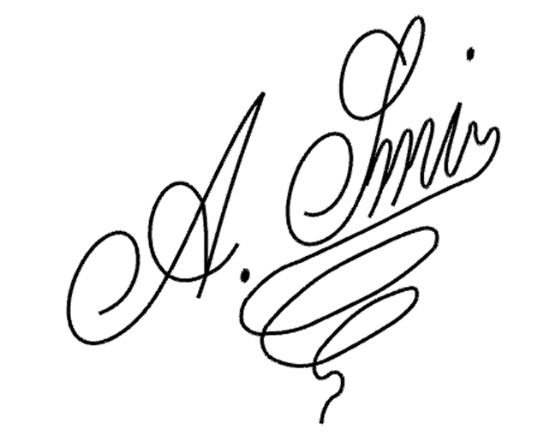
To: [Teacher’s/Principal’s Name],
[School Name]
Date: [MM/DD/YYYY]
Absent Letter
Dear [Teacher’s/Principal’s Name],
I am writing to inform you that my child, [Student Name], was absent from school on [date(s)] due to [brief reason – e.g., illness, family emergency, travel].
We appreciate your understanding and apologize for any disruption this may have caused. If possible, please let us know about any classwork or assignments that need to be completed so [Student Name] can stay on track with their studies.
Thank you for your understanding. If you have any questions or need any further information, please feel free to contact me at [phone number].
Sincerely,
[Parent’s Name]

