Slide 1
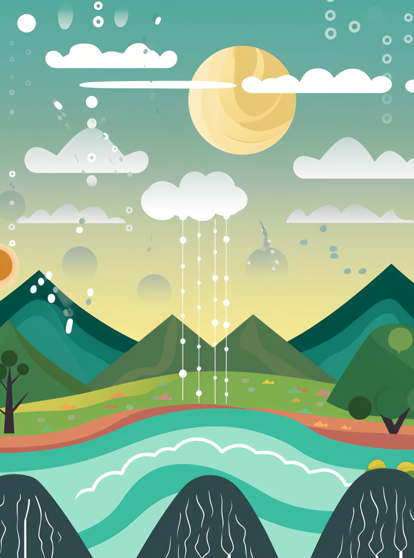
THE CURIOUS SCIENTIST
Unlocking the Wonders
One Discovery at a Time
The Amazing Journey
of Water!
How Water Travels
Around the Earth
Water is one of the most important things on Earth. But did you know that the water we drink, swim in, and play with has been on an amazing journey for millions of years? This journey is called the water cycle, and it keeps water moving around our planet, making life possible.
Let's start our journey in the ocean, where most of Earth's water is found. On a sunny day, the heat from the Sun warms the ocean's surface, causing water to evaporate and rise into the sky as invisible water vapor. As the vapor rises, it cools down and forms clouds. These clouds are made up of tiny droplets of water that have condensed, and when they get heavy enough, they fall back to Earth as rain, snow, or hail.
But the journey doesn’t stop there! Some of this water might land on a mountain and trickle down as a stream, flowing into rivers that lead back to the ocean. Other drops might soak into the ground, becoming groundwater that plants drink up through their roots. Eventually, all the water finds its way back to the ocean, and the cycle begins again.
This continuous movement of water is essential for all life on Earth. It waters our plants, fills our lakes and rivers, and even powers our weather systems. The next time you take a sip of water, think about the incredible journey it has been on!

Slide 2
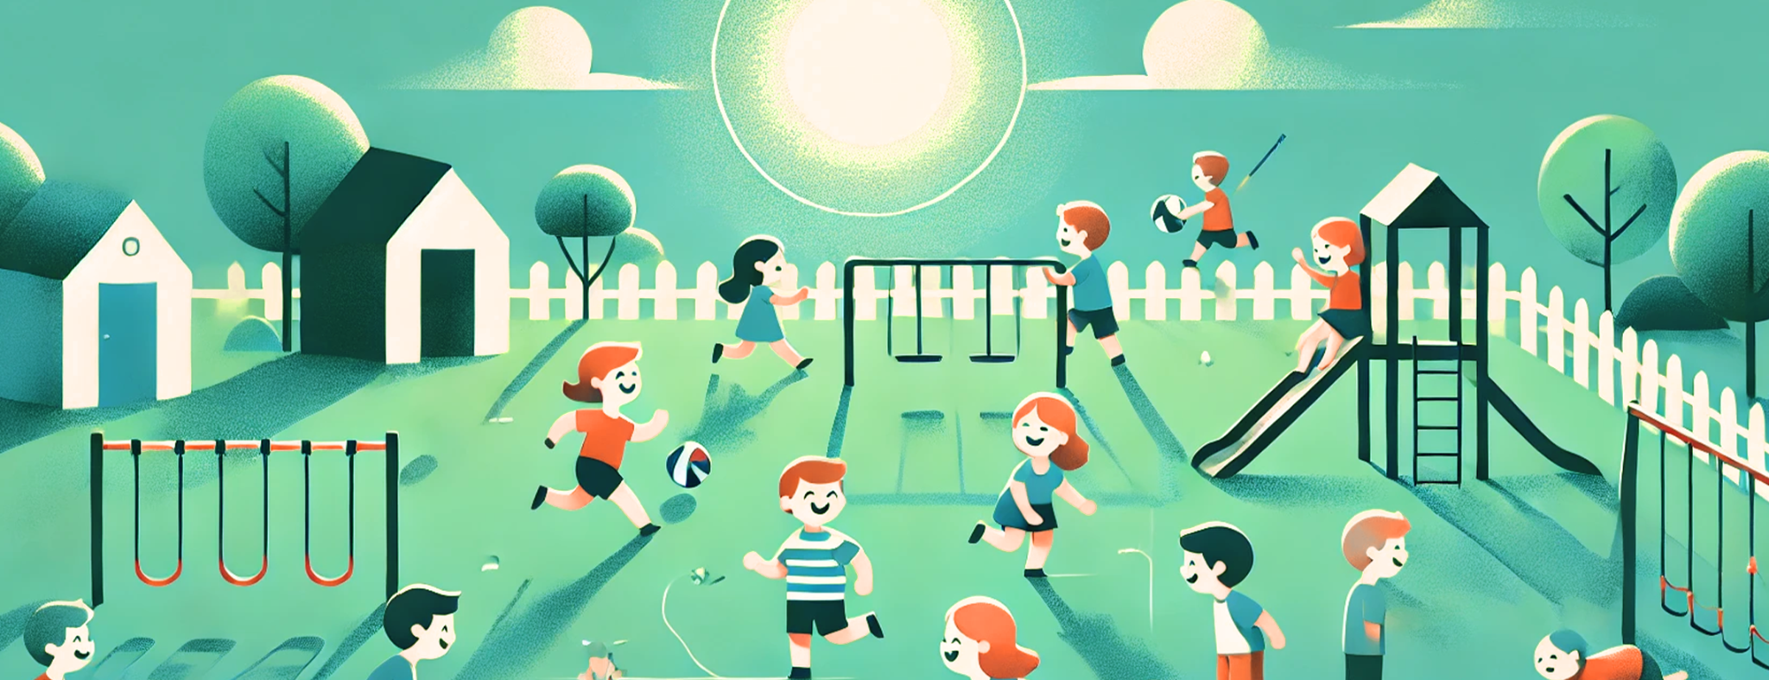
The Sun: Our Star
and Powerhouse
Without the different parts of the planet to receive varying amounts of sunlight throughout the year.
But the Sun's influence goes even further. It helps regulate our daily rhythms, telling our bodies when it's time to wake up and when it's time to sleep. The Sun's energy also drives the water cycle, making it rain and snow, and it's the reason why we have wind. All of these processes are interconnected, showing just how vital the Sun is to everything on Earth. All of these processes are interconnected, showing just how vital the Sun is to everything on Earth. All of these processes are interconnected, showing just how vital.
Why the Sun is So Important to Life on Earth
The Sun is the star at the center of our solar system, and it's much more than just a bright light in the sky. This massive ball of burning gas is a powerhouse of energy, providing the heat and light necessary for life on Earth. But how exactly does the Sun affect everything around us?
At the heart of the Sun, hydrogen atoms are constantly being smashed together in a process called nuclear fusion. This process releases a tremendous amount of energy, which travels through space and reaches Earth as sunlight. This sunlight is crucial for life. It warms our planet, helps plants grow, and powers the weather systems that bring us rain and wind.
Plants use sunlight to make food in
a process called photosynthesis.
So, next time you step outside on a sunny day, take a moment to appreciate the Sun, our very own star, and the life-giving energy it provides.
The Sun is the star at the center of our solar system, and it's much more than just a bright light in the sky. This massive ball of burning gas is a powerhouse of energy, providing the heat and light necessary for life on Earth. But how exactly does the Sun affect everything around us?

Slide 3
Why Do Leaves
Change Color?
The Science Behind Autumn’s Beautiful Colors in 4 Simple Points
1
Chlorophyll Breakdown:
During spring and summer, leaves are green because they contain chlorophyll, a chemical that helps plants convert sunlight into energy. As autumn approaches, days become shorter and temperatures drop, signaling trees to prepare for winter.
2
Revealing Hidden Colors:
As the chlorophyll breaks down, other pigments in the leaves start to show. Carotenoids, which are always present but usually masked by chlorophyll, give leaves their yellow and orange hues their yellow and orange hues their yellow and orange hues.
3
Anthocyanin Production:
These pigments produce red and purple shades in the leaves. Interestingly, anthocyanins may help protect the leaves from sun damage or assist the tree in recovering nutrients before the leaves fall off.
4
Weather Impact:
The intensity of autumn colors can vary from year to year based on the weather. Sunny days and cool nights tend to produce the most vibrant colors. The sunlight increases sugar concentration in the leaves, which enhances the production of anthocyanins, leading to deeper reds and purples.

Slide 4
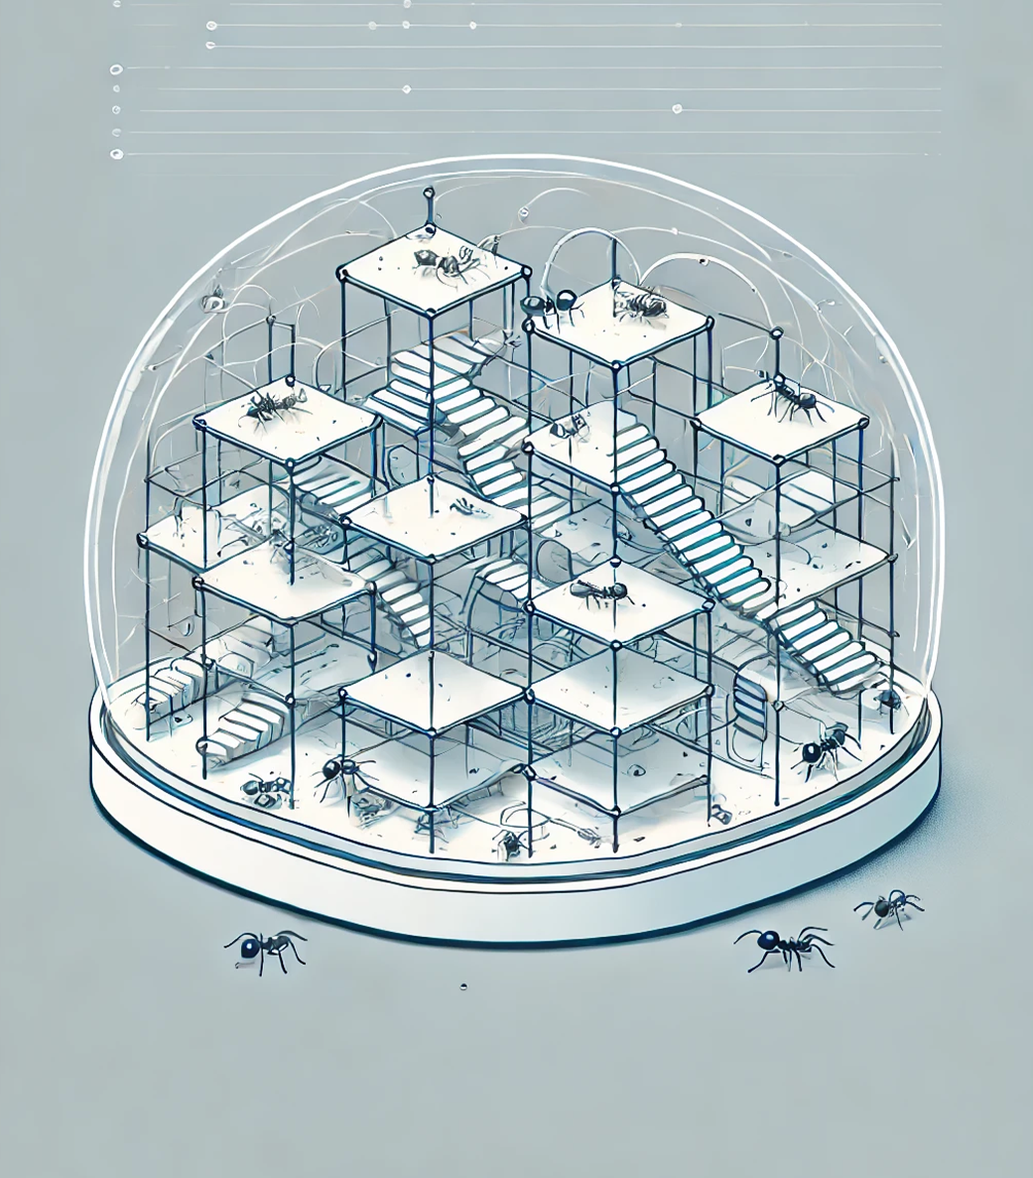
Meet the Mini
Engineers: Ants!
The Incredible Homes Built by Tiny Insects
Ants might be small, but they are some of the most hardworking and organized creatures on Earth. Living in complex societies called colonies, these tiny insects build some of the most intricate homes in the animal kingdom. Let's take a closer look at how these mini engineers create their amazing underground cities.
Each ant colony can house thousands, even millions, of ants. These colonies are like bustling cities, with different rooms and tunnels designed for specific purposes. There are chambers for storing food, nurseries where the queen's eggs are cared for, and special rooms where worker ants rest after a long day of work. Some ant species even have "farms" where they grow fungus to eat!
The construction of an ant colony is a team effort. Worker ants dig the tunnels and chambers using their powerful jaws, carrying tiny grains of soil to the surface. As they dig, they work together in perfect harmony, following chemical trails left by other ants to know where to go and what to do. The result is an underground network that keeps network that keeps the colony safe and organized.
Ants also have special roles within the colony. Some are workers, others are soldiers that protect the colony.

