Slide 1
01 JULY 2025
SCIENCE DIGEST
№10
"This is a significant leap in our understanding and application of quantum computing," said Dr. Jane Smith, lead researcher.
BREAKTHROUGH IN QUANTUM COMPUTING:
GENE EDITING
CRISPR-CAS9 GENE EDITING
Breakthrough in Quantum Computing: Scientists Achieve Stable Qubit Network
T
his advancement paves the way
for more sophisticated in cryptography, complex simulations, and artificial intelligence. This advancement paves the way for more sophisticated applications in cryptography, complex simulations, and artificial intelligence.
In a groundbreaking development, researchers at MIT have unveiled a new quantum computing algorithm that promises to revolutionize data processing speeds. By leveraging quantum entanglement, the team has managed to achieve a level of computational efficiency previously thought unattainable. In a groundbreaking development, researchers at MIT have unveiled a new quantum computing algorithm that promises to revolutionize data processing speeds. By leveraging quantum entanglement, the team has managed to achieve a level of computational efficiency This advancement paves the way for more sophisticate and artificial intelligence.
Gene Editing Revolution
A
collaborative effort between the
University of California, Berkeley and the Broad Institute has successfully demonstrated the use of CRISPR-Cas9 to eliminate genetic diseases in human embryos. This milestone, achieved in a controlled laboratory setting, opens the door to potential cures for hereditary conditions such as cystic fibrosis and muscular dystrophy. This milestone, achieved in a controlled laboratory setting, opens the door to potential cures for hereditary conditions such as cystic fibrosis. These groundbreaking results highlight the potential.
Our approach shows promise and we're preparing for clinical trials.
Dr. John Miller

Slide 2
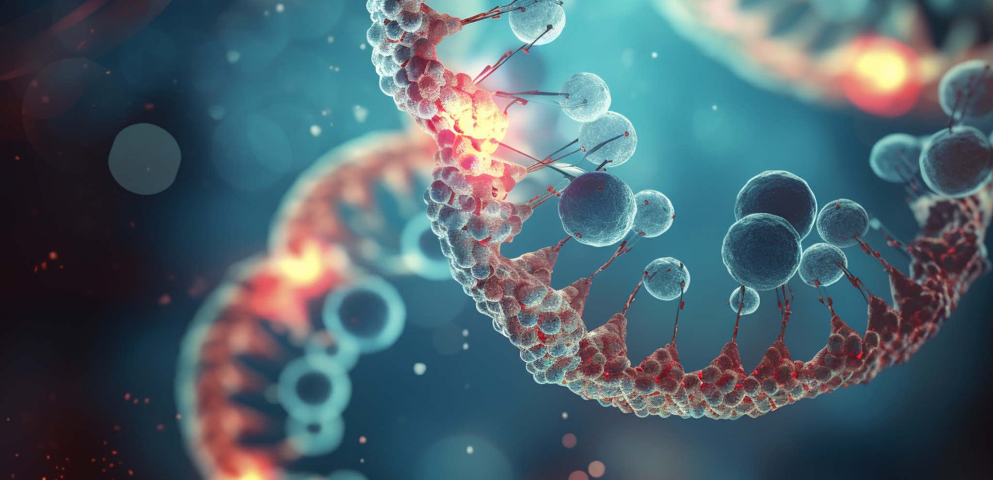
"This is a significant leap in our understanding and application of quantum computing," said Dr. Jane Smith, lead researcher.
GENE EDITING
GENE EDITING BREAKTHROUGH FOR GENETIC DISORDERS
Gene Editing Breakthrough Promises Cure for Genetic Disorders
T
his advancement paves the way
for more sophisticated in cryptography, complex simulations, and artificial intelligence. This advancement paves the way for more sophisticated applications in cryptography, complex simulations, and artificial intelligence.
In a groundbreaking development, researchers at MIT have unveiled a new quantum computing algorithm that promises to revolutionize data processing speeds. By leveraging quantum entanglement, the team has managed to achieve.
In a significant advancement for biotechnology, scientists at the Genomic Research Institute have successfully used CRISPR gene-editing technology to correct a genetic mutation in lab-grown human cells.
This breakthrough offers hope for the development of treatments for a range of genetic disorders, including cystic fibrosis and sickle cell anemia. The research team is now planning clinical trials to test the safety and efficacy of the technique in humans. This breakthrough offers hope for the development of treatments for a range of genetic disorders, including cystic fibrosis and sickle cell anemia and more.
In a groundbreaking development, researchers at MIT have unveiled a new quantum computing algorithm that promises to revolutionize data processing speeds. By leveraging quantum entanglement, the team has managed to achieve a level of computational efficiency In a groundbreaking development, researchers at MIT have unveiled a
This gene editing advancement could transform how we treat genetic diseases.
Dr. Ahmed Khan

Slide 3
NEW STUDY REVEALS ACCELERATING ICE MELT IN ANTARCTICA
Understanding the Acceleration
A
comprehensive study published
in the Journal of Climate Science has revealed that ice melt in Antarctica is occurring at an accelerating rate. The research, conducted by an international team of climate scientists, highlights the urgent need for global action to mitigate the effects of climate change. The study’s findings indicate a potential rise in sea levels that could affect coastal communities worldwide. The research, conducted by an international team of climate scientists, highlights the urgent need for global action to mitigate the effects of climate change. The study’s findings indicate a potential rise in sea levels that could affect coastal communities worldwide. The research, conducted by an international team of climate scientists, highlights the urgent need for global action to mitigate the effects of climate change. The study’s findings indicate a potential rise in sea
comprehensive study published in the Journal of Climate Science has revealed that ice melt in Antarctica is occurring at an accelerating rate. The research, conducted by an international team of climate scientists, highlights the urgent need for global action to mitigate the effects of climate change. The study’s findings indicate a potential rise in sea levels that could affect coastal communities worldwide.
Artist rendition of the Europa Clipper spacecraft en route to Jupiter's moon.
NASA ANNOUNCES MISSION TO EUROPA
We are on the cusp of developing clinical therapies to revolutionize genetic disorder treatments.
In a landmark achievement, researchers at the Quantum Computing Institute have developed the first stable qubit network. This breakthrough is poised to accelerate the development of quant computers, potentially revolutionizing fields from cryptography to materials science. The team used a novel approach to error correction, significantly improving qubit coherence times.
Quantum computing has long been hindered by the instability of qubits, the basic units of quantum information. Traditional methods struggled with maintaining coherence.
Dr. Ahmed Khan
Caption: Melting ice sheets in Antarctica as observed by climate scientists.

Slide 4
BREAKTHROUGH IN QUANTUM COMPUTING:
PREPARING FOR LIFTOFF
Researchers at the Quantum Computing Institute working on the qubit network.
In a landmark achievement, researchers at the Quantum Computing Institute have developed the first stable qubit network. This breakthrough is poised to accelerate the development of quant computers, potentially revolutionizing fields from cryptography to materials science. The team used a novel approach to error correction, significantly improving qubit coherence times.
Quantum computing has long been hindered by the instability of qubits, the basic units of quantum information. Traditional methods struggled with maintaining coherence, leading to errors and limiting the practical use of quantum computers. However, the new approach implemented by the Quantum Computing Institute involves.
I
In a landmark achievement, researchers at the Quantum Computing Institute have developed the first stable qubit network. This breakthrough is poised to accelerate the development of quantum computers, potentially revolutionizing fields from cryptography to materials science. The team used a novel approach to error correction, significantly improving qubit coherence times.
Quantum computing has long been hindered by the instability of qubits, the basic units of quantum information. Traditional methods struggled with maintaining coherence, leading to errors and limiting the practical use of quantum computers. However, the new approach implemented by the Quantum Computing Institute involves an advanced error-correcl.
n a landmark achievement, qubit
researchers at the Quantum Computing Institute have developed the first stable qubit network. This breakthrough is poised to accelerate the development of quantum computers, potentially revolutionizing fields from cryptography to materials science. The team used a novel approach to error correction, significantly improving qubit coherence times.
This breakthrough brings us closer to curing genetic disorders like cystic fibrosis.
Dr. Emily Carter
AI DISCOVERY
AI-POWERED DRUG
New Algorithms Expedite Pharmaceutical Research
A
rtificial intelligence transform
pharmaceutical research. Sciat BioTech Innovations have created an AI algorithm capable of identifying potential drug candidates in a fraction of the time required by traditional methods. This advancement could lead
us to faster development of life-saving medications and a more efficient drug disco Artificial intelligence is transforming pharmaceutical research. Scientists at BioTech Innovations have created an AI algorithm capable of identifying potential drug candidates.
AI algorithms analyzing potential drug candidates.

