Slide 1
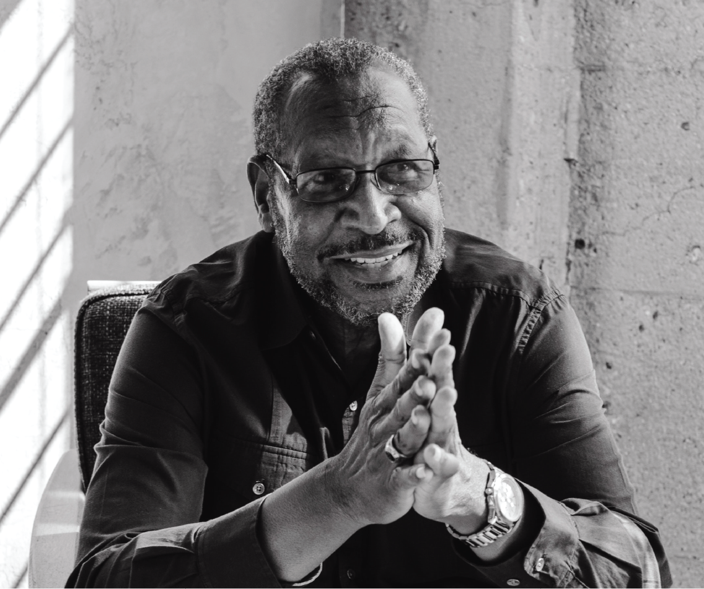
Celebrating the life of
David Davidson
OCTOBER 06, 1977 – MAY 07, 2025
Monday 10 May
123 Anywhere St. Any City, ST 12345
at Six o'clock in the Evening

Slide 2
ORDER OF SERVICE
Closing Remarks
Prelude Music
Invocation
Remarks
Vocal Solo
Guest Speakers
Prayer in the Home
Kimberly Nguyen
Korina Villanueva
Lars Peeters
Neil Tran
Lorna Alvarado
Margarita Perez
Marceline Anderson
PALLBEARERS
Howard Ong
Connor Hamilton
Chiaki Sato
FUNERAL SERVICE
Avery Davis at 123-456-7890
Main building,
123 Anywhere st., Any City

