Slide 1
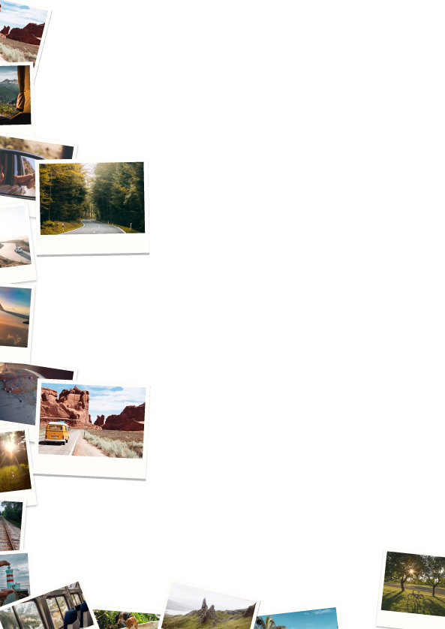
Retirement Bucket List
Try the food from a Michelin star restaurant.
Take an Italian food tour, either in Italy or your hometown, whichever your budget allows.
Take baking lessons and learn to cook some of the world’s most decadent desserts.
Travel to diners and dive restaurants to find some of the best food around.
Spend Mardi Gras along the gulf coast, trying creole cuisines.
Go wine tasting and become a connoisseur of fine wines.
Journey to Egypt and visit the pyramids.
Travel to Africa and go on a safari.
Visit the Holy Land or enjoy the Holy Land Experience.
Take a trip to Hawaii and enjoy some of the island festivities.
Go on a cruise to the Caribbean and enjoy fun in the sun.
Raft down the Amazon River.
Visit the Grand Canyon.
Take a trip to China and visit the Great Wall.
Trip to the Bermuda Triangle.
Take a helicopter tour.
Visit the Eiffel Tower and enjoy some French cuisines.
Go camping and fishing. Take your grandchildren with you to make it a great family experience.
Go canoeing and enjoy the view of some of the most breathtaking waters around.
Learn to go horseback riding.
Plant a vegetable garden and learn to can the goods that you grow.
Ride on a camel.
Take a hot air balloon ride and enjoy the amazing landscapes from a thousand or more feet in the air.
Take scuba diving lessons or go snorkeling.
Watch sunrises and sunsets. Take your camera with you to capture the breathtaking sights that you see.
Take flying lessons, and learn how to fly a helicopter or airplane.
Begin freelance writing and blogging.
Take swimming lessons.
Take cooking lessons. Learn how to cook classic dishes on specific cultures.
Vacation alone.
Join a community theater and learn acting skills and perform in plays.
Learn to play a musical instrument.
Take a self-defense class.
Take art lessons. Learn to paint or work with pottery.
Give blood.
Raise money for charity.
Volunteer at an animal shelter. Walk dogs, play with them, feed, and clean up after them.
Serve on the board of community organizations that are dear to your heart.
Speak at local schools and colleges, passing on your knowledge to the next generation.
Take on restoration projects and involve others, teaching them this skill.
Teach English as a second language.
Volunteer at community events.

