Slide 1

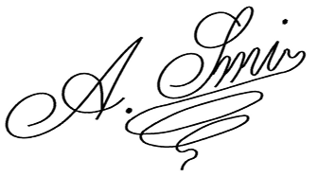

RESIGNATION LETTER
EFFECTIVE IMMEDIATELY
[Your Name]
[Your Address]
[City, State, ZIP Code]
[Email Address]
[Phone Number]
[Date]
[Recipient’s Name]
[Recipient’s Position/Title]
[Company Name]
[Company Address]
[City, State, ZIP Code]
Subject: Immediate Resignation
Dear [Recipient’s Name],
I am writing to formally resign from my position at [Company Name], effective immediately.
Due to personal reasons, I am unable to continue in my current role. I regret any inconvenience this sudden decision may cause and will assist with the handover as needed.
I would like to express my sincere gratitude for the opportunities and experiences I have had during my time with [Company Name]. It has been a pleasure to work alongside such a talented and supportive team.
I will promptly return any company property in my possession and am available to assist with the offboarding process to ensure an efficient handover.
Thank you for your understanding. I wish the company continued success and growth in the future.
Sincerely,
[Your Name]

