Slide 1
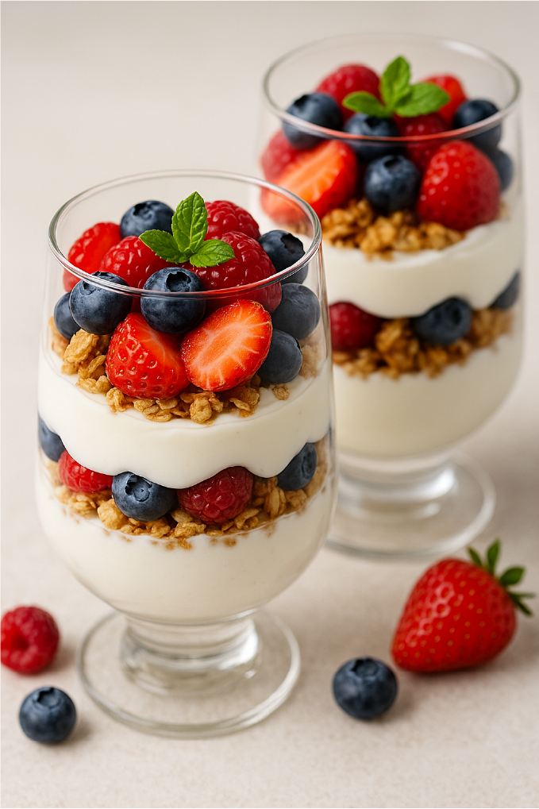
Vanilla Yogurt Parfaits with Berries
Light, creamy, and fruity — perfect for a quick treat or a casual dinner party.
Ingredients:
1 cup (240g) Greek yogurt (vanilla or plain)
1 tablespoon honey or maple syrup (optional)
½ teaspoon vanilla extract (if using plain yogurt)
½ cup granola
1 cup mixed fresh berries
A few mint leaves (optional, for garnish)
Directions:
1. | In glasses, layer yogurt, granola, and berries.
2. | Repeat layers, ending with berries.
3. | Garnish with mint.
4. | Chill if desired or serve immediately.
 |  |  |  | Recipe Details:
 |  |  |  | Prep time: | 10 minutes
 |  |  |  | Chill time: | 30 minutes
 |  |  |  | Total time: | 10–40 minutes
 |  |  |  | Difficulty: | Easy
 |  |  |  | Servings: | 2
Note:
You can use any seasonal fruit or add a spoonful of jam between the layers.

Slide 2
Vanilla Yogurt Parfaits with Berries
Light, creamy, and fruity — perfect for a quick treat or a casual dinner party.
Note: |  |  |  |  | Recipe Details:
 |  |  |  |  | Prep time: | 10 minutes
 |  |  |  |  | Chill time: | 30 minutes
 |  |  |  |  | Total time: | 10–40 minutes
 |  |  |  |  | Difficulty: | Easy
 |  |  |  |  | Servings: | 2
Directions continued:
1. | Prepare the | In a small bowl, stir together the Greek yogurt, honey, and vanilla
 | yogurt: | extract until smooth. If you're using flavored yogurt, you can skip
 |  | the honey and vanilla.
2. | Wash and prep | Rinse your berries gently under cool water. Slice any larger fruits like
 | the fruit: | strawberries. Pat dry with a paper towel.
3. | Layer the | In a glass or jar, add a few spoonfuls of yogurt at the bottom.
 | parfait: | Sprinkle a layer of granola over the yogurt. Add a layer of fresh berries.
 |  | Add another layer of yogurt, followed by granola and then berries.
4. | Repeat the | You can adjust the order based on preference.
 | layers: | Top with a mint leaf for a fresh look. You can serve the parfait!
5. | Garnish and | Top with a mint leaf for a fresh look. You can serve the parfait right
 | chill: | away for a crunchy texture or refrigerate for 30 minutes if you
 |  | prefer a softer granola.

