Slide 1
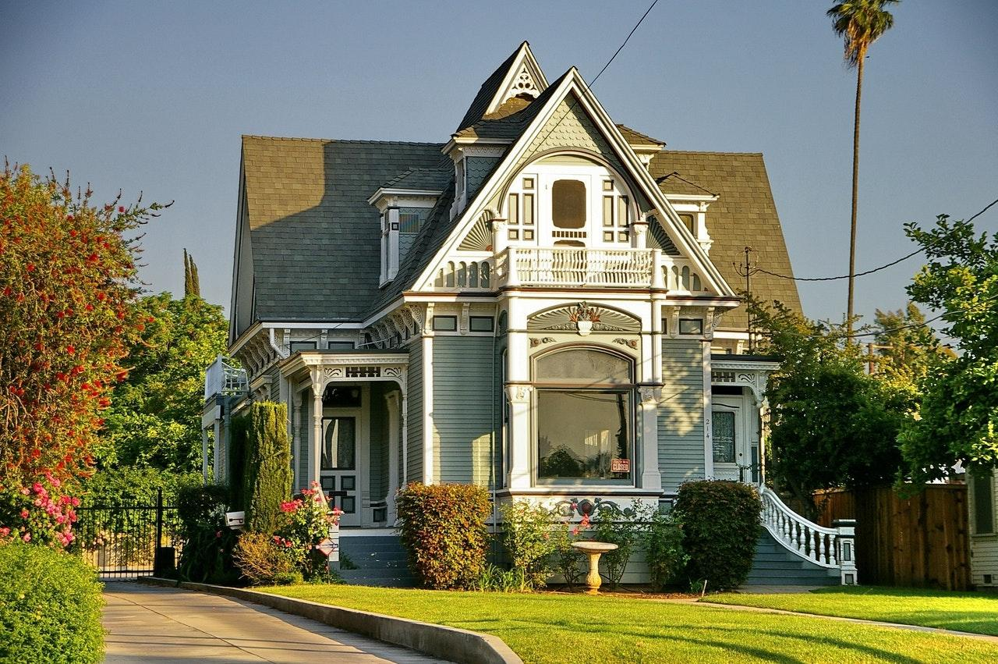
Real Estate
Business Card

Slide 2
RIVER CONNER
Realtor
123-456-7890
098-765-4321
Real Estate
Business Card
example@mail.com
example.com
Dooley Gateway,
Jedidiahstad

