Slide 1
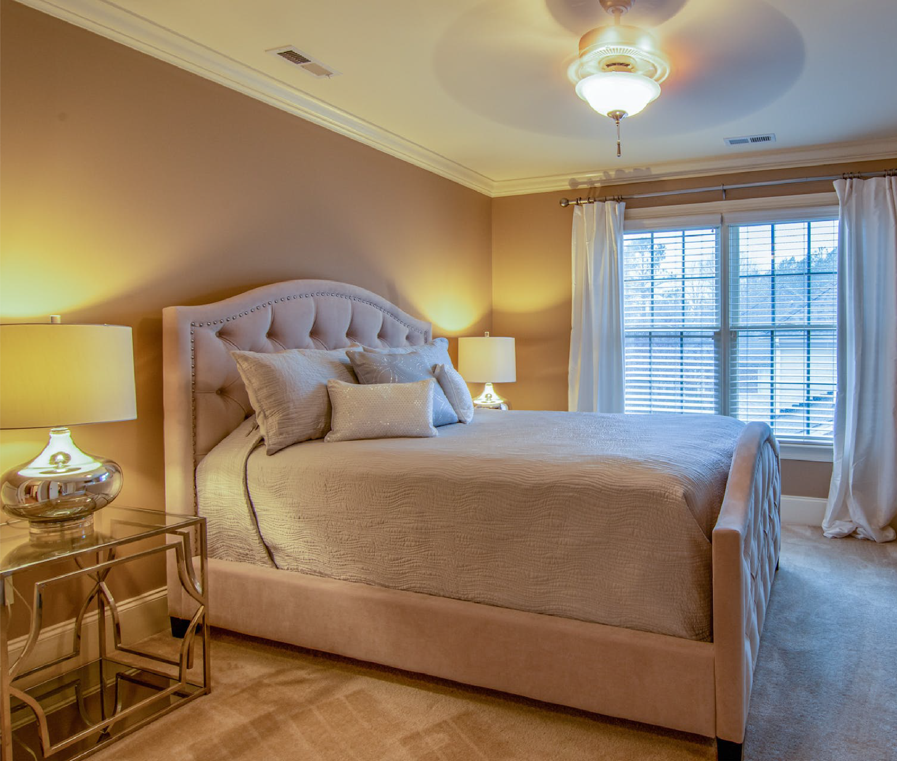
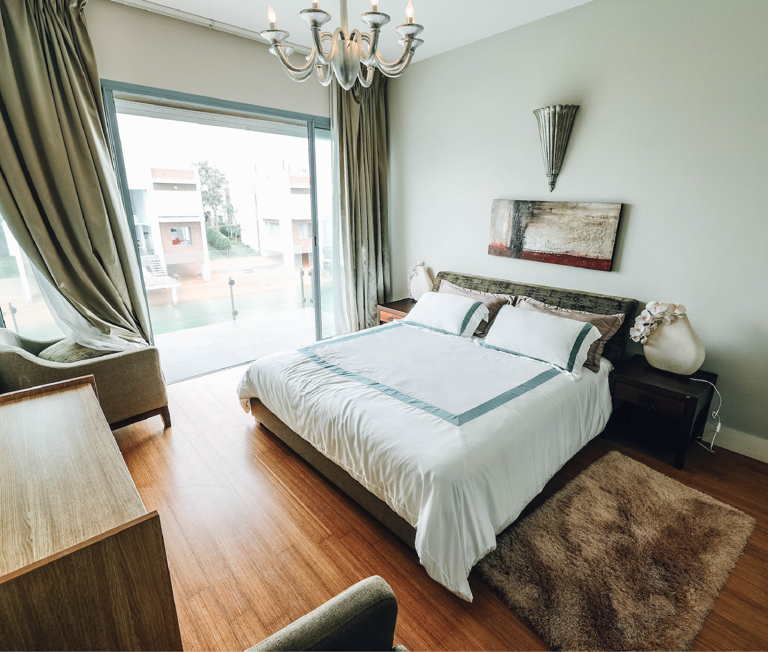
REALTOR
CONTACTS:
YOUR
DREAM HOME
Garett Durgan
AWAITS
Web: realtorgarettdurgan.com
Phone: +1 970-703-8234
E-Mail: Dreamhome@mail.com
Dreamhome.com
Discover Your Perfect Property on
Dreamhome.com

Slide 2
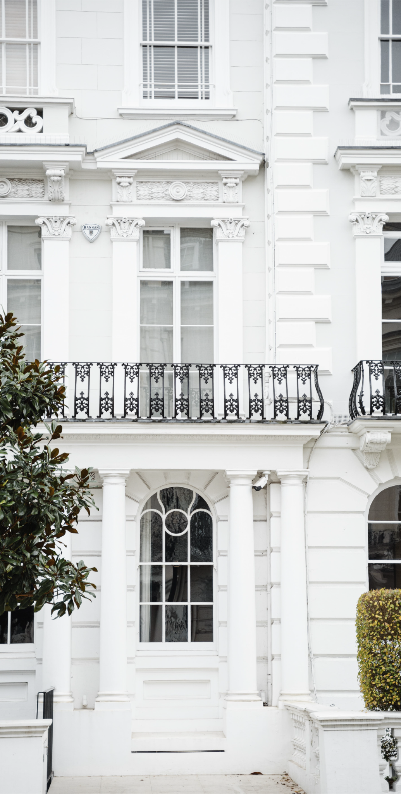
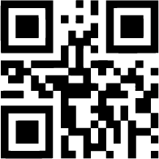
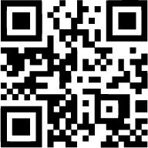
ABOUT
COMPANY:
FEATURED
PROPERTIES:
1:
Urban Luxury
Apartment
At Dream Home, we understand that real estate isn't just about properties; it's about the lives, dreams, and futures they represent. With a foundation built on trust, expertise, and innovation, we pride ourselves on offering unparalleled service to our clients.
With 25 years of experience in the industry, we've established ourselves as a cornerstone in the local real estate market. Our team of dedicated professionals combines market knowledge with a client-centric approach, ensuring that every transaction is smooth, transparent, and tailored to your needs.
• A stylish 2-bedroom apartment in the heart of the city, offering stunning views and access to vibrant city life.
• High-end finishes, panoramic windows, amenities like gym, rooftop terrace, and nearby entertainment options.
2:
Suburban
Family Retreat
• A spacious 4-bedroom home with a large backyard, perfect for families seeking comfort and tranquility.
• Open floor plan, modern kitchen, landscaped garden, proximity to schools and amenities.
“
More Photos and Offers Here
”

