Slide 1
PRODUCT LIFECYCLE
MANAGEMENT
The Stages of a Product’s Journey

Slide 2
PRODUCT
LIFECYCLE
Stages of the Product Lifecycle
Development Stage
Maturity Stage
Description: This is the initial phase where a product is conceptualized, designed, and developed.
Description: Sales growth starts to slow down as the product reaches peak market penetration.
Introduction Stage
Decline Stage
Description: The product is launched into the market.
Description: Sales begin to decline as the product becomes outdated or loses relevance.
Growth Stage
Description: The product starts gaining market
acceptance and sales increase rapidly.

Slide 3
Product Lifecycle Management
Development
Growth
Decline
Stage
Stage
Stage
Introduction
Maturity
1
Stage
3
Stage
5
2
4
This is the initial phase where a product is conceptualized, designed, and
developed.
The product starts gaining market
acceptance and
sales increase
rapidly.
Sales begin to
decline as the
product becomes outdated or loses relevance.
The product is
launched into
the market.
Sales growth starts
to slow down as the product reaches peak market penetration.

Slide 4
Product Lifecycle Management
01
02
03
04
05
Development
Introduction
Growth
Maturity
Decline
Stage
Stage
Stage
Stage
Stage
This is the initial phase where a product is conceptualized, designed, and
developed.
The product is launched into the market.
The product starts gaining market acceptance and sales increase rapidly.
Sales growth starts to slow down as the product reaches peak market penetration.
Sales begin to decline
as the product becomes outdated or loses relevance.

Slide 5
Product Lifecycle Management
Introduction Stage
Maturity Stage
The product is launched
into the market.
Sales growth starts to slow down as the product reaches peak market penetration.
Development Stage
Growth Stage
Decline Stage
This is the initial phase where
a product is conceptualized, designed, and developed.
The product starts gaining market acceptance and sales increase rapidly.
Sales begin to decline as the product becomes outdated or loses relevance.

Slide 6
Product Lifecycle Management
Decline
Stage
Maturity
Stage
Growth
Stage
Sales begin to decline as the product becomes outdated or loses relevance.
Introduction Stage
Sales growth starts to slow down as the product reaches peak market penetration.
Development
Stage
The product starts gaining market acceptance and sales increase rapidly.
The product is launched
into the market.
This is the initial phase where a product is conceptualized, designed, and developed.
01
02
03
04
05

Slide 7
Product Lifecycle Management
Чч
Чч
Чч
Чч
Чч
Development Stage
Introduction Stage
Growth Stage
Maturity Stage
Decline Stage
This is the initial phase where a product is conceptualized, designed, and developed.
The product is launched
into the market.
The product starts gaining market acceptance and sales increase rapidly.
Sales growth starts to slow down as the product reaches peak market penetration.
Sales begin to decline as the product becomes outdated or loses relevance.

Slide 8
Product Lifecycle Management
Development
Introduction
Growth
STAGE 1
STAGE 2
STAGE 3
This is the initial phase where a product is conceptualized,
designed, and developed.
The product is launched
into the market.
The product starts gaining market acceptance and sales increase rapidly.
Decline
Maturity
STAGE 5
STAGE 4
Sales begin to decline as the product becomes outdated or loses relevance.
Sales growth starts to slow down as the product reaches peak market penetration.

Slide 9
Product Lifecycle Management
1
2
Development Stage
Introduction Stage
This is the initial phase where a product is conceptualized, designed, and developed.
The product is launched into the market.
3
4
Growth Stage
Maturity Stage
The product starts gaining market acceptance and sales increase rapidly.
Sales starts to slow down as the product reaches peak market penetration.
5
Decline Stage
Sales begin to decline as the product becomes outdated or loses relevance.

Slide 10
Product Lifecycle Management
Introduction
Maturity
The product is launched
into the market.
Sales starts to slow down as the product reaches peak market penetration.
2
4
Development
Growth
Decline
This is the initial phase where
a product is conceptualized, designed, and developed.
The product starts gaining market acceptance and sales increase rapidly.
Sales begin to decline as the product becomes outdated or loses relevance.
1
3
5

Slide 11
Product Lifecycle Management
01
02
03
04
05
Development
Introduction
Growth
Maturity
Decline
This is the initial phase where a product is conceptualized,
designed, and
developed.
The product is
launched into the
market.
The product starts
gaining market acceptance and
sales increase rapidly.
Sales starts to slow
down as the product reaches peak market penetration.
Sales begin to
decline as the
product becomes outdated or loses relevance.

Slide 12
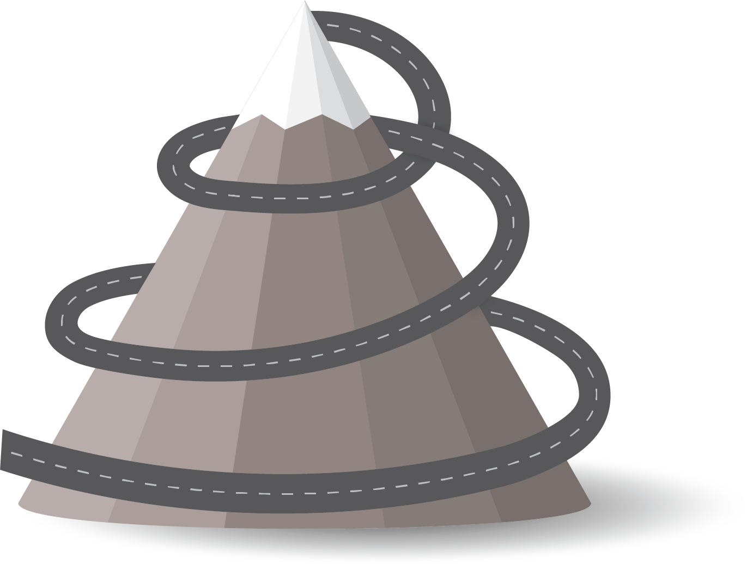
Product Lifecycle Management
Development Stage
Maturity Stage
This is the initial phase
where a product is
conceptualized, designed,
and developed.
Sales growth starts to slow down as the product reaches peak market penetration.
Introduction Stage
Decline Stage
The product is launched into
the market.
Sales begin to decline as the product becomes outdated or loses relevance.
Growth Stage
The product starts gaining
market acceptance and sales
increase rapidly.

Slide 13
Product Lifecycle Management
1
2
3
4
5
Development
Introduction
Growth
Maturity
Decline
Stage
Stage
Stage
Stage
Stage
This is the initial phase
where a product is conceptualized, designed, and developed.
The product is
launched into the
market.
The product starts gaining market acceptance and
sales increase rapidly.
Sales growth starts to slow down as the product
reaches peak market penetration.
Sales begin to decline as
the product becomes outdated or loses
relevance.

Slide 14
Product Lifecycle Management
Development
Introduction
Growth
Stage 01
Stage 02
Stage 03
This is the initial
phase where a
product is
conceptualized,
designed, and
developed.
The product is
launched into
the market.
The product
starts gaining market accep-
tance and sales
increase rapidly.
Maturity
Decline
Stage 04
Stage 05
Sales growth
starts to slow
down as the
product reaches
peak market
penetration.
Sales begin to decline as
the product
becomes
outdated or
loses relevance.

Slide 15
Product Lifecycle Management
Development
Introduction
Growth
Maturity
Decline
Stage 01
Stage 02
Stage 03
Stage 04
Stage 05
This is the initial phase
where a product is
conceptualized,
designed, and
developed.
The product is launched into the market.
The product starts gaining market acceptance and sales increase rapidly.
Sales growth starts to
slow down as the
product reaches peak
market penetration.
Sales begin to decline as
the product becomes
outdated or loses relevance.

Slide 16
Product Lifecycle Management
Development
Introduction
Growth
Maturity
Decline
This is the initial phase where a product is conceptualized, designed, and developed.
The product is launched
into the market.
The product starts gaining market acceptance and sales increase rapidly.
Sales growth starts to slow down as the product reaches peak market penetration.
Sales begin to decline as the product becomes outdated or loses relevance.

Slide 17
Product Lifecycle Management
Decline
Stage 05
Introduction
Sales begin to decline as the product becomes outdated or loses relevance.
Development
Stage 02
Stage 01
The product is launched into the market.
This is the initial phase where a product is conceptualized, designed, and developed.
Maturity
Stage 04
Sales growth starts to slow down as the product reaches peak market penetration.
Growth
Stage 03
The product starts gaining market acceptance and sales increase rapidly.

Slide 18
Product Lifecycle Management
STAGE 1
STAGE 2
STAGE 3
STAGE 4
STAGE 5
Development
Introduction
Growth
Maturity
Decline
This is the initial phase where a product is conceptualized,
designed, and
developed.
The product is launched into the market.
The product starts gaining market acceptance and sales increase rapidly.
Sales growth starts to slow down as the product reaches peak market penetration.
Sales begin to decline as the product becomes outdated or loses relevance.

Slide 19
Product Lifecycle Management
Growth
The product starts gaining market acceptance and sales increase rapidly.
Decline
Introduction
Sales begin to decline as the product becomes outdated
or loses relevance.
The product is launched
into the market.
Development
This is the initial phase where a product is conceptualized, designed, and developed.
Maturity
Sales growth starts to slow down as the product reaches peak market penetration.

Slide 20
Product Lifecycle Management
Development
Introduction
Growth
Maturity
Decline
Stage 01
Stage 02
Stage 03
Stage 04
Stage 05
This is the initial phase where
a product is conceptualized,
designed, and developed.
The product is launched
into the market.
The product starts gaining market acceptance and sales increase rapidly.
Sales growth starts to slow down as the product reaches peak market penetration.
Sales begin to decline as the product becomes outdated
or loses relevance.

Slide 21
Product Lifecycle Management
1
3
5
Development
Growth
Decline
This is the initial phase where
a product is conceptualized,
designed, and developed.
The product starts gaining market acceptance and sales increase rapidly.
Sales begin to decline as the product becomes outdated or loses relevance.
2
4
Introduction
Maturity
The product is launched into the market.
Sales growth starts to slow down as the product reaches peak market penetration.

Slide 22
Product Lifecycle Management
Introduction
Maturity
The product is launched into the market.
Sales growth starts to slow down as the product reaches peak market penetration.
Development
Growth
Decline
This is the initial phase where a product is conceptualized,
designed, and developed.
The product starts gaining market acceptance and sales increase rapidly.
Sales begin to decline as the product becomes outdated or loses relevance.

Slide 23
Product Lifecycle Management
Development
Introduction
Growth
Maturity
Decline
Stage 01
Stage 02
Stage 03
Stage 04
Stage 05
This is the initial phase where
a product is conceptualized,
designed, and developed.
The product is launched
into the market.
The product starts gaining market acceptance and sales increase rapidly.
Sales growth starts to slow down as the product reaches peak market penetration.
Sales begin to decline as the product becomes outdated
or loses relevance.

Slide 24
Product Lifecycle Management
Introduction
Maturity
The product is launched
into the market.
Sales growth starts to slow down as the product reaches peak market penetration.
02
04
Development
Growth
Decline
This is the initial phase where a product is conceptualized, designed, and developed.
The product starts gaining market acceptance and sales increase rapidly.
Sales begin to decline as the product becomes outdated
or loses relevance.
01
03
05

Slide 25
Product Lifecycle Management
05
Decline
04
Sales begin to decline as the
product becomes outdated or
loses relevance.
Maturity
03
Sales starts to slow down as the product reaches peak market penetration.
Growth
The product starts gaining market acceptance and
sales increase rapidly.
01
02
Development
Introduction
This is the initial phase where a product is conceptualized,
designed, and developed.
The product is launched into the market.

Slide 26
Product Lifecycle Management
01
02
03
04
05
Development
Introduction
Growth
Maturity
Development
This is the initial phase where a product is conceptualized, designed, and developed.
The product is launched into the market.
The product starts gaining market acceptance and sales increase rapidly.
Sales growth starts to slow down as the product reaches peak market penetration.
Sales begin to decline as the product becomes outdated or loses relevance.

Slide 27
Product Lifecycle Management
STAGE 01
STAGE 02
STAGE 03
STAGE 04
STAGE 05
Development
Introduction
Growth
Maturity
Decline
This is the initial
phase where a product
is conceptualized,
designed, and developed.
The product is launched
into the market.
The product starts gaining market acceptance and sales increase rapidly.
Sales growth starts to slow down as the product reaches peak market penetration.
Sales begin to decline as the product becomes outdated
or loses relevance.

Slide 28
Product Lifecycle Management
1
3
5
2
4
Development
Growth
Decline
This is the initial phase where a product is conceptualized,
designed, and
developed.
The product starts gaining market acceptance and sales increase rapidly.
Sales begin to decline as the product becomes outdated or loses relevance.
Introduction
Maturity
The product is launched
into the market.
Sales growth starts to slow down as the product reaches peak market penetration.

Slide 29
Product Lifecycle Management
1
2
3
4
5
Development
Introduction
Growth
Maturity
Decline
This is the initial phase where a product is conceptualized,
designed, and developed.
The product is launched into the market.
The product starts gaining market acceptance and sales increase rapidly.
Sales growth starts to slow down as the product reaches peak market penetration.
Sales begin to decline as the product becomes outdated or loses relevance.

Slide 30
THANK YOU!
Product Lifecycle Management Roadmap Template

