Slide 1
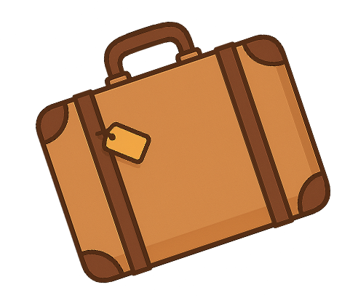

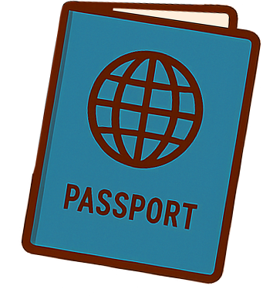
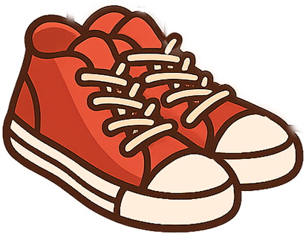

VACATION PACKING LIST
CLOTHING
ELECTRONICS
MISCELLANEOUS
Ties/suspenders
Sport coat
Pajamas/robe/slippers
Dress shirts/dress pants
Casual shirts/t-shirts
Sweaters
Workout clothes/shoes
Swimsuit
Dress shoes
Socks
Casual pants/shorts
Suits
Skirts/dresses
Bras
Hats/scarves/gloves
Underwear
Jackets/coats/sweaters
Casual shoes/sandals
Belts
Shapewear/bodysuit
Nylons/tights
Adapter
Power bank
Laptop, charger
eReader
Extra memory cards
Tablet and accessories
Smart Watch, charger
Electric razor
Tablet, charger, pen
Phone, charger, case
Camera, charger
Headphones
Other
Games/playing cards
Dice
Snacks
Glasses
Travel locks
Keys
Journal
Watch
Sunglasses
Jewelry/accessories
Batteries
Books
Binoculars
Earplugs
Duct tape
Umbrella
Other
MONEY
Debit card/credit card
Checks/travelers checks
Wallet/purse
Cash
TOILETRIES
Shampoo & conditioner
Toothbrush/toothpaste
Cologne
Hair gel/hairspray
Deodorant
Lotion/lip balm
Hair accessories
Facial cleanser
Toothbrush
Tampons/pantiliners
Razor/shave gel
Mouthwash
Tweezers/nail clippers
CHILDREN ITEMS
DOCUMENTATION
Favorite toy
Children's books
Coloring books
Washable markers
Snacks and water bottle
Tablet with games
Headphones for kids
Wet wipes and tissues
Clothes/Shoes
Sweatshirt
Visa
Passport
Tickets
Itinerary
Driver's license
Birth certificate
Travel guide
Map
Immunization records

