Slide 1
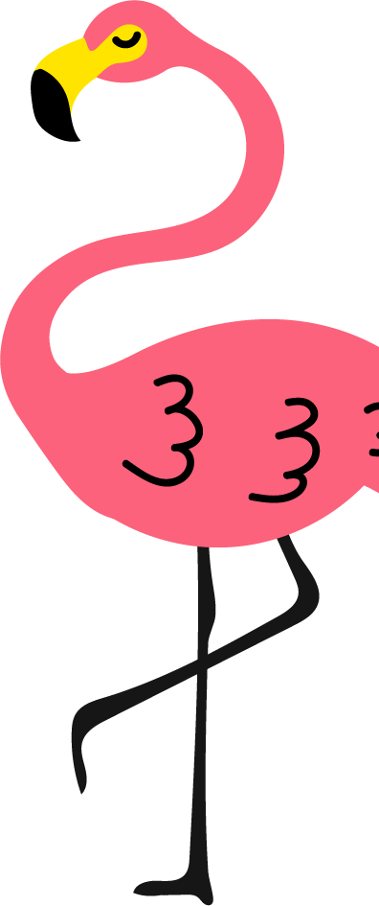
SUMMER
BUCKET LIST
Build a sandcastle
Visit a carnival or fair
Learn to swim or pick up a water sport
Set up an outdoor obstacle challenge
Go berry picking
Have a picnic in the park
Take a family bike ride
Visit a local zoo or aquarium
Visit a historic site
Plan a nature treasure hunt
Try bird watching
Learn basic survival skills
Make homemade popsicles
Build a model airplane or car
Go stargazing
Make homemade playdough or slime
Set up water games outdoor
Volunteer at a local charity
Make and fly a kite
Make a homemade lava lamp
Make DIY stepping stones
Go to a drive-in movie
Create a summer music playlist
Paint a summer art canvas
Do a DIY science experiment
Have a water balloon fight
Organize a neighborhood yard sale
Visit a farmer's market
Create a time capsule
Go on a road trip to a new town
Make shadow puppets
Write your first book
Learn to juggle
Write and perform a play
Make a summer scrapbook
Make a homemade birdhouse
Paint kindness rocks
Learn about a different culture
Try out a new hobby
Visit an amusement park
Start a DIY jewelry-making project
Create pressed flower jar lanterns
Learn about recycling and do a project
Host a movie night under the stars
Go on a leaf hunt (identify leaves)
Have a family board game tournament
Learn to play a musical instrument
Have a tea party
Start a summer journal or blog
Go on a cloud hunt name clouds in the sky
Make tie-dye shirts
Have a family BBQ night
Learn a new dance routine
Create sidewalk chalk art
Go fishing
Start a vegetable garden
Start a summer reading challenge
Have a beach clean-up day
Organize a scavenger hunt
Try bubble painting
Try out yoga or mindfulness exercises
Have a DIY spa day
Make campfire s'mores
Organize a bike parade
Visit a local museum
Go on a nature hike
Create nature sun prints
Learn a new sport
Learn about constellations
Set up an outdoor kitchen and make mud pies
Learn to cook a simple meal
Learn how to do magic tricks
Make mason jar aquariums
Plan a themed dress-up day
Learn to roller skate or skateboard
Visit a national or state park
Visit a farm or petting zoo
Catch fireflies (but release them after)
Make salt dough pinch pots
Paint with flowers
Create a DIY solar oven
Go camping in the backyard
Have a beach day and collect shells
Write a letter to a pen pal
Build a stick fort
Make DIY sponge water bombs
Make an outdoor river with foil
Make suncatchers
Try geocaching
Make a bird feeder
Have a DIY pizza night
Make a homemade pinata
Start a mini book club
Start a collection (rocks, leaves, shells)
Create a family cookbook
Visit a water park
Make homemade ice cream
Visit a botanical garden
Have a DIY photoshoot

