Slide 1

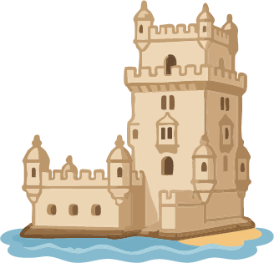



Portugal
Itinerary
Day 1:
Arrival in Lisbon
Stay in Lisbon (Days 1–4)
Day 2:
Lisbon
Day 3:
Belém
Day 4:
Sintra Day Trip
Day 5:
Cascais + Cabo da Roca
Return to Lisbon
Day 6:
Lisbon to Porto
Stay in Porto (Days 6–8)
Day 7:
Porto
Day 8:
Douro Valley Day Trip
Day 9:
Flight from Porto to Faro
Stay in Algarve (Days 9–10)
Day 10:
Algarve + Departure

