Slide 1
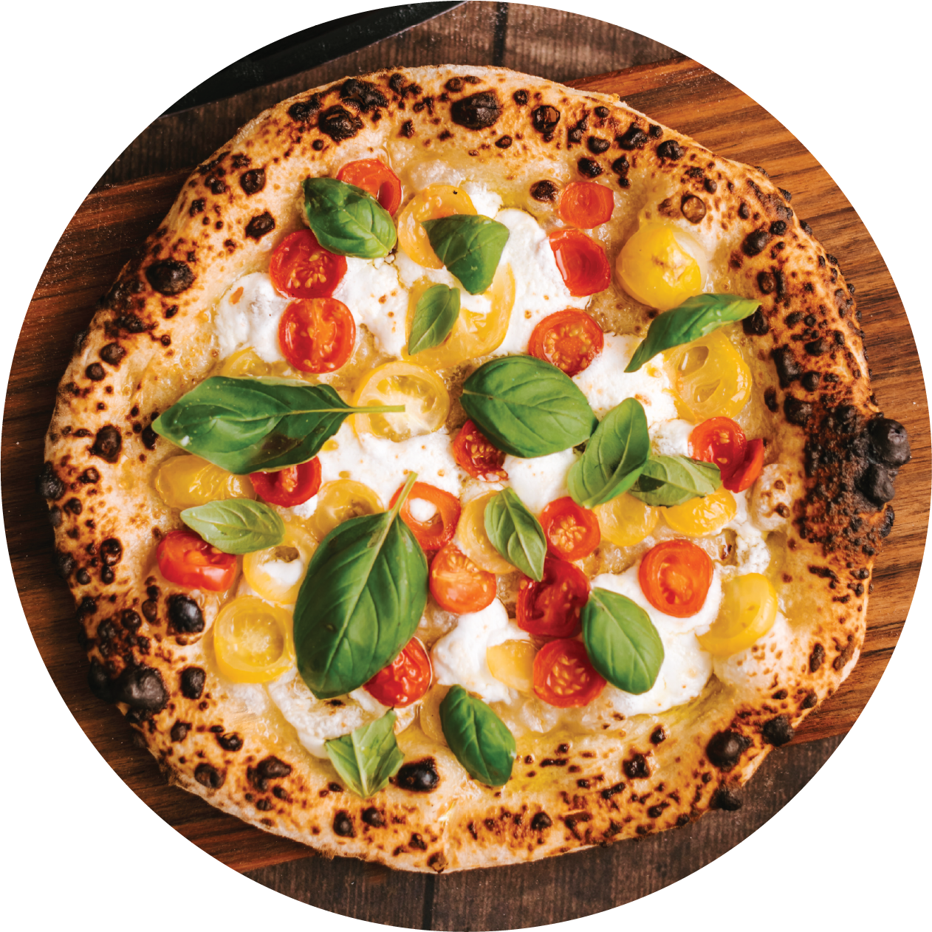
extra
DELICIOUS
PIZZA
PIZZA
The most delicious pizza, tender dough,
delicious toppings, you will find all types
of pizza with us, come while it is hot!

