Slide 1
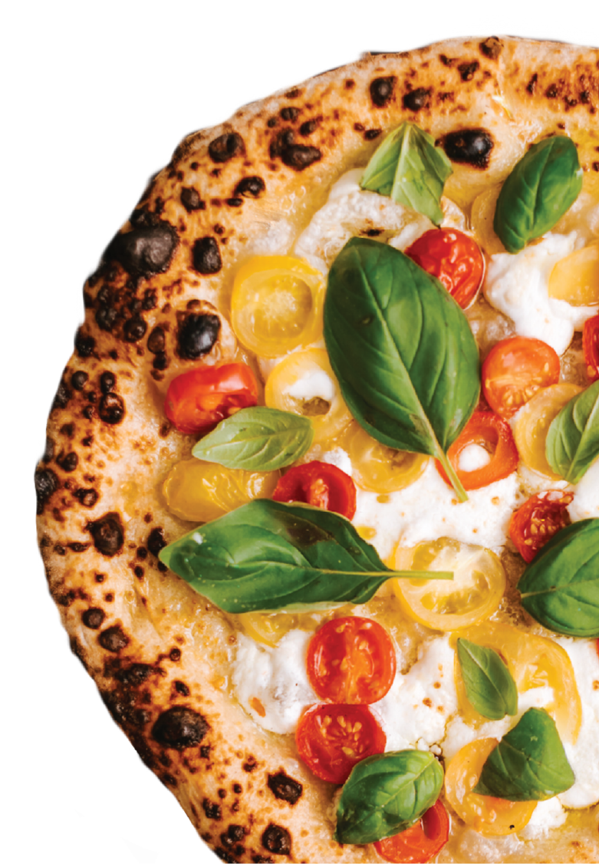
extra
DELICIOUS
PIZZA
Savor Every Slice of Perfection
LET'S BE IN TOUCH:
ORDER NOW:
Deliciouspizza@mail.com
Deliciouspizza.com
261 Green Street, North Little Rock, Arkansas
+1 774-773-1457
Free Home Delivery!
OPEN HOURS
Monday - Friday 8:00am - 9:00pm
Saturday 11:00am - 10:00pm
Sunday Closed
Deliciouspizza.com

Slide 2
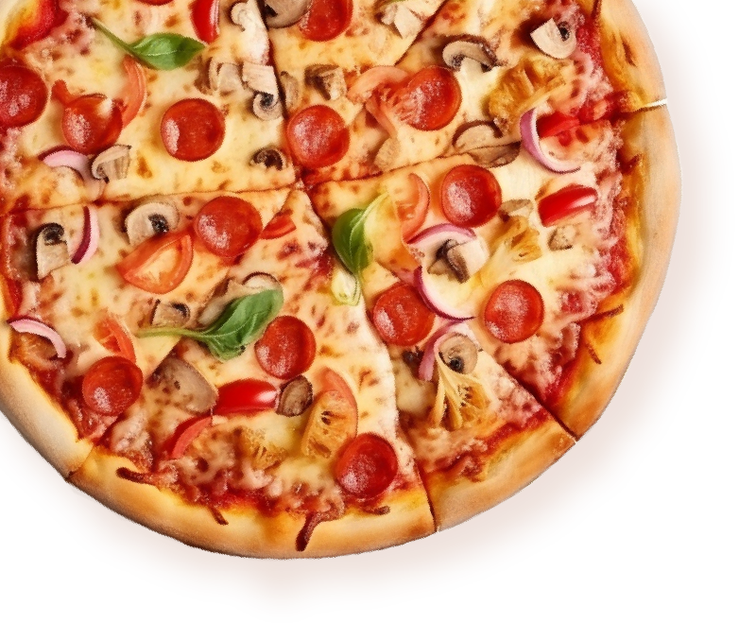
PIZZA
OFFERINGS:
BUILD YOUR
OWN PIZZA:
-20%
Classic Margherita...........................................$18.50
Unleash your creativity! Customize your pizza with a variety of toppings, cheeses, and sauces to suit your taste buds. From pineapple to prosciutto, the choice is yours!
Endless possibilities to create your perfect flavor combination, tailored to satisfy your cravings.
Our homage to tradition, featuring a thin crust topped with vibrant tomato sauce, fresh mozzarella, garden-picked basil leaves, and a drizzle of olive oil.
PIZZA
WELCOME TO
DELICIOUS
PIZZA:
Meat Lover's Supreme..................................$21.50
PIZZA
A carnivore delight! Piled high with generous portions of pepperoni, Italian sausage, savory bacon, and a mix of
cheeses atop our flavorful pizza sauce.
Vegetarian Garden Delight.........................$14.50
Our homage to tradition, featuring a thin crust topped with vibrant tomato sauce, fresh mozzarella, garden-picked basil leaves, and a drizzle of olive oil.
At Delicious Pizza, we believe in crafting more than just pizzas — we create experiences that tantalize taste buds and bring people together. Nestled in the heart of North Little Rock, our restaurant is a haven for pizza enthusiasts seeking a slice of culinary delight.
Spicy BBQ Chicken........................................$18.50
A fusion of flavors! Tender chicken marinated in tangy BBQ sauce, paired with caramelized onions, bell peppers,
and a sprinkle of spicy jalapeños, all topped
with melted cheese.
-15%

