Slide 1
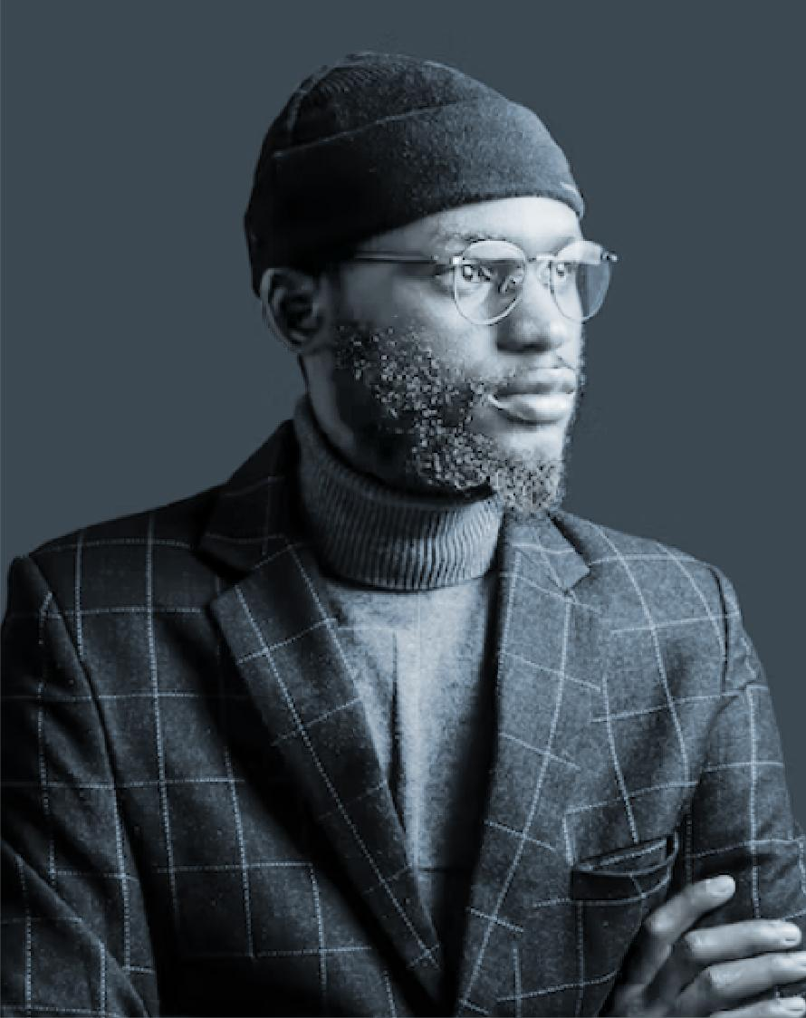
Adeniji
Abdullahi A
P H Y S I C I A N
A S S I S T A N T
P R O F I L E
Personable and professional NCCPA-certified physician assistant with 3+ years expertise in busy, mid-sized clinic. Seeking to leverage successful treatment and care of over 500 patients with traumatic injuries and orthopedic emergencies to become the next physician assistant at Your Place, Any City
C O N T A C T
Phone
123-456-7890
Email
best@gdoc.io
W O R K
E X P E R I E N C E
Address
123 Anywhere st.
Any City
Orthopedic Surgery Physician Assistant
January 2016-March 2019
E D U C A T I O N
Your Work Experience, Any City
2021
Oncology Physician Assistant
January 2015-January 2016
Your Education Place, Any City
Your Work Experience, Any City
Health Technology and Management
Physician Associate Program
A W A R D
2017
Awarded the 2018 AAPA/PAEA
Preceptor of the Year Award
Your Education Place, Any City
Professional Development
Earned "Humanitarian of the
Year" acknowledgment for 2015.
Advanced Patient Care
S K I L L S
L A N G U A G E S
Compassionate
Ultrasound
Spanish (Latin American):
Professional Working Proficiency
Neurofeedback
Epidemiology
Bengali: Limited Working Proficiency

