Slide 1
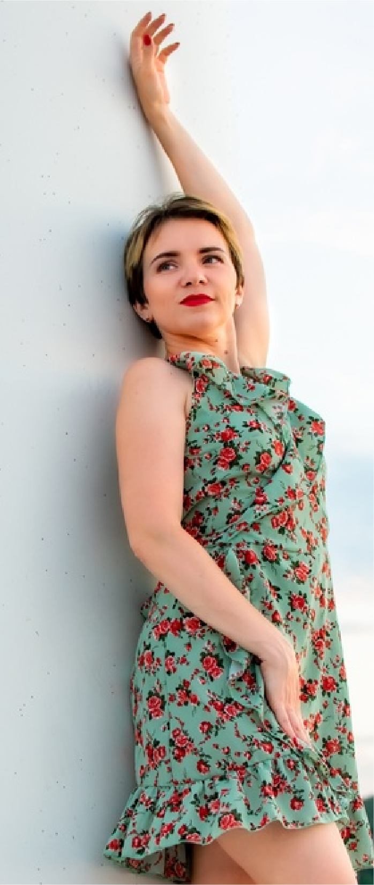
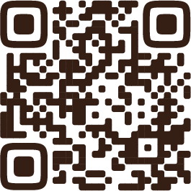
PACKAGE ONE . . . . . . 275$
PACKAGE ONE . . . . . . 275$
One hours session
25 edited pictures
Photo album
One 5 x 7 prints
Online access
PACKAGE TWO . . . . . . 450$
Two hours session
50 edited pictures
Photo album
Three 5 x 7 prints
Online access
PACKAGE THREE . . . 750$
EMMA WILLIAMS
8 hours session
250 edited pictures
Photo album
Canvas print
Online access
INDIVIDUAL SESSION
FASHION PHOTOGRAPHER
One hour . . . . . . . . . . . . . . . . . . 100$
Two hours . . . . . . . . . . . . . . . . . . 180$
Three hours . . . . . . . . . . . . . . . 250$
4 - 5 hours . . . . . . . . . . . . . . . . 350$

