Slide 1
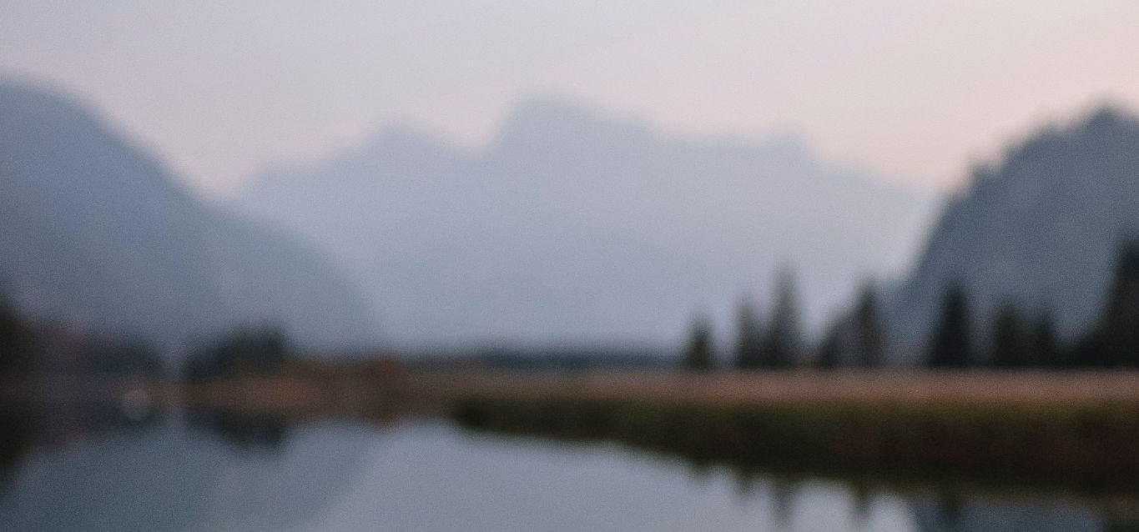

PRICE LIST
60 MINUTE SESSION*
PROFESSIONAL PHOTOGRAPHY
FAMILY PHOTOGRAPHY
$515.00
WEDDING PHOTOGRAPHY
$875.00
*4-6 HOURS
CREATIVE PORTRAIT
$275.00
FILM PHOTOGRAPHY
$485.00

