Slide 1
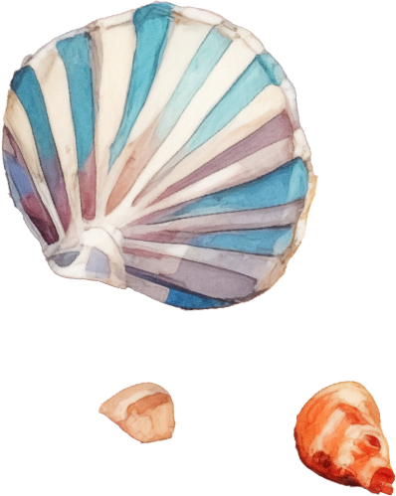
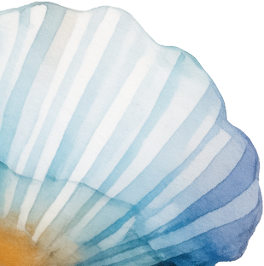
Packing List
for the beach
Clothing:
Beach Gear:
Flip-flops or sandals
Beach umbrella
Swimwear
Canopy
Light clothing
Beach chairs
Hat
Portable beach mat
Sunglasses
Beach tent
Beach towel
Shelter
Beach cover-up
Beach bag or tote
Sun Protection:
Entertainment:
Sunscreen
Frisbee
Lip balm with SPF
Waterproof speaker
Aloe vera gel
Portable music player
Sun hat or umbrella
for extra shade
Books
Water & Snack:
Water bottles (big)
Electrolyte drinks
Granola bars
Snacks
Fruits
Nuts
Cooler bag

