Slide 1
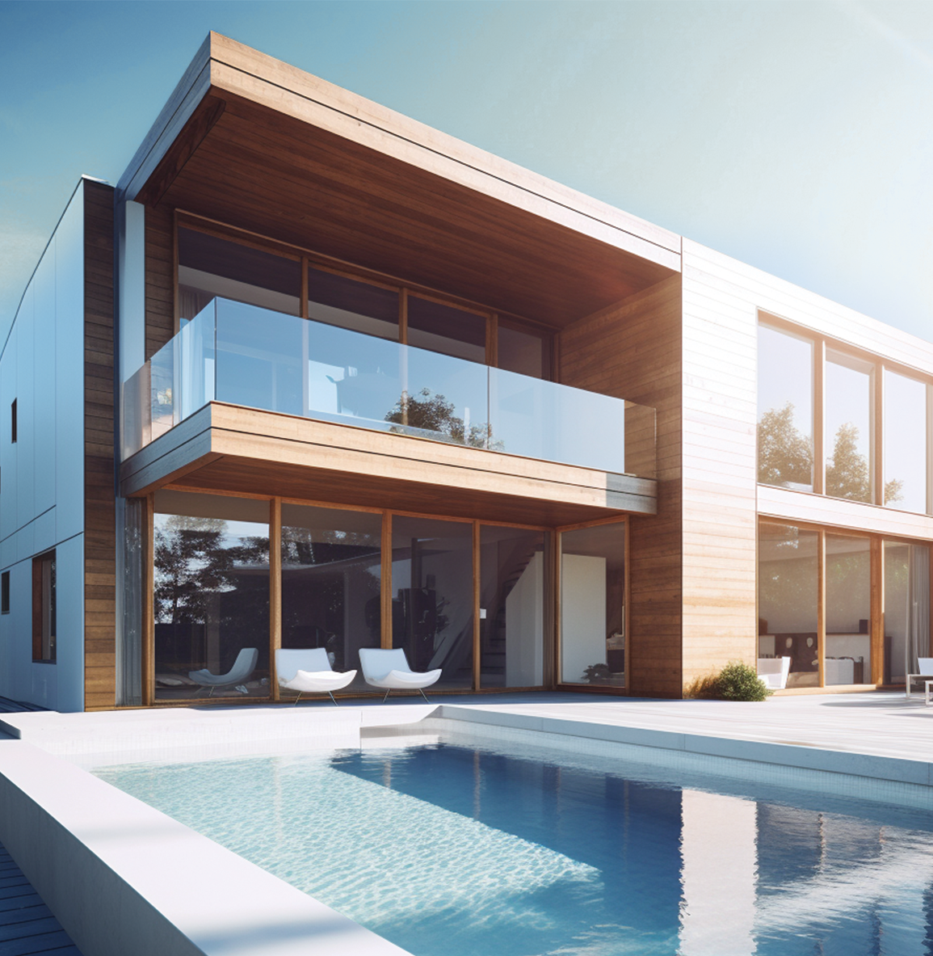
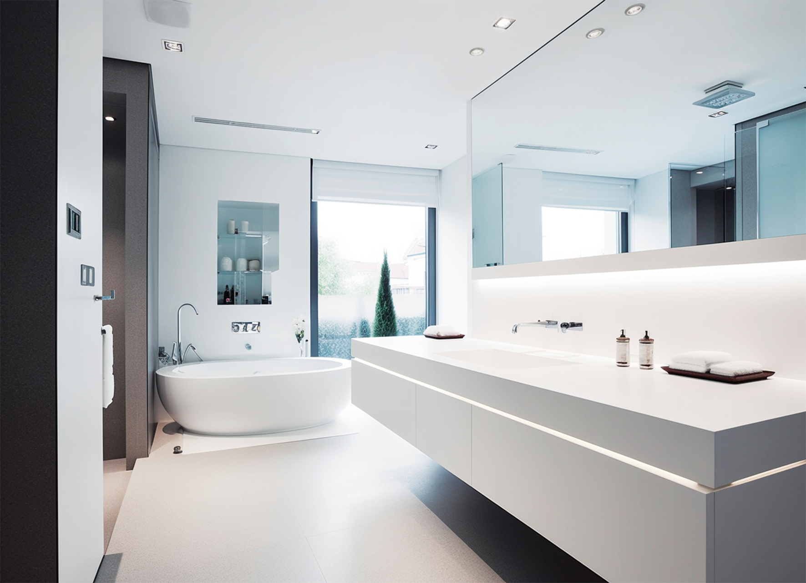
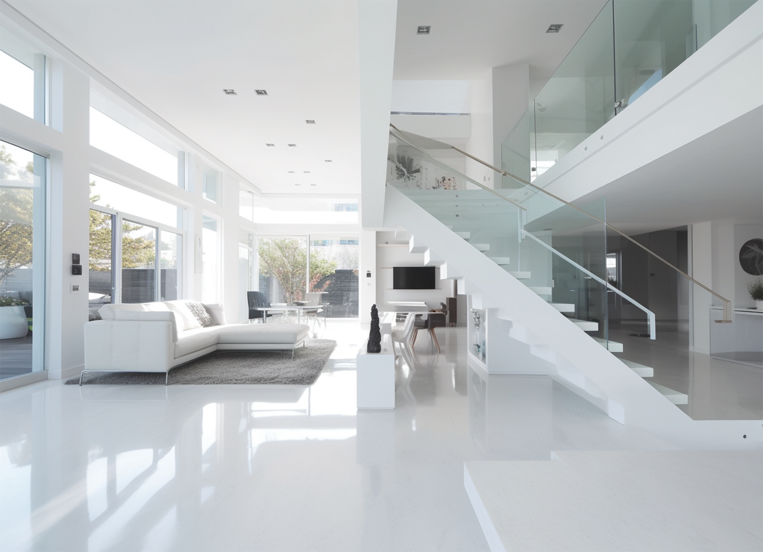
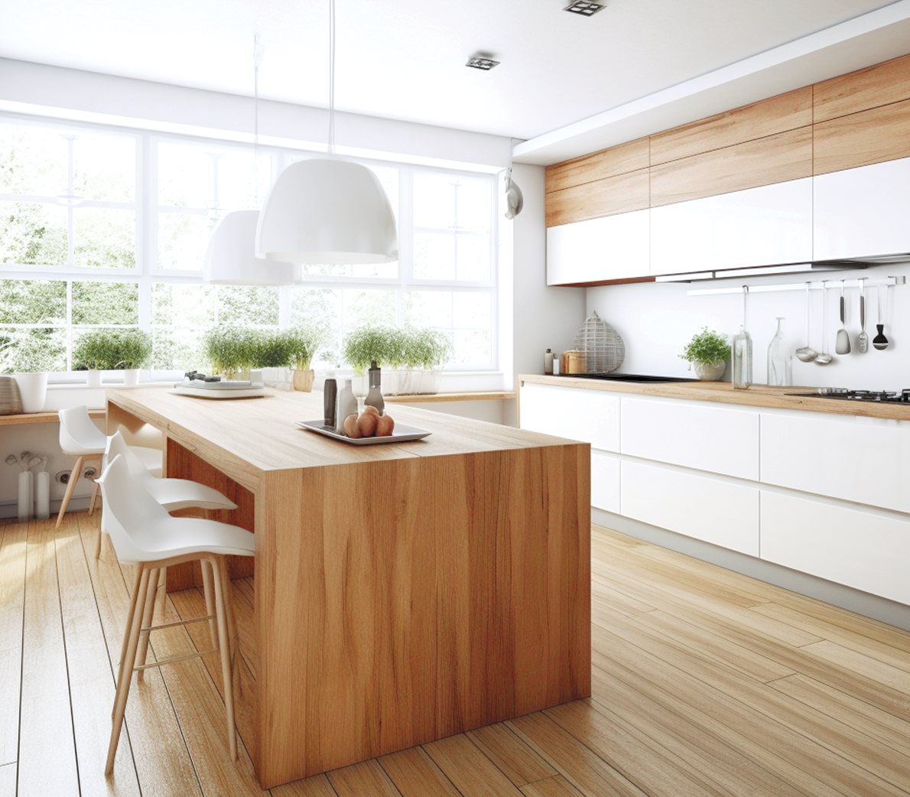
OPEN
HOUSE
10.05 AT 8PM
987 Willow Lane, Roseville,
Harmonyville, USA 67890
Welcome to this inviting family home nestled in the peaceful neighborhood of Harmonyville.
This delightful residence offers a perfect blend of comfort, functionality, and timeless appeal.
MORE INFO: 123-455-67-67 , 134-445-45-67 | openhouse@mail.com | openhouse.com

