Slide 1
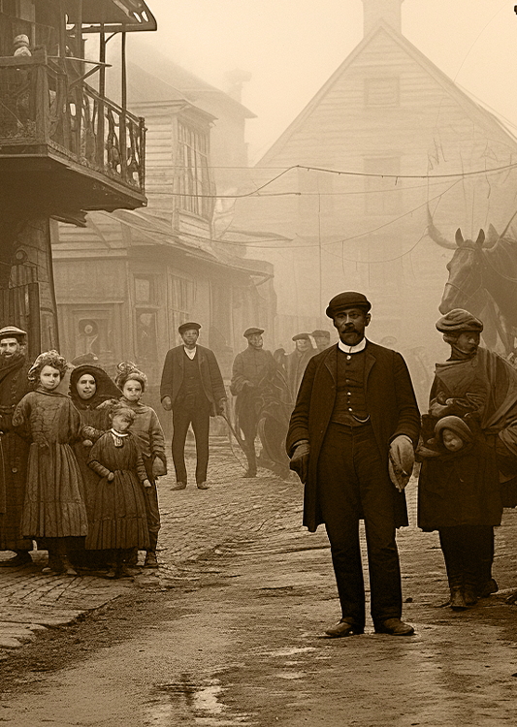
NEW FACTORY OPENS IN RIVER CITY
The Times Tribune
NEW FACTORY OPENS IN RIVER CITY
The grand opening of the River City Textile Mill marks a significant milestone in the city's industrial growth. The mill, which promises to bring over 500 jobs to
The grand opening of the River City Textile Mill marks a significant milestone in the city's industrial growth. The mill, which promises to bring over 500 jobs to
ISSUE № 25
SUNDAY, JULY 20TH 1910
ISSUE № 25
NEW FACTORY OPENS IN THE CITY
River City, December 11, 1925 – The grand opening of the River City Textile Mill marks a significant milestone in the city's industrial growth.
THE ROARING TWENTIES IN FULL SWING
R
iver, December 11, 1925
grand opening of the River City Textile Mill marks a significant milestone in the city's industrial growth. The mill, which promises to bring over 500 jobs to the local community, was inaugurated yesterday with much fanfare. Mayor John H. Thompson and other dignitaries attended the ceremony, celebrating what they called "a new era of prosperity."
New York City, December 9, 1925 – The Jazz Age is in full swing, with New York City at the heart of the cultural explosion.
L
os Angeles, December
10 – Aviatrix Earhart continues to break barriers and set records in the field of aviation. Yesterday, she completed a non-stop flight from Los Angeles to New York, showcasing not only her skill but also the potential of long-distance air travel.
Earhart's successful flight marks a significant achievement in aviation history.
Photograph: Mayor Thompson cutting the ribbon at the River City Textile Mill
The new factory is expected to produce a variety of textiles, contributing to both the local economy and the national market. The machinery installed at the mill promises efficiency and high-quality output, setting a new standard in the textile industry.
In his speech, Mayor Thompson emphasized the importance of industrial development for River City's future. "This mill not only signifies economic growth but also community development. Our citizens will have more opportunities, and our city will thrive."
Residents of River City have expressed their excitement and optimism about the new job opportunities. Mary Johnson, a local shopkeeper, said, "This mill is a blessing for our town. We've been waiting for such opportunities.
River City, December 11, 1925 – The grand opening of the River City Textile Mill marks a significant milestone in the city's industrial growth. The mill, which promises to bring over 500 jobs to the local community, was inaugurated yesterday with much fanfare. Mayor John H. Thompson and other dignitaries attended the ceremony, celebrating what they called "a new era of prosperity."
The new factory is expected to produce a variety of textiles, contributing to both the local economy and the national market. The machinery installed at the mill promises efficiency and high-quality output, setting a new standard in the textile industry.
In his speech, Mayor Thompson emphasized the importance of industrial development for River City's future.
AMELIA EARHART'S LATEST FEAT
New York City, December 9, 1925 – The Jazz Age is in full swing, with New York City at the heart of the cultural explosion.
VIATION ADVANCES
L
os Angeles, December
10 – Aviatrix Earhart continues to break barriers and set records in the field of aviation. Yesterday, she completed a non-stop flight from Los Angeles to New York, showcasing not only her skill but also the potential of long-distance air travel.
Photograph: A lively jazz band performing at The Cotton Club
AVIATION ADVANCES
Los Angeles, December 10, 1925 – Aviatrix Amelia Earhart continues to break barriers and set records in the field of aviation. Yesterday, she completed a non-stop flight from Yesterday, she completed a non-stop flight from Los Angeles to New York, showcasing not only her skill but also the potential of long-distance air travel.

Slide 2
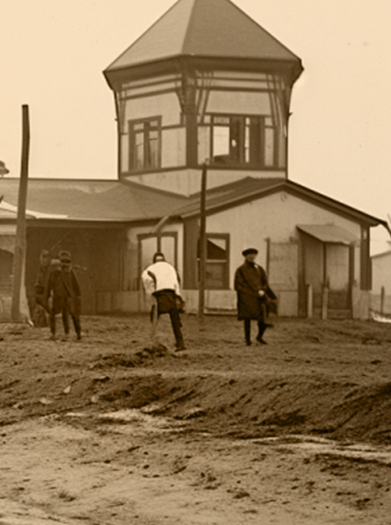
ISSUE № 25
SUNDAY, JULY 20TH 1910
ISSUE № 25
STREETS ALIVE: A SYMPHONY OF URBAN LIFE
AVIATION ADVANCES
Yesterday, she completed a non-stop flight from Yesterday, she completed a non-stop flight from Los Angeles to New York, showcasing not only her skill but also the potential of long-distance air travel.Los Angeles, December 10, 1925 – Aviatrix Amelia Earhart continues to break barriers and set records in the field of aviation. Yesterday, she completed a non-stop flight from Yesterday, she completed a non-stop flight from Los Angeles to New York, showcasing not only her skill but also the potential
but also the potential of long-distance air travel.Los Angeles, December 10, 1925 – Aviatrix Amelia Earhart continues to break barriers and set records in the field of aviation. Yesterday, she completed a non-stop flight from Yesterday, she completed a non-stop flight from Los Angeles to New York, showcasing not only her skill but also the potential of long-distance air travel.
Yesterday, she completed a non-stop flight from Yesterday, she completed a non-stop flight from Los New York.
New York City, December 9, 1925 – The Jazz Age is in full swing, with New York City at the heart of the cultural explosion.
L
os Angeles, December
10 – Aviatrix Earhart continues to break barriers and set records in the field of aviation. Yesterday, she completed a non-stop flight from Los Angeles to New York, showcasing not only her skill but also the potential of long-distance air travel. Earhart's successful flight marks. Los Angeles to New York, showcasing not only her skill but also marks.
Photograph: A lively jazz band performing at The Cotton Club
break barriers and set records in the field of aviation. Yesterday, she completed a non-stop flight from Los Angeles to New York, showcasing not only her skill but also.
AMELIA EARHART'S LATEST FEAT
New York City, December 9, 1925 – The Jazz Age is in full swing, with New York City at the heart of the cultural explosion.
VIATION ADVANCES
L
os Angeles, December
10 – Aviatrix Earhart continues to break barriers and set records in the field of aviation. Yesterday, she completed a non-stop flight from Los Angeles to New York, showcasing not only her skill but also the potential.
Photograph: Musicians performing on a street corner in the city
«From the crack of dawn to the midnight hour»
dawn breaks over the skyline, the city awakens from its slumber, a cacophony of sounds filling the air. Workers stream into downtown offices, their footsteps echoing against the pavement as they hurry to beat the morning rush. Meanwhile, street vendors set up their stalls, filling the air with
STREETS ALIVE
As dawn breaks over the skyline, the city awakens from its slumber, a cacophony of sounds filling the air. Workers stream into downtown offices, their footsteps echoing against the pavement as they hurry to beat the morning rush. Meanwhile, street vendors set up their stalls, filling the air filling the air filling the air filling the air filling the air filling the air filling the air with the enticing aroma of freshly brewed coffee and sizzling breakfast fare.
As dawn breaks over the skyline, the city awakens from its slumber, a cacophony of sounds filling the air. Workers stream into downtown offices, their footsteps echoing

Slide 3
ISSUE № 25
SUNDAY, JULY 20TH 1910
ISSUE № 25
METROPOLIS MEMOIRS: LIFE IN THE CITY
T
New York City, December 9, 1925 – The Jazz Age is in full swing, with New York City at the heart of the cultural explosion.
he new new factory is
expected to produce a variety of textiles, contributing to both the local economy and the national market.
L
os Angeles, December
10 – Aviatrix Earhart continues to break barriers and set records in the field of aviation. Yesterday, she completed a non-stop flight from Los Angeles to New York, showcasing not only her skill but also the potential of long-distance air travel.
Earhart's successful flight marks marks a significant achievement in aviation history. Flight marks mar signif in aviation history. Flight marks mar.
«From the crack of dawn to the midnight hour»
In his speech, Mayor Thompson emphasized the importance of industrial development for River City's future. economic growth but also community development. Our citizens will signifie citizens will signifie opportunities, and our city will thrive."
Photograph: A busy street scene in downtown New York
A SYMPHONY OF URBAN LIFE
STREETS ALIVE: A SYMPHONY OF URBAN LIFE
P
aris, July 6, 1912 – The allure
of the skies continues to captivate adventurers and spectators alike as hot air balloons take flight across the world. From the bustling streets of Paris to the serene countryside, these majestic vessels of flight offer a unique perspective on the world below.
Yesterday, amidst a backdrop of azure skies, the Montgolfier brothers' invention once again graced the Parisian skyline. Spectators gathered in awe as the vibrant hues of the balloon contrasted against the vast expanse above. With a gentle whoosh of heated air, the balloon
the skies continues to captivate adventurers and spectators alike as hot air balloons take flight across the world. From the bustling streets of Paris to the serene countryside, these majestic vessels of flight offer a unique perspective on the world below. Yesterday, amidst a backdrop of azure skies, the Montgolfier brothers' invention once again graced the Parisian skyline. Spectators gathered in awe as the vibrant hues of the balloon contrasted against the vast expanse above. With a gentle whoosh of heated air, the balloon ascended, carrying its intrepid passengers on a journey of exploration and wonder.
New York City, December 9, 1925 – The Jazz Age is in full swing, with New York City at the heart of the cultural explosion.
L
os Angeles, December
10 – Aviatrix Earhart continues to break barriers and set records in the field of aviation. Yesterday, she completed a non-stop flight from Los Angeles to New York, showcasing not only her skill but also the potential of long-distance air travel.
A crowded intersection
in downtown Chicago
ROARING TWENTIES
The new factory is expected to produce a variety of textiles, contributing to both the local economy and the national market. The machinery installed at the mill promises efficiency and high-quality output
significant milestone in the city's industrial growth. The mill, which promises to bring over 500 jobs to the local community, was inaugurated yesterday with much fanfare. Mayor Joh. Thompson and other
The new factory is expected to produce a variety of textiles, contributing to both the local economy and the national market. The machinery installed at the mill promises efficiency and high-quality output.
T
he new new factory is
expected to produce a variety of textiles, contributing to both the local economy and the national market. The machinery installed at the mill promises efficiency.

Slide 4
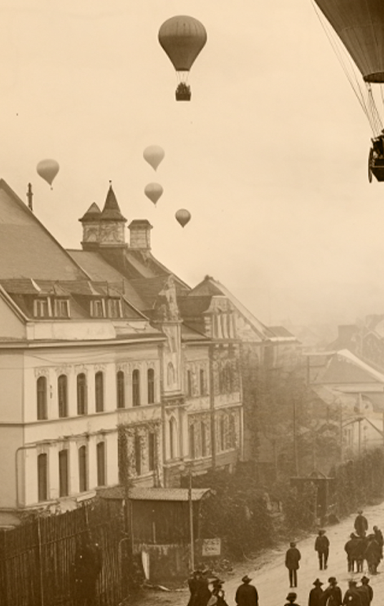
ISSUE № 25
SUNDAY, JULY 20TH 1910
ISSUE № 25
THE ROARING TWENTIES IN FULL SWING
New York City, December 9, 1925 – The Jazz Age is in full swing, with New York City at the heart of the cultural explosion.
AVIATION ADVANCES
T
he new new factory is
expected to produce a variety of textiles, contributing to both the local economy and the national market. The machinery installed at the mill promises efficiency and high-quality output, setting a new standard in the textile industry.
«THE NEW
FACTORY IS
EXPECTED»
Photograph: A lively jazz band performing at The Cotton Club
THE ROARING TWENTIES IN FULL SWING
In his speech, Mayor Thompson emphasized the importance of industrial development for River City's future. "This mill not only signifies economic growth but also community development. Our citizens will signifie citizens will signifie opportunities, and our city will thrive."
River City, December 11, 1925 – The grand opening of the River City Textile Mill marks a significant milestone in the city's industrial growth. The mill, which promises to bring over 500 jobs to the local community.
Photograph: Mayor Thompson cutting the ribbon at the River City Textile Mill
THE ROARING TWENTIES
T
JOURNEY INTO THE SKIES
he new new factory is
expected to produce a variety of textiles, contributing to both the local economy and the national market. The machinery installed at the mill promises efficiency and high-quality output, setting a new standard in.
In his speech, Mayor Thompson emphasized the importance of industrial development for River City's future. "This mill not only signifies economic growth but also community development.
AVIATION ADVANCES
P
aris, July 6, 1912 – The allure
of the skies continues to captivate adventurers and spectators alike as hot air balloons take flight across the world. From the bustling streets of Paris to the serene countryside, these majestic vessels of flight offer a unique perspective on the world below.
Yesterday, amidst a backdrop of azure skies, the Montgolfier brothers' invention once again graced the Parisian skyline. Spectators gathered in awe as the vibrant hues of the balloon contrasted against the vast expanse above. With a gentle whoosh of heated air, the balloon ascended, carrying its intrepid passengers.
Los Angeles,
December 10, 1925 –
Aviatrix Amelia Earhart continues to break barriers and set records in the field of aviation. Yesterday, she completed a non-stop flight from Yesterday, she completed a non-stop flight from Los Angeles to New York, showcasing not
Paris, July 6, 1912

