Slide 1
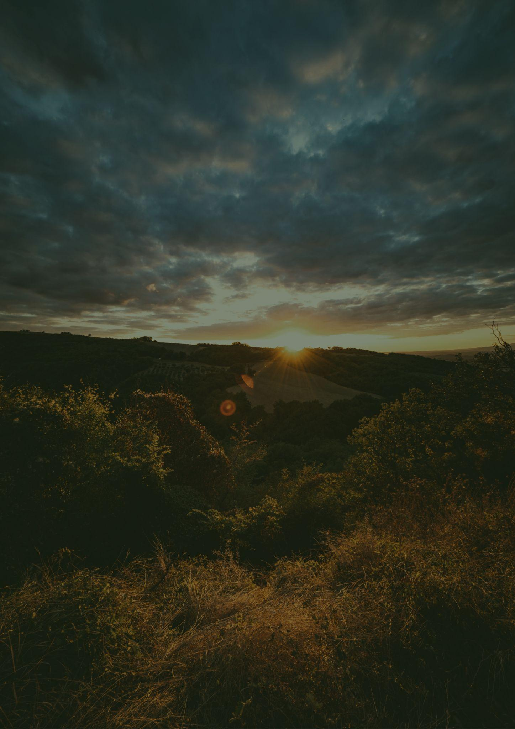
North Dakota
Travel bucket list
Theodore Roosevelt Park
Cowboy Hall of Fame
Fort Mandan
Fort Union
Maah Daah Hey Trail
Bonanzaville USA
Heritage Center
Enchanted Highway
National Buffalo Museum
Medora Musical
Peace Garden
North Dakota Capitol
Fargo Theatre
Bison Monument
Dakota Zoo
Three Tribes Museum
Fort Abraham Lincoln
National Buffalo Museum
Fort Union
Lake Sakakawea
Plains Art Museum
Garrison Dam
Scandinavian Heritage
Maah Daah Hey Trail
Lake Sakakawea Park
Fort Mandan

