Slide 1

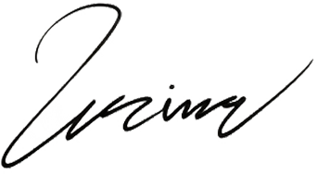



Renewable
Dreams
Foundation
To: Michael Johnson
3 Street, Suite 4, Linkville
johnson@nexustech.com
+1 (555) 987-6543
24/07/2024
Dear Michael Johnson,
Subject: [Brief Description or Purpose of the Letter]
I hope this letter finds you well. On behalf of [Nonprofit Organization Name], we are reaching out to express our heartfelt appreciation for your ongoing support and partnership in our mission. At [Nonprofit Organization Name], our commitment is to [briefly describe the mission or purpose of the nonprofit organization]. We believe in the power of [mention the organization's core values or guiding principles] and strive to make a positive impact on our community and beyond.
Should you have any questions, suggestions, or would like to discuss our upcoming projects, please feel free to reach out to us. You can contact us at [Phone Number] or [Email Address]. Once again, thank you for your invaluable support. Together, we are making a difference and building a brighter future for all.
With gratitude,
Emily Reynolds
Chief Executive Officer
reneble@foundation.com
+1 (555) 987-4567
renebledreams.com

