Slide 1

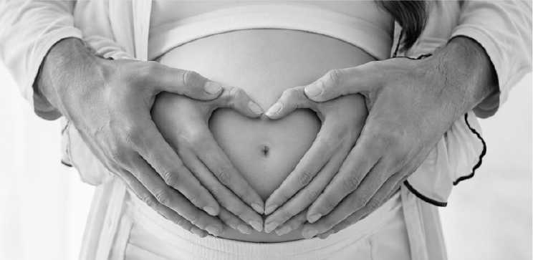
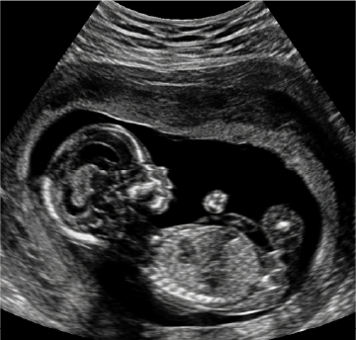



THE BABY TIMES
MONDAY, OCTOBER 11, 2027
PAGE 4
THE MOST IMPORTANT NEWS OF OUR LIVES
SPECIAL
EDITION
THE BABY TIMES
EXTRA!
EXTRA!
EXCLUSIVE INTERVIEW
VOL. 1, NO. 1
MONDAY, OCTOBER 11, 2027
PRICELESS
WITH THE PARENTS-TO-BE
WE'RE HAVING
A BABY!
OUR GREATEST ADVENTURE IS ABOUT TO BEGIN.
BREAKING NEWS:
BABY ON THE WAY!
DETAILS
We are beyond excited to announce that our greatest adventure has officially begun. Our little miracle is growing, and we can't wait to meet the newest member of our family.
Due Date
November 2027
HOW DO YOU FEEL?
"We feel incredibly grateful and excited. Every day makes this journey feel more real, and we already love our little one more than words can describe."
— MOM
WHAT ARE YOU MOST
EXCITED FOR?
"Meeting our baby for the first time, hearing that first cry, and beginning this beautiful new chapter together as a family."
— DAD
STATUS
Growing Our
Little Miracle
STAY TUNED FOR MORE UPDATES!
IN THIS ISSUE
COMING SOON
Sleepless Nights
Endless Love
A Lifetime of Memories
EXCLUSIVE PREVIEW OF WHAT'S TO COME
Breaking News: Baby on the Way
Exclusive Interview
Baby Facts & Fun
Thank You
Tiny Feet
Little Outfits
Big Love

Slide 2
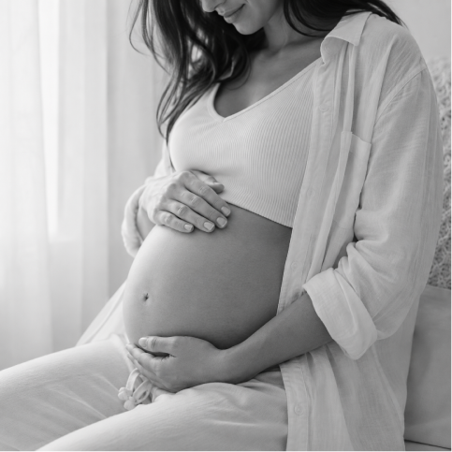
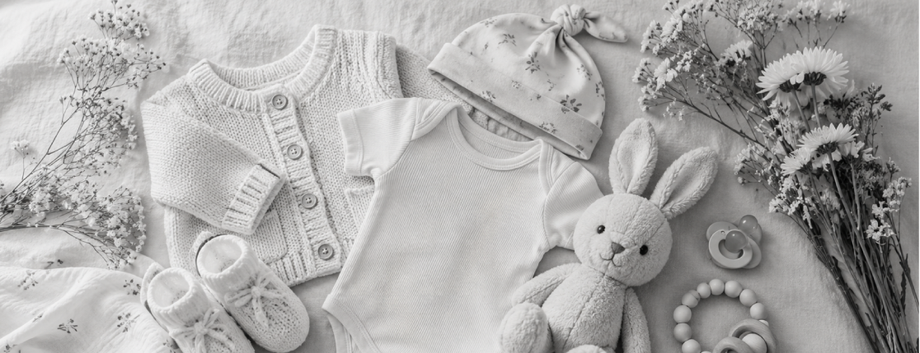
THE BABY TIMES
MONDAY, OCTOBER 11, 2027
PAGE 2
THE BABY TIMES
MONDAY, OCTOBER 11, 2027
PAGE 3
BABY FACTS & FUN
THANK YOU
DID YOU KNOW?
BY THE NUMBERS
To our wonderful family and friends,
Thank you for your endless love, encouragement, and support throughout this incredible journey. Your kindness means the world to us, and we can't wait to introduce you to our precious little one.
Every message, hug, smile, and prayer have made this experience even more special.
We are so excited to begin this next chapter and share every milestone with the people we love most.
With love,
MOM & DAD
1
Every tiny heartbeat is a reminder that love grows in amazing ways.
Baby
2
Small kicks can create the biggest smiles.
Loving
Parents
The sweetest moments are often the smallest ones.
3
"See you soon,
little one."
Our greatest adventure is just getting started.
Hearts
Beating
Together
COUNTDOWN TO OUR BIGGEST ADVENTURE
Baby Arriving Soon!
2
0
2
7
The Next
Chapter
Begins Soon
Baby Loading...
90%

