Slide 1
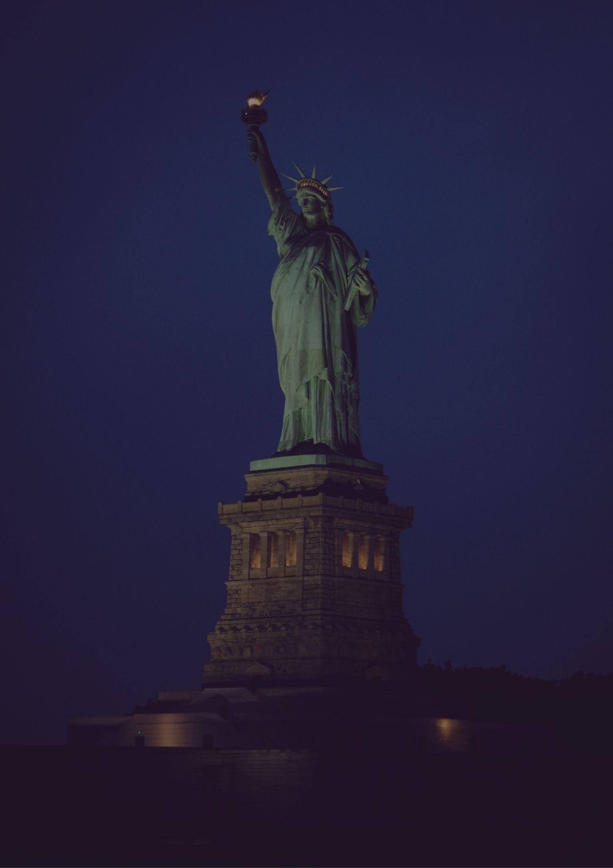
New York
Travel bucket list
Times Square
Coney Island
Statue of Liberty
The Bronx Zoo
Niagara Falls
Ausable Chasm
Metropolitan Museum
Corning Museum of Glass
Central Park
Lake George
Hudson Valley
Times Square
Letchworth State Park
Cooperstown
Adirondack Mountains
Statue of Liberty
Thousand Islands
Rockefeller Center
Finger Lakes
Empire State Building
Watkins Glen State Park
Fifth Avenue
Lake Placid
High Line
Brooklyn Bridge
Grand Central Terminal

